Slide 1


OTA 2G&3G Modernization Project
Site Photos
Subcontractor: MGNIC
Site ID: C36X014
Installation/Swap Date: 02/07/2016
Name: HAICHEUR HADJER
Department: Documentation (OTA Project)
Mail: haicheur.hadjer@zte.com.cn

Slide 2
Work Done ( Please to list bellow the work items done on the site)
….

Slide 3
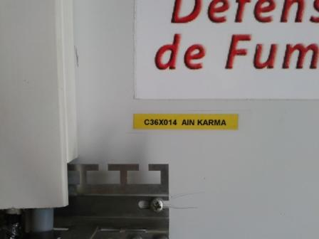
Site Identification
Paste the Picture here

Slide 4
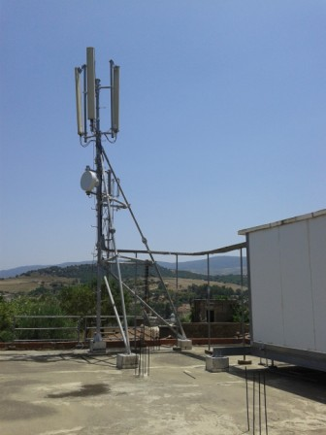
Site View outdoor
Paste the Picture here

Slide 5
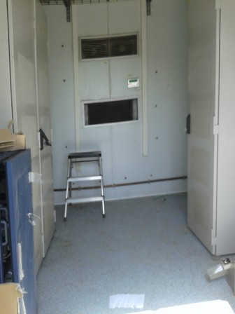
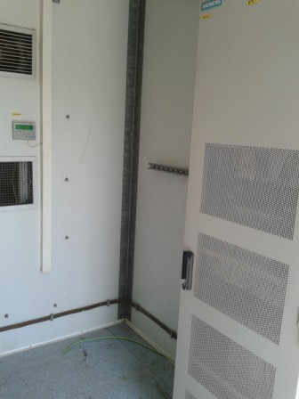
Site View Indoor
Paste the Picture here

Slide 6
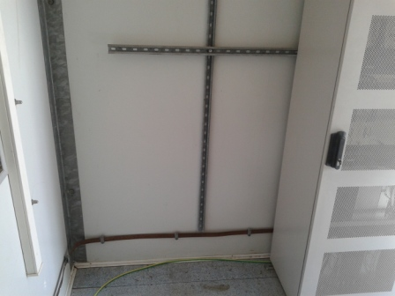
Position BTS

Slide 7
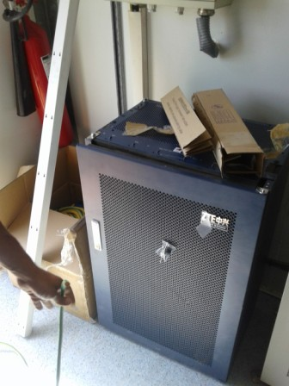
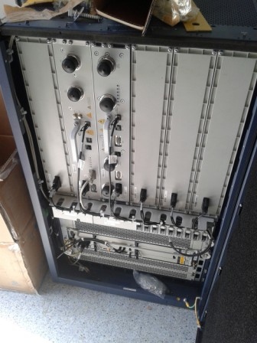
Equipments delivered
Paste the Picture here

Slide 8
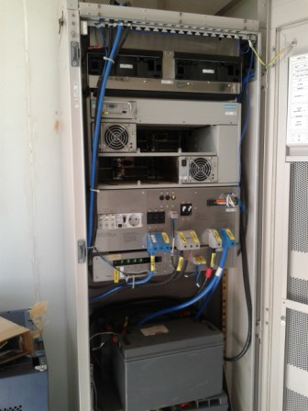
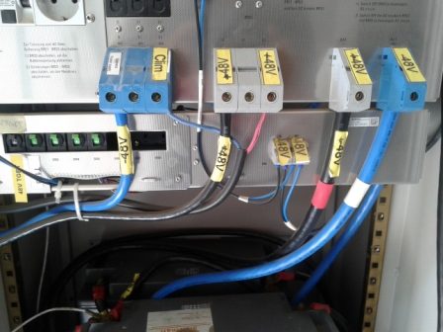
Power Suplly

Slide 9
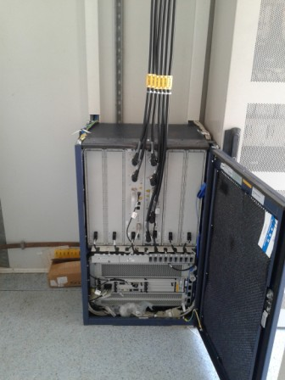
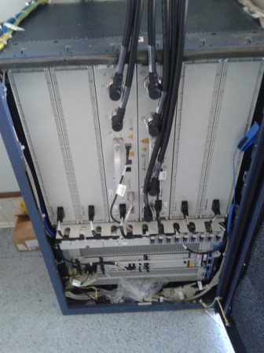
BTS Cabinet
Paste the Picture here

Slide 10
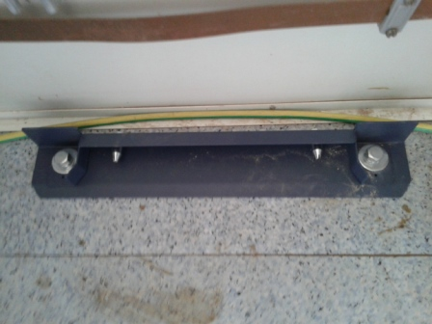
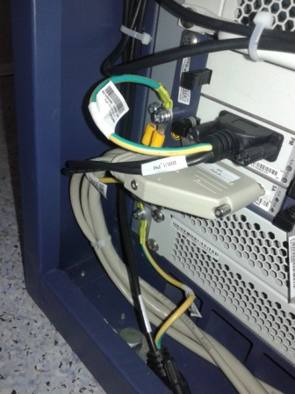
BTS Cabinet fixation
Paste the Picture here

Slide 11
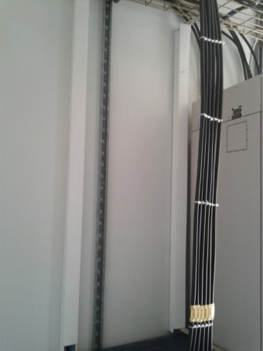
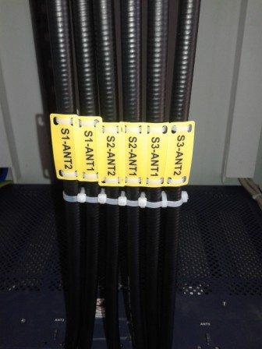
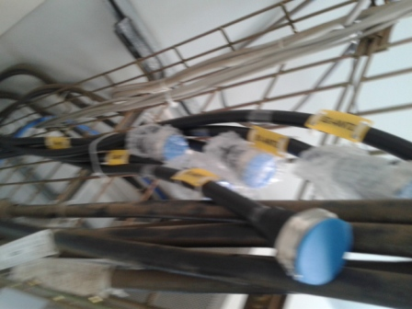
Indoor Jumpers + label
Paste the Picture here

Slide 12
Cable Tray
Paste the Picture here

Slide 13
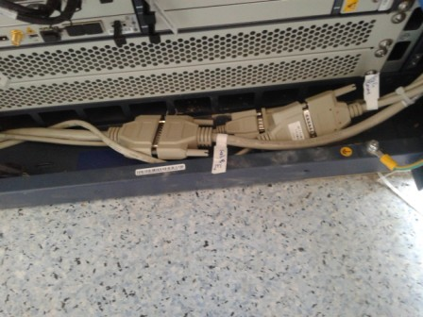
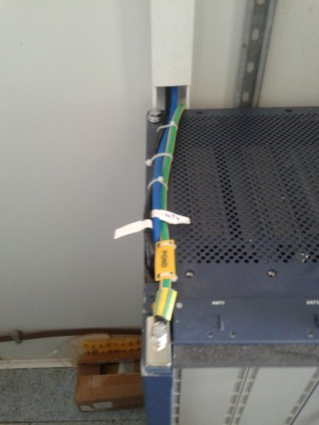
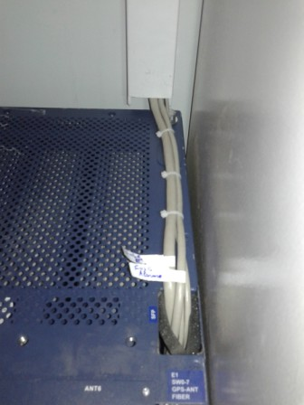
BBU (Connectivity and labeling)
Paste the Picture here

Slide 14
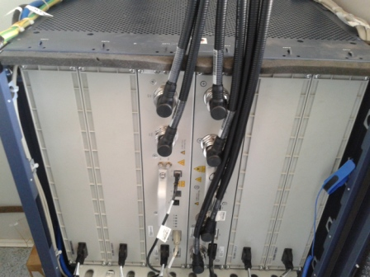
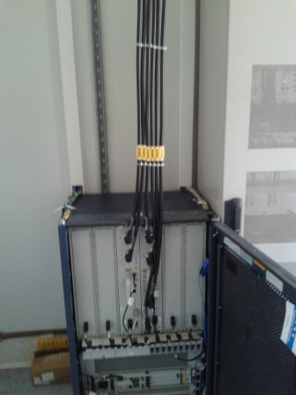
RSU/RRU
Paste the Picture here

Slide 15
Grounding Indoor
Paste the Picture here

Slide 16
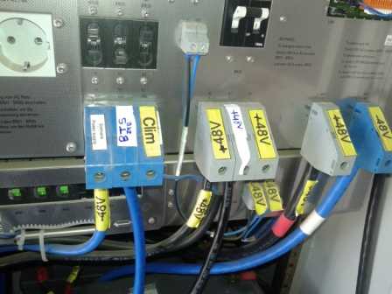
Power Supply
Paste the Picture here

Slide 17
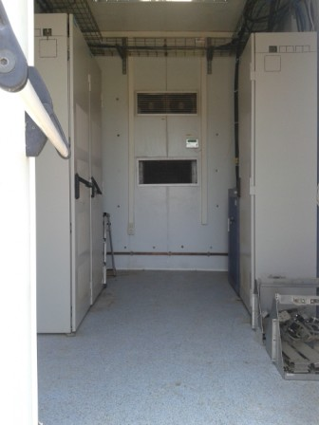
Cleanup
Paste the Picture here

Slide 18
Others
Paste the Picture here

