Slide 1


OTA 2G&3G Modernization Project
Site Photos
Subcontractor: ********
Site ID: C36X034
Installation/Swap Date: 02/07/2016
Name: HAICHEUR HADJER
Department: Documentation (OTA Project)
Mail: haicheur.hadjer@zte.com.cn

Slide 2
Work Done ( Please to list bellow the work items done on the site)
SITE IDENTIFICATION
SITE BEFORE
SITE AFTER
BBU/RSU
LABEL
GROUNDING
CLEAN
….

Slide 3
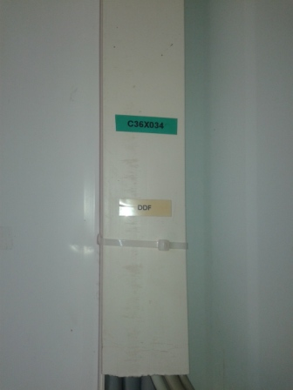
Site Identification
Paste the Picture here

Slide 4
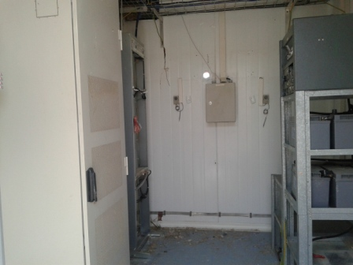
Site View Indoor
Paste the Picture here

Slide 5
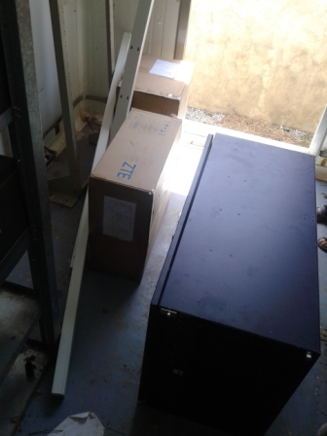
Equipments delivered
Paste the Picture here

Slide 6
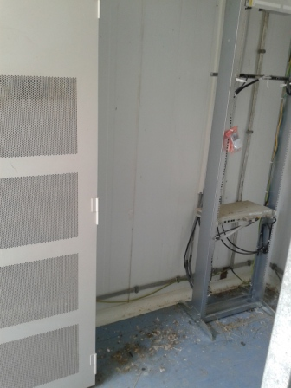
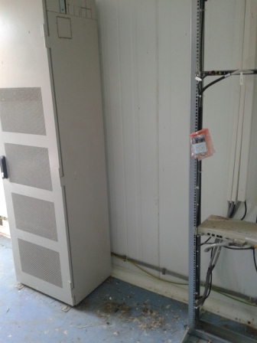
New Position New BTS

Slide 7
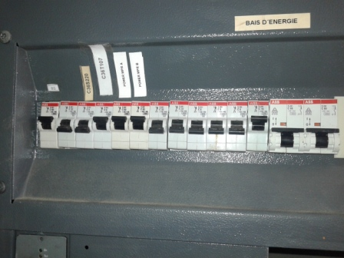
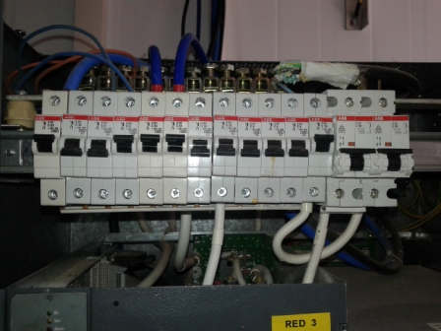
DC Breaker

Slide 8
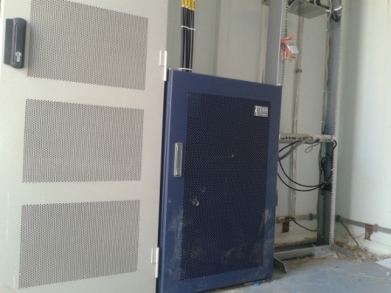
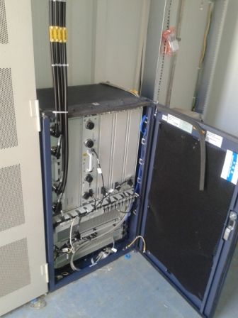
BTS
Paste the Picture here

Slide 9
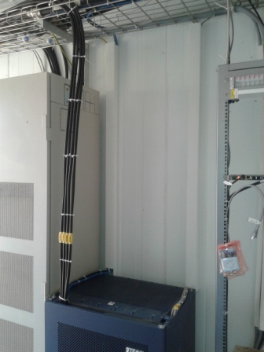
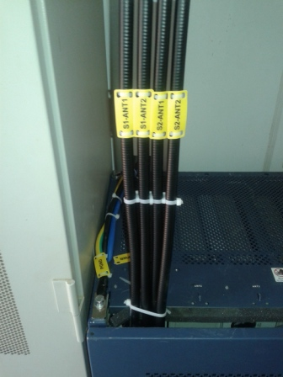
Indoor Jumpers + label
Paste the Picture here

Slide 10
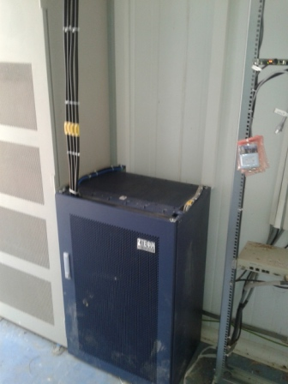
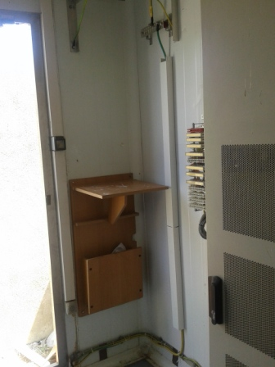
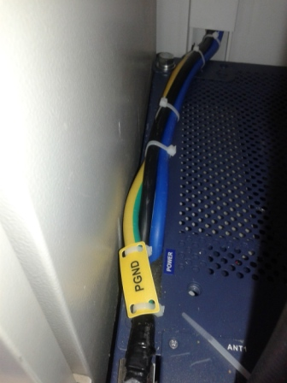
Cable Tray
Paste the Picture here

Slide 11
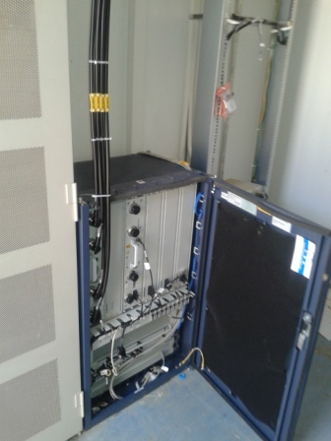
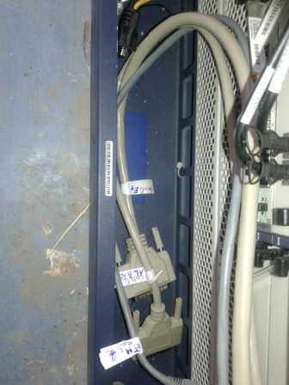
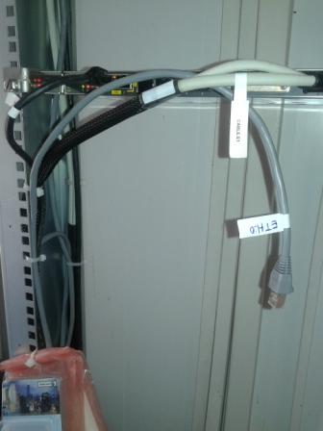
BBU (Connectivity and labeling)
Paste the Picture here

Slide 12
RSU/RRU

Slide 13
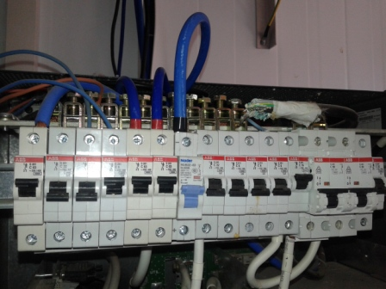
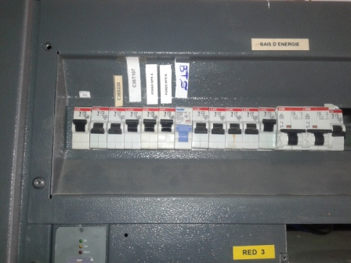
Add New Disjoncteur 63 A

Slide 14
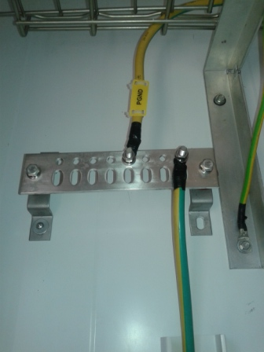
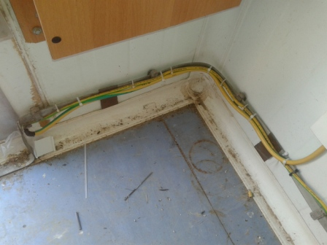
Grounding / Grounding Bar (Indoor and/or Outdoor)
Paste the Picture here

Slide 15
New barrettes (Indoor)
Paste the Picture here

Slide 16
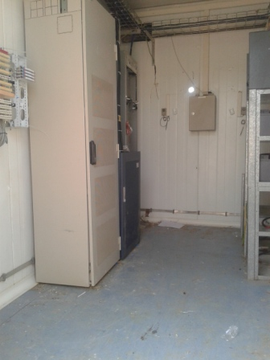
Cleanup
Paste the Picture here

