Slide 1


OTA 2G&3G Modernization Project
Site Photos
Subcontractor: MGNIC
Site ID: C36X052
Installation/Swap Date: 18/07/2016
Name: HAICHEUR HADJER
Department: Documentation (OTA Project)
Mail: haicheur.hadjer@zte.com.cn

Slide 2
Work Done ( Please to list bellow the work items done on the site)
SITE IDENTIFICATION
SITE VIEW OUTDOOR/INDOOR
INSTALL NEW BTS 2G
BBU/RSU CONNECTIVITY AND LABEL
JUMPER
CLEAN UP SITE
….

Slide 3
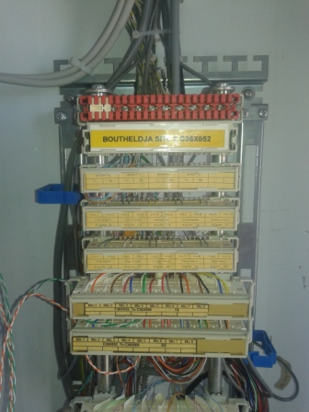
Site Identification
Paste the Picture here

Slide 4
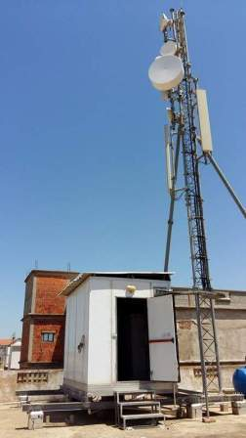
Site View outdoor
Paste the Picture here

Slide 5
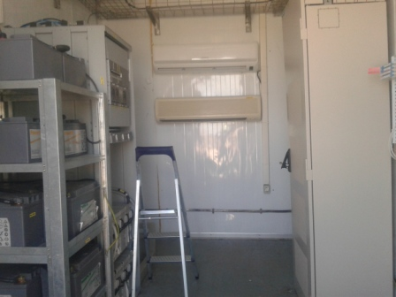
Site View Indoor
Paste the Picture here

Slide 6
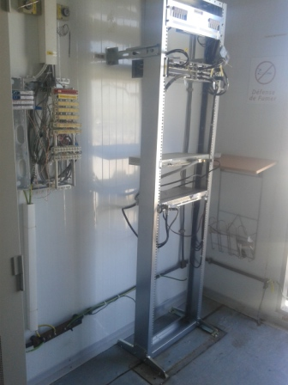
IDU
Paste the Picture here

Slide 7
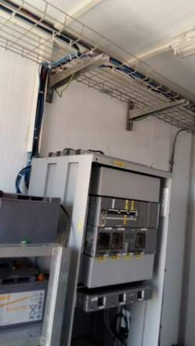
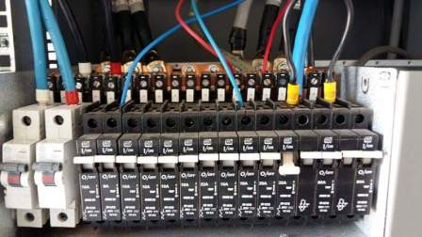
POWER SUPPLY

Slide 8
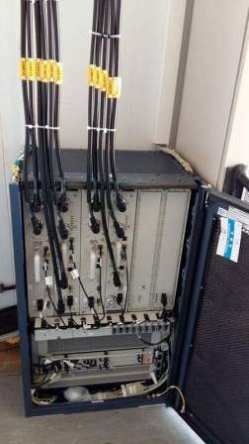
BTS Cabinet
Paste the Picture here

Slide 9
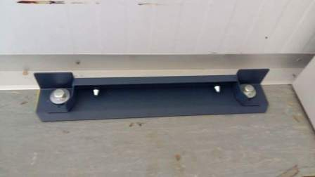
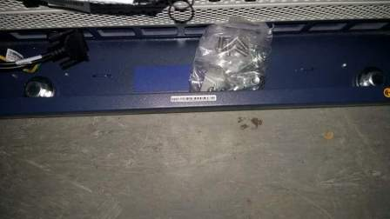
BTS Cabinet fixation
Paste the Picture here

Slide 10
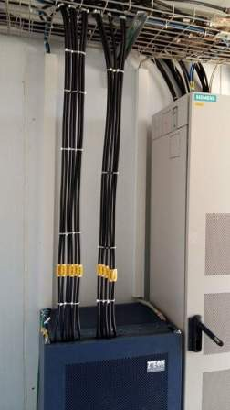
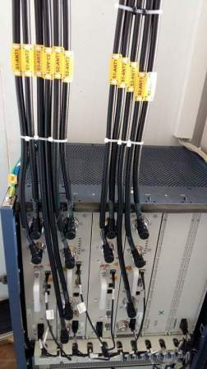
Indoor Jumpers + label
Paste the Picture here

Slide 11
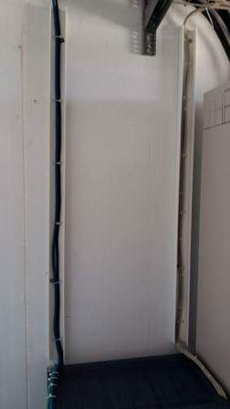
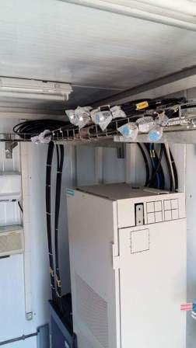
Cable Tray
Paste the Picture here

Slide 12
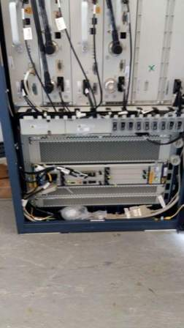
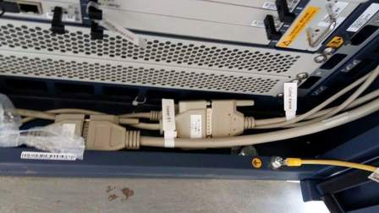
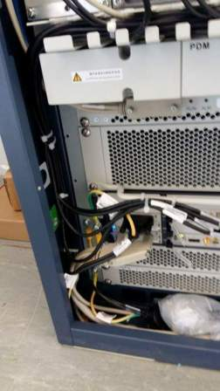
BBU (Connectivity and labeling)
Paste the Picture here

Slide 13
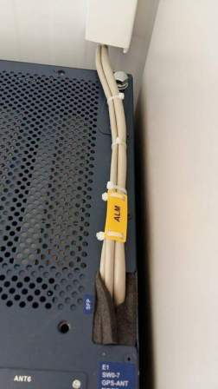
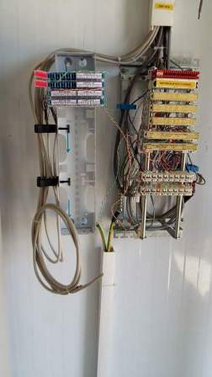
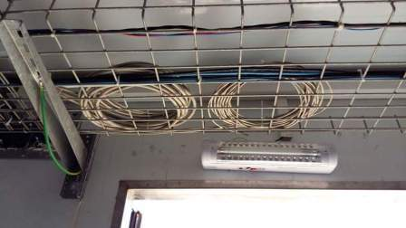
Les Alarmes

Slide 14
RSU/RRU
Paste the Picture here

Slide 15
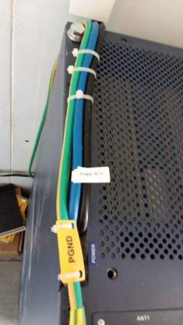
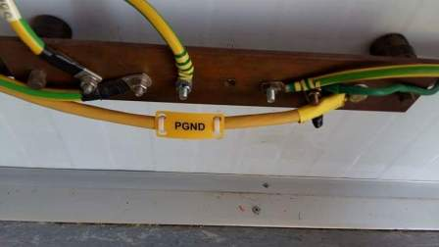
Grounding Indoor
Paste the Picture here

Slide 16
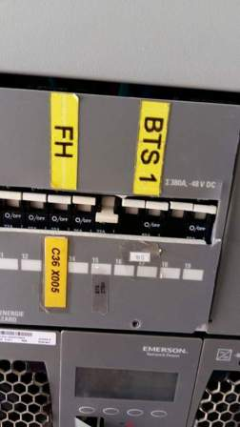
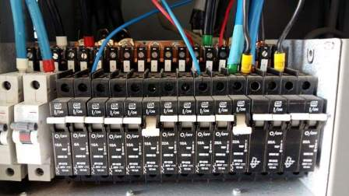
Power Supply
Paste the Picture here

Slide 17
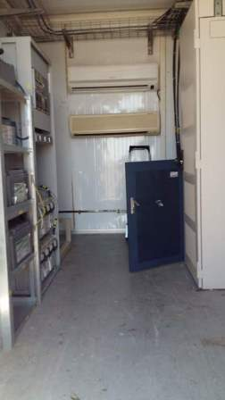
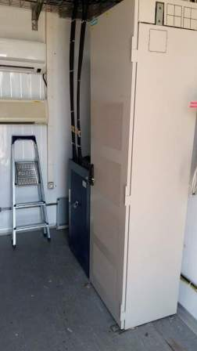
Cleanup
Paste the Picture here

Slide 18
Others
Paste the Picture here

