Slide 1


OTA 2G&3G Modernization Project
Site Photos
Subcontractor: MGNIC
Site ID: C36X011
Installation/Swap Date:29/06/2016
Name: HAICHEUR HADJER
Department: Documentation (OTA Project)
Mail: haicheur.hadjer@zte.com.cn

Slide 2
Work Done ( Please to list bellow the work items done on the site)
Site Identification
Site View Indoor/Outdoor
Desintall
Install new PS
Power Supply
Rack batteries
Site clean
….

Slide 3
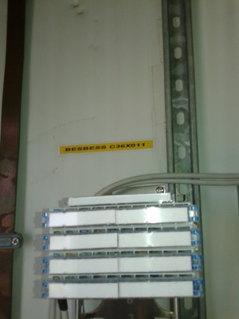
Site Identification
Paste the Picture here

Slide 4
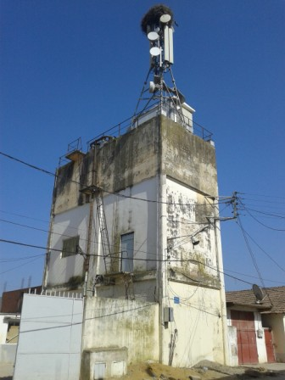
Site View outdoor
Paste the Picture here

Slide 5
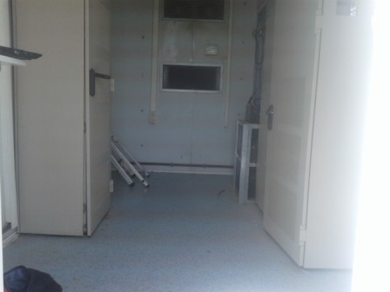
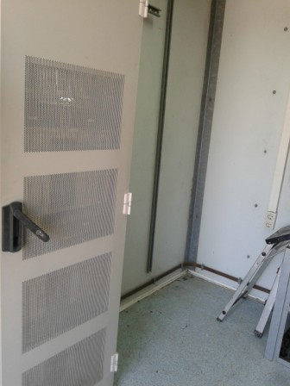
Site View Indoor
Paste the Picture here

Slide 6
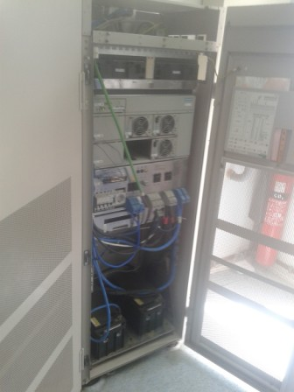
Power Supply
Paste the Picture here

Slide 7
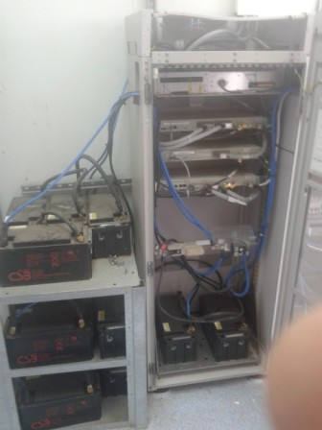
IDU+Battery
Paste the Picture here

Slide 8
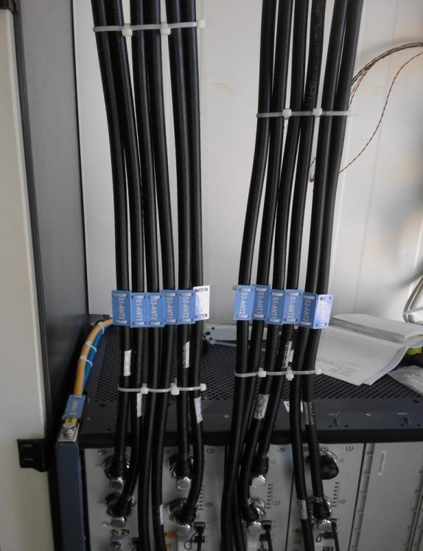
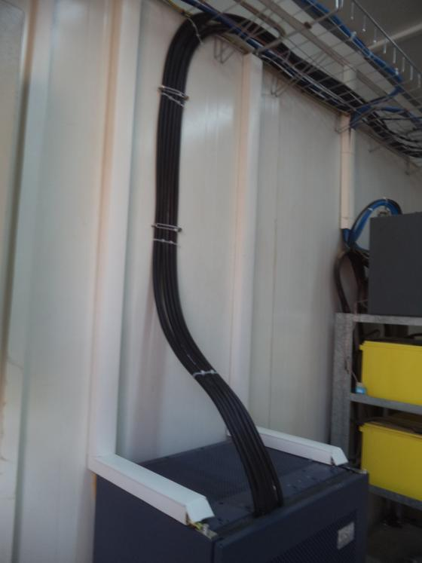
Indoor Jumpers + label
Paste the Picture here

Slide 9
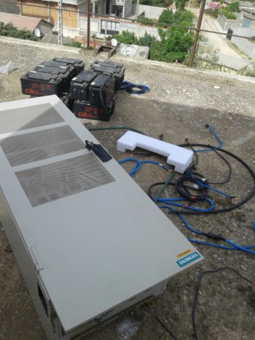
desinstall

Slide 10
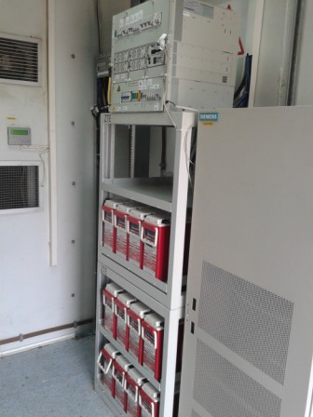
New Power Supply

Slide 11
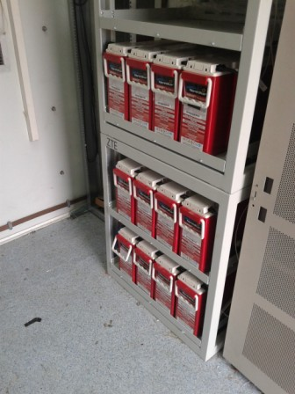
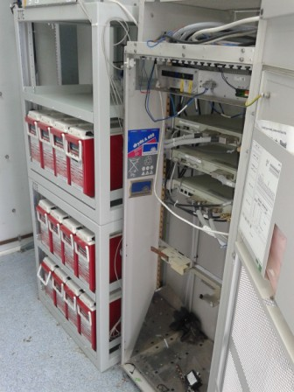
Batteries

Slide 12
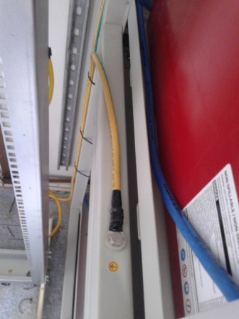
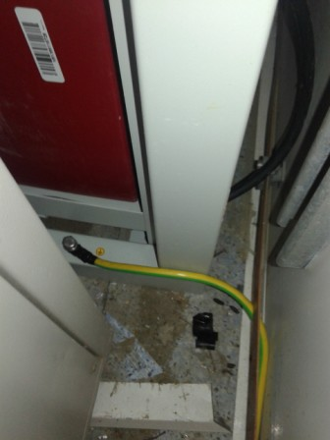
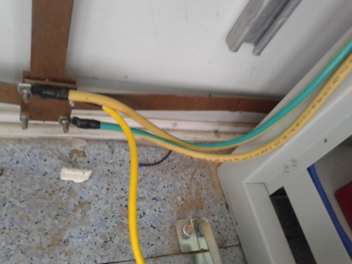
Grounding Rack Battery
Paste the Picture here

Slide 13
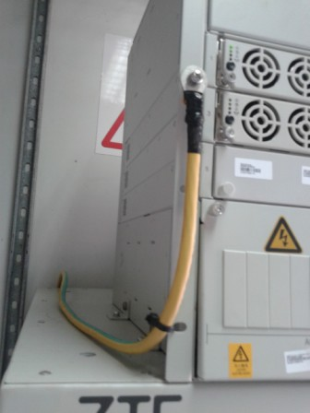
Grounding Power Supply

Slide 14
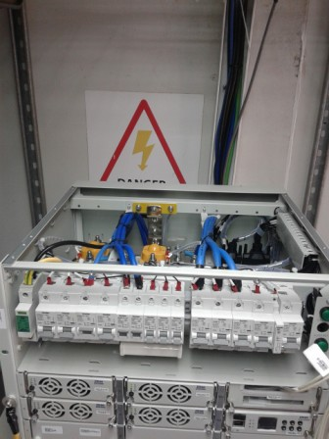
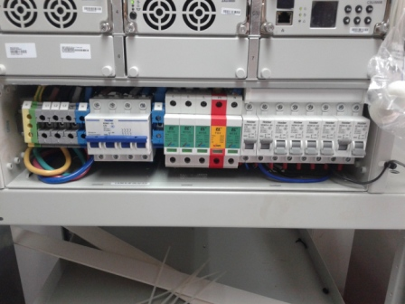
DC Breaker
Paste the Picture here

Slide 15
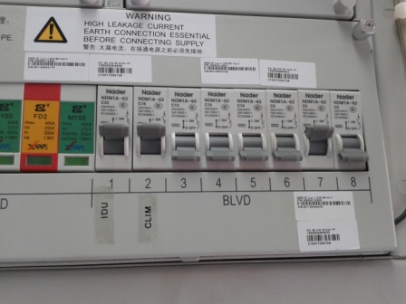
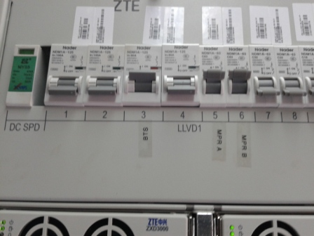
Power Supply Label
Paste the Picture here

Slide 16
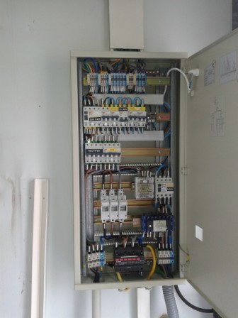
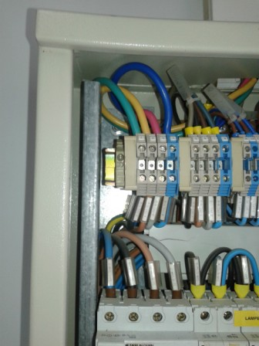
TGBT

Slide 17
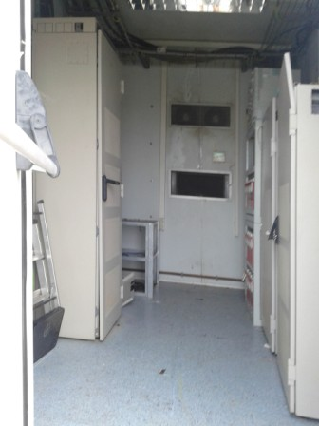
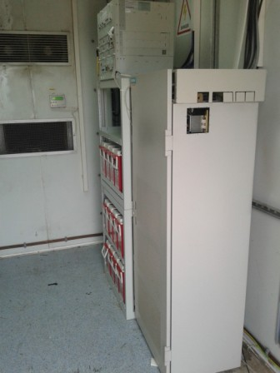
Cleanup
Paste the Picture here

Slide 18
Others
Paste the Picture here

