Slide 1


OTA 2G&3G Modernization Project
Site Photos
Subcontractor: MGNIC
Site ID: C36X022
Installation/Swap Date: 19/07/2016
Name: HAICHEUR HADJER
Department: Documentation (OTA Project)
Mail: haicheur.hadjer@zte.com.cn

Slide 2
Work Done ( Please to list bellow the work items done on the site)
Site Identification
Site View outdoor
Site View Indoor BEFOR
Site View Indoor AFTER
Equipments delivered
Node B Cabinet site C36X022
Node B cable PS
Indoor Jumpers + label
RSU/RRU
BBU
GROUND /LABEL
View Genarele INDOOR after

Slide 3
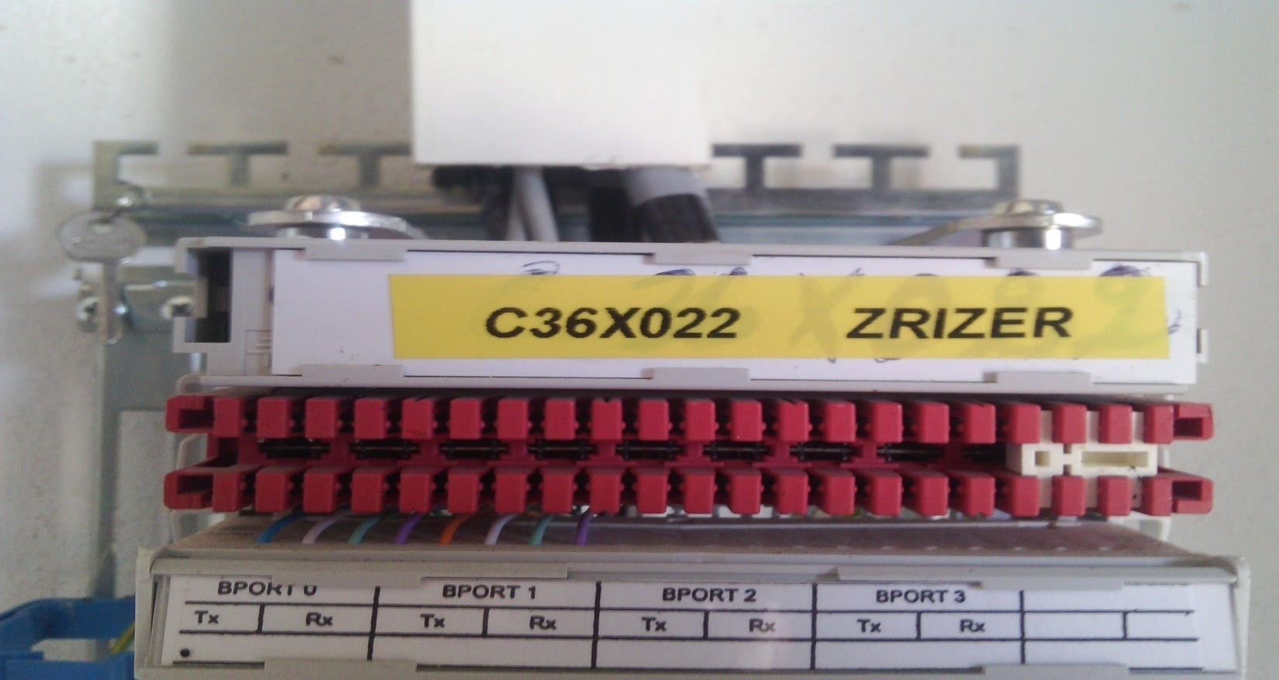
Site Identification
Paste the Picture here

Slide 4
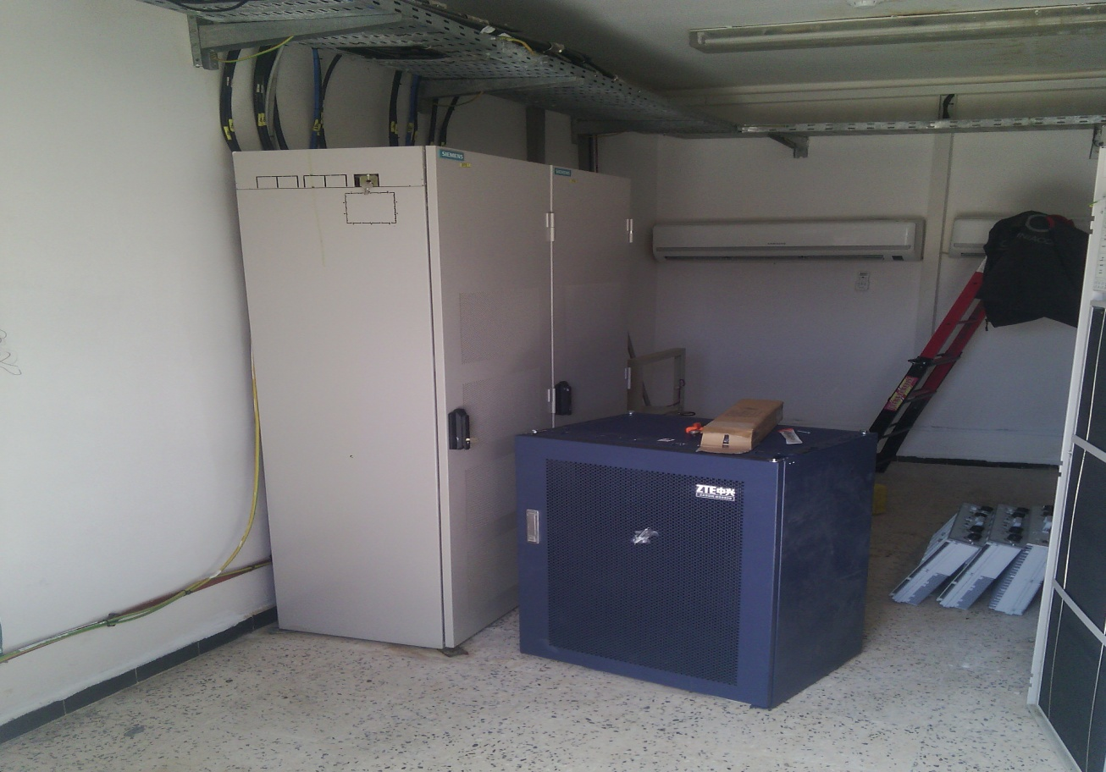
Site View Indoor
Paste the Picture here

Slide 5
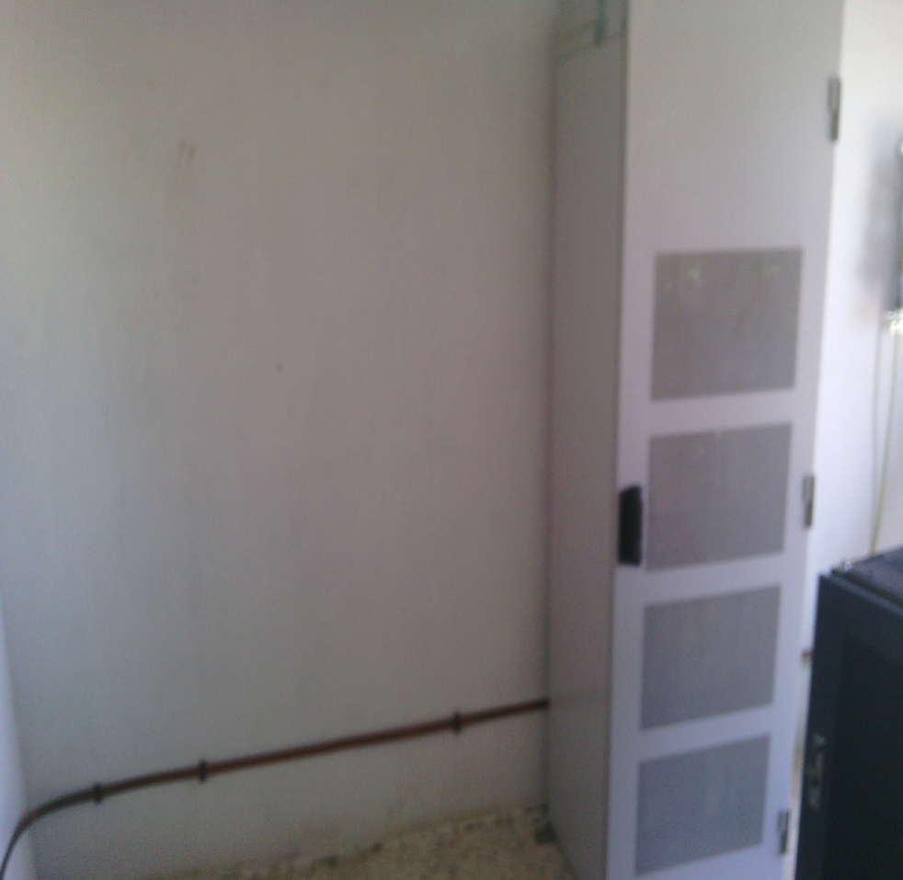
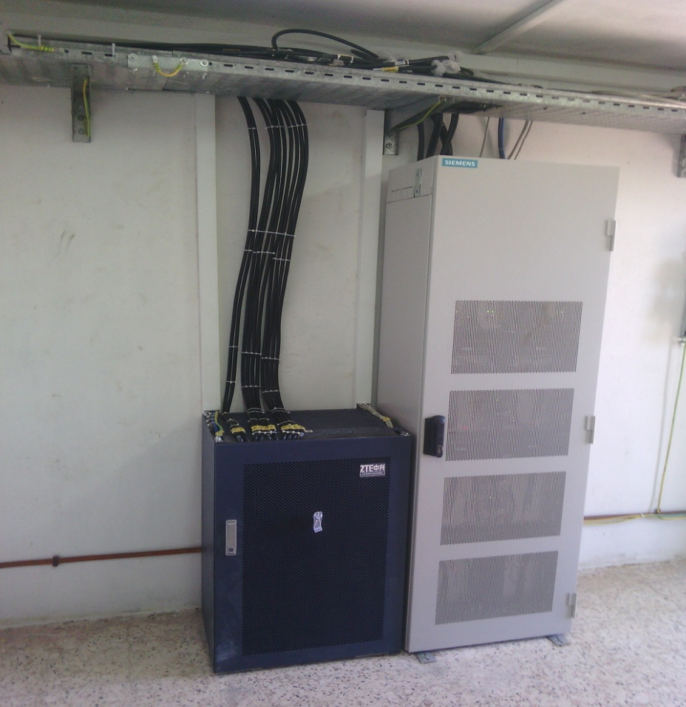
Site View Indoor BEFOR
Paste the Picture here

Slide 6
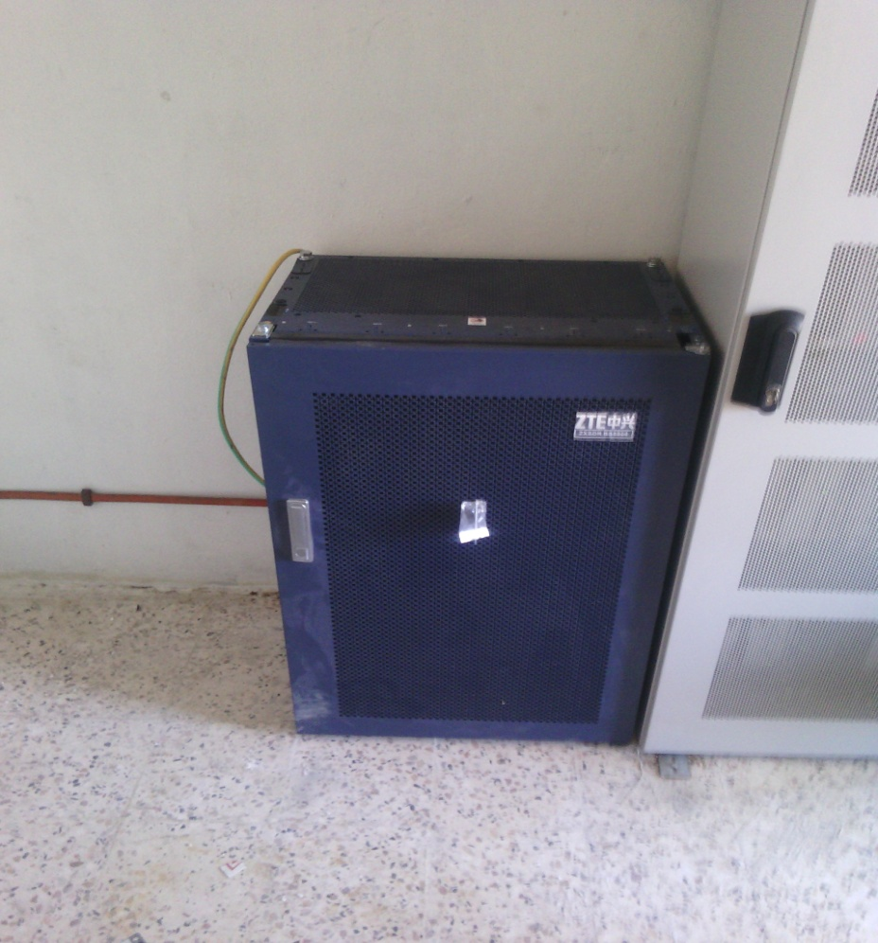
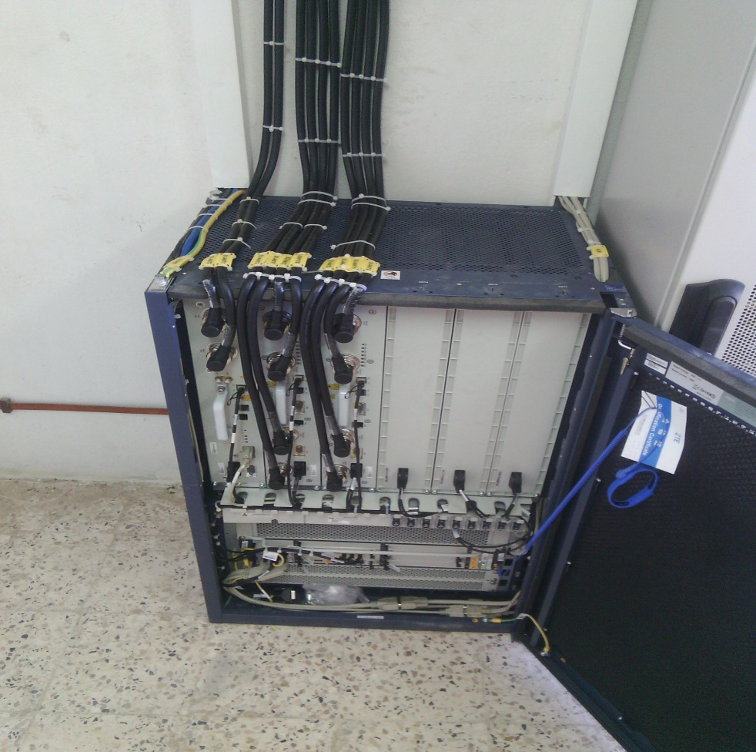
Site View Indoor AFTER

Slide 7
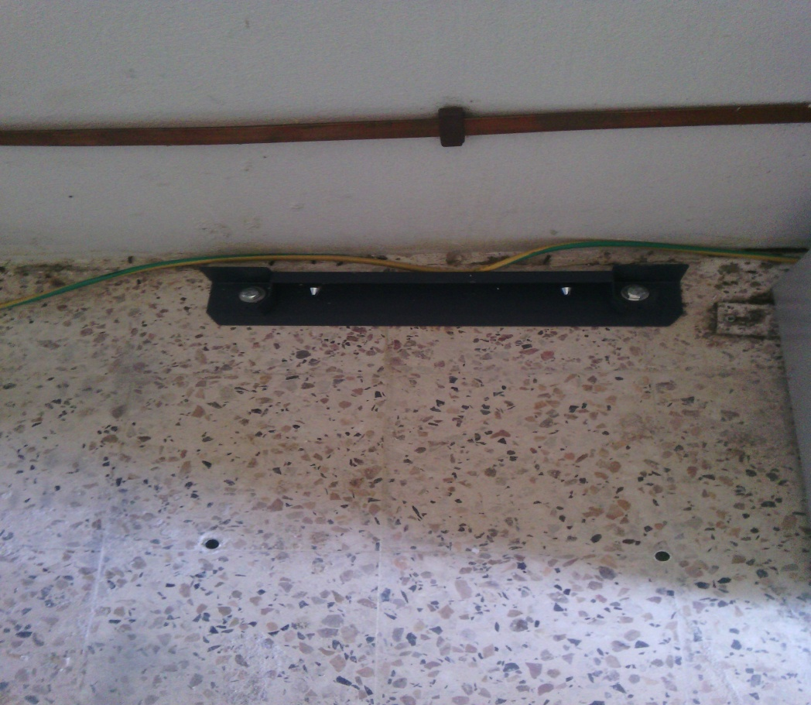
FIXATION NODE B

Slide 8
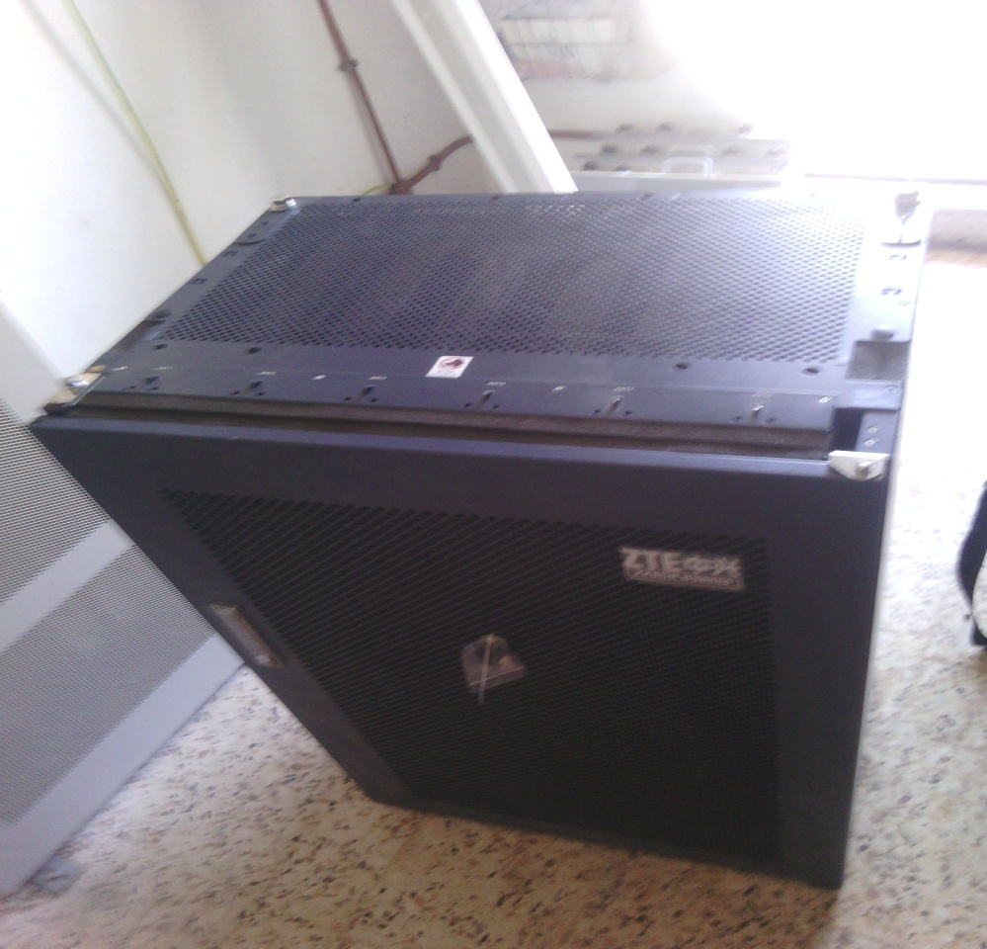
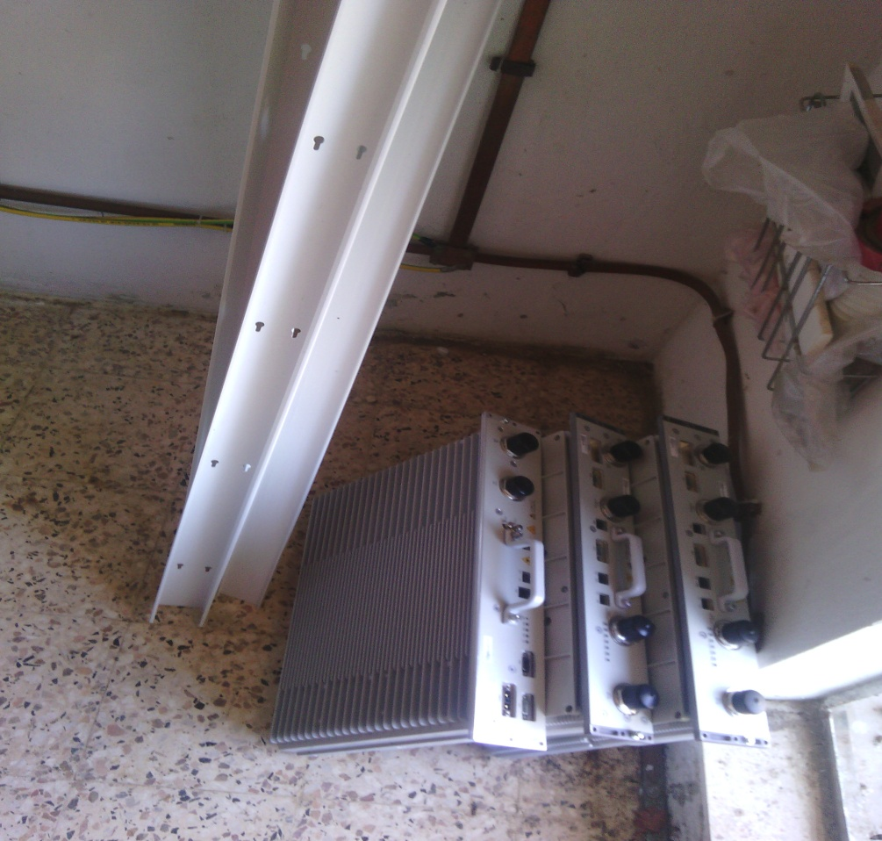
Equipments delivered
Paste the Picture here

Slide 9

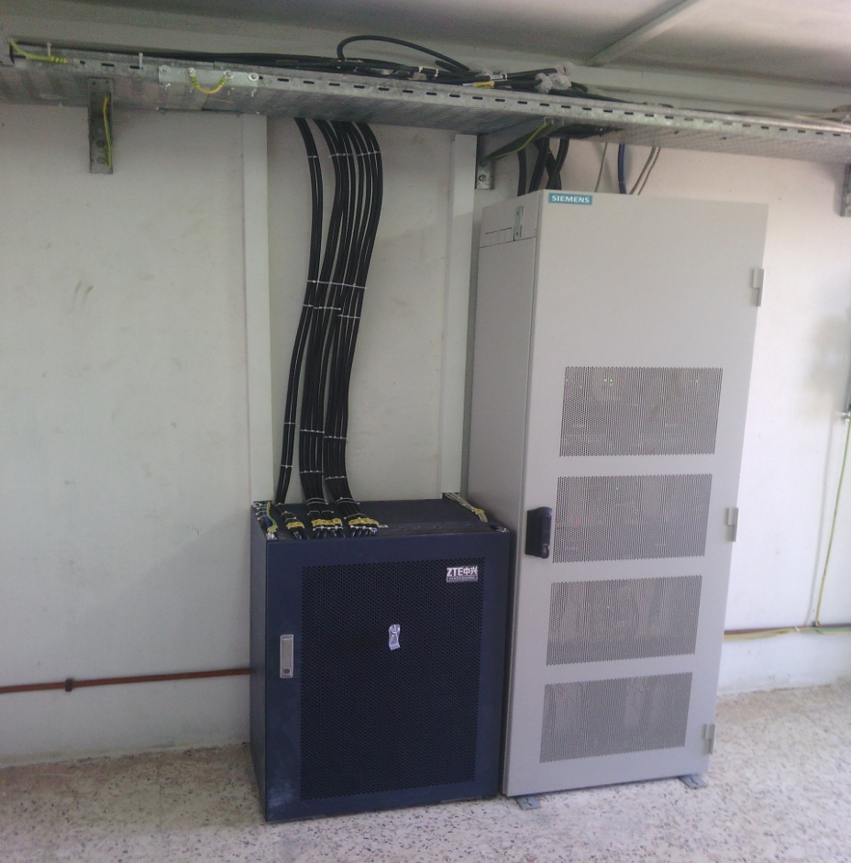
Node B Cabinet
Paste the Picture here

Slide 10
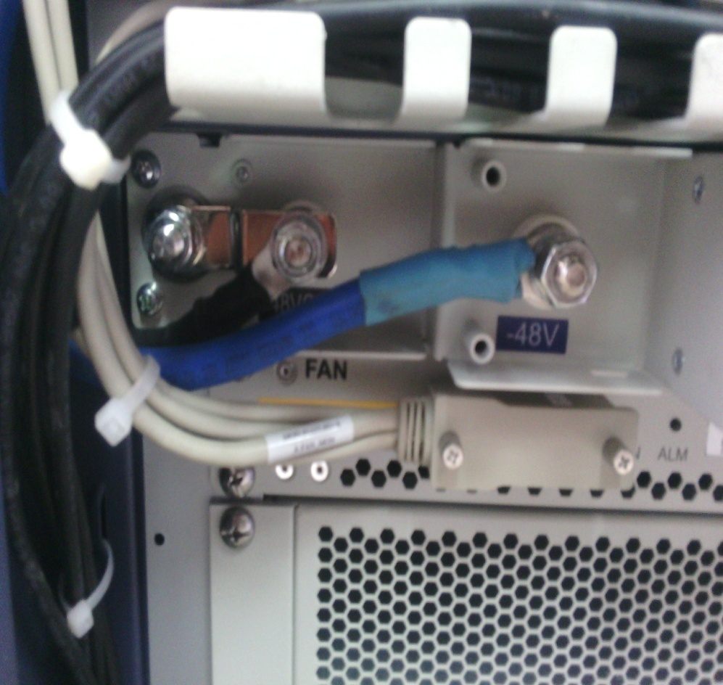
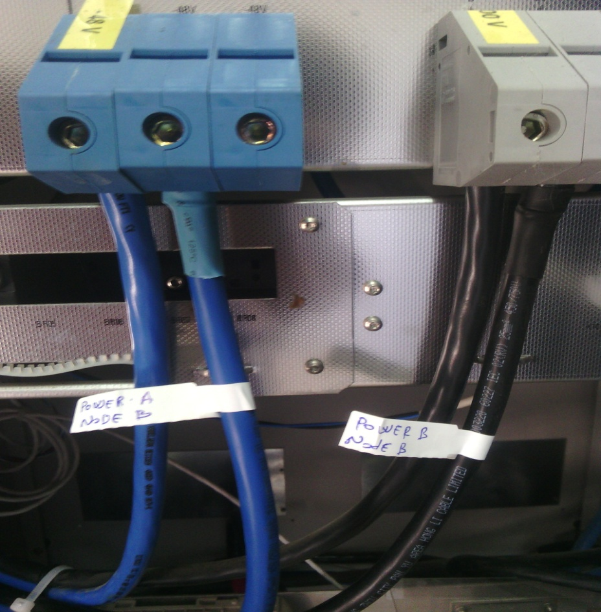
Node B cable PS

Slide 11
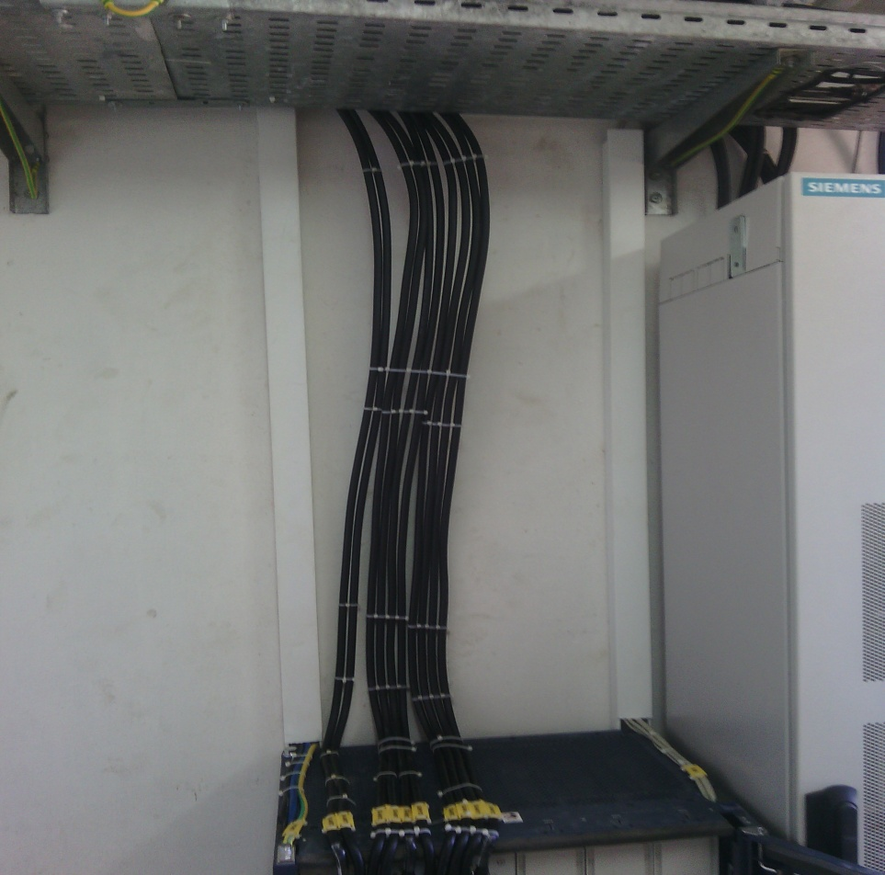
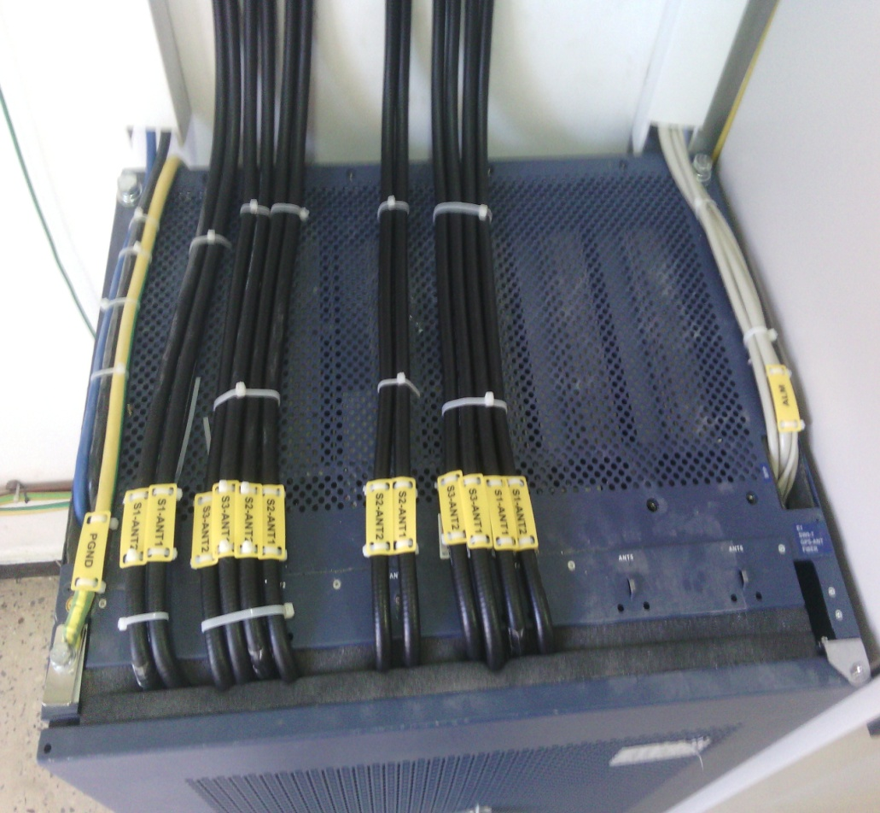
Indoor Jumpers + label
Paste the Picture here

Slide 12
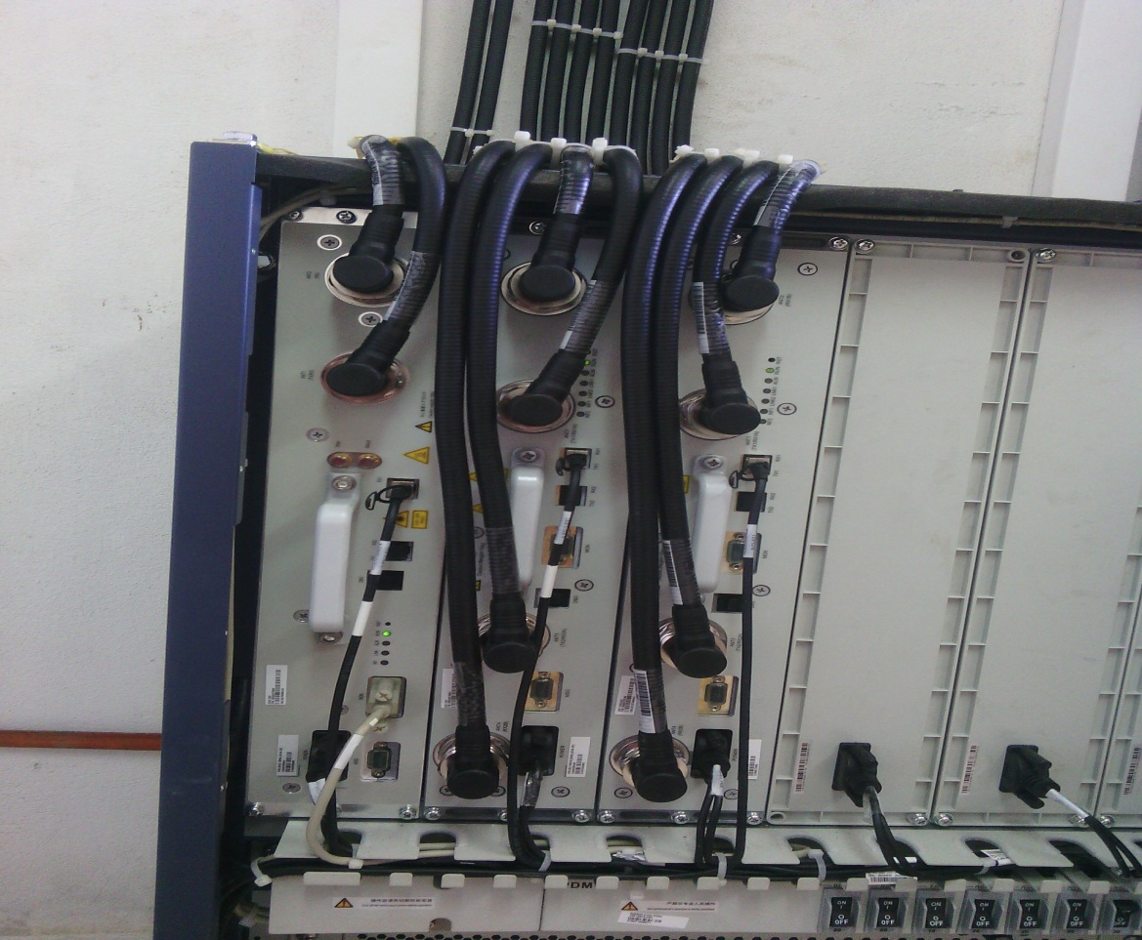
RSU/RRU
Paste the Picture here

Slide 13
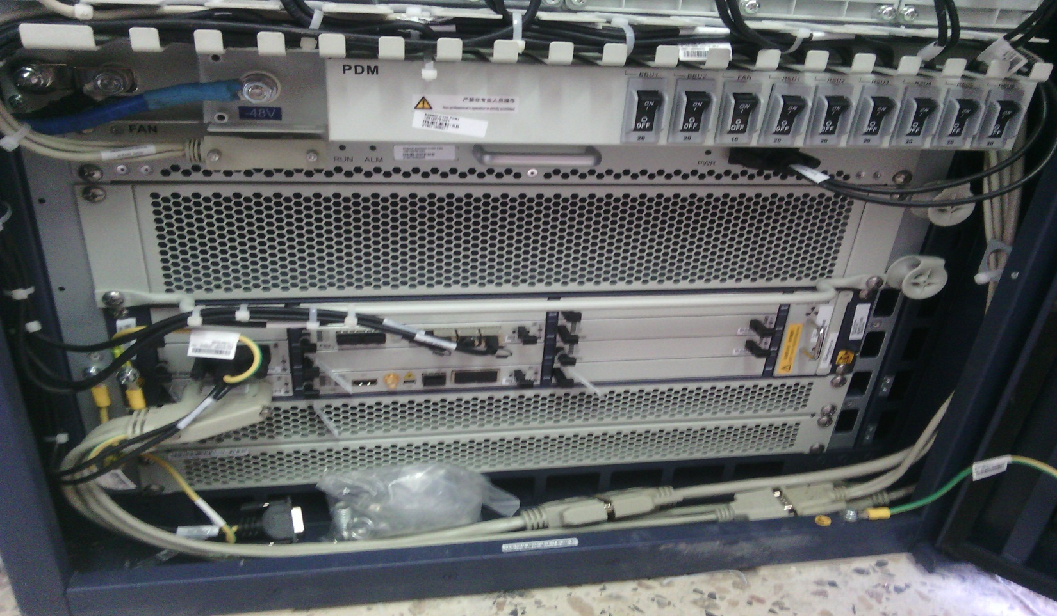
BBU

Slide 14
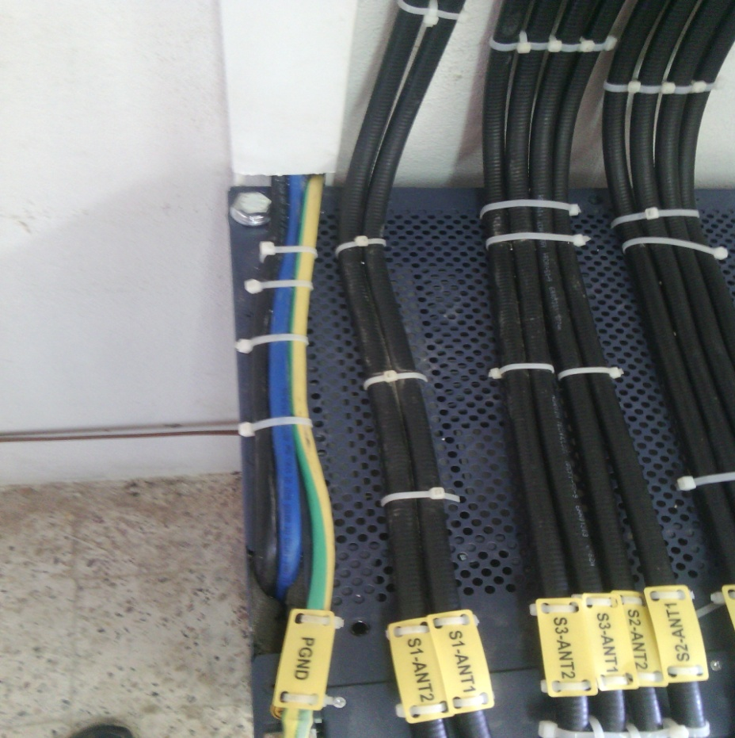
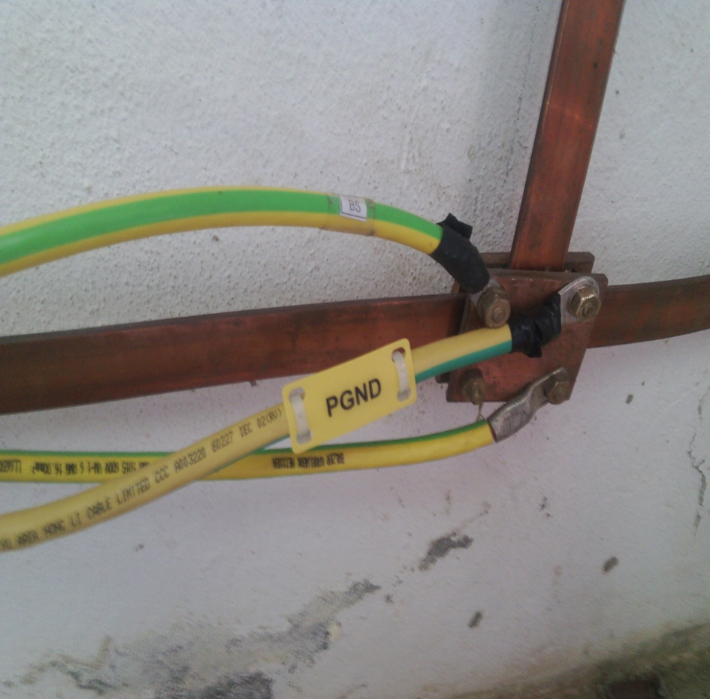
GROUND /LABEL
Paste the Picture here

Slide 15
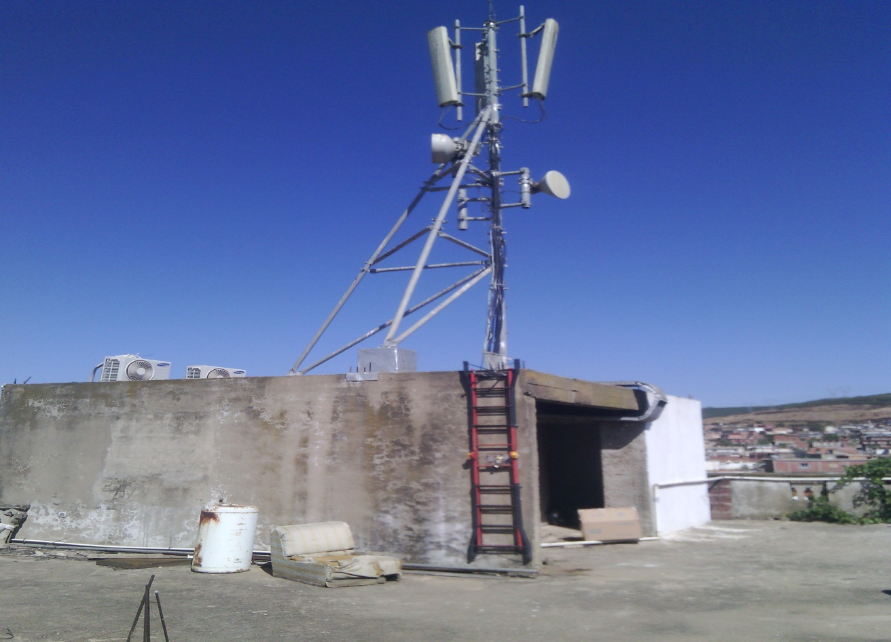
View General
Paste the Picture here

Slide 16
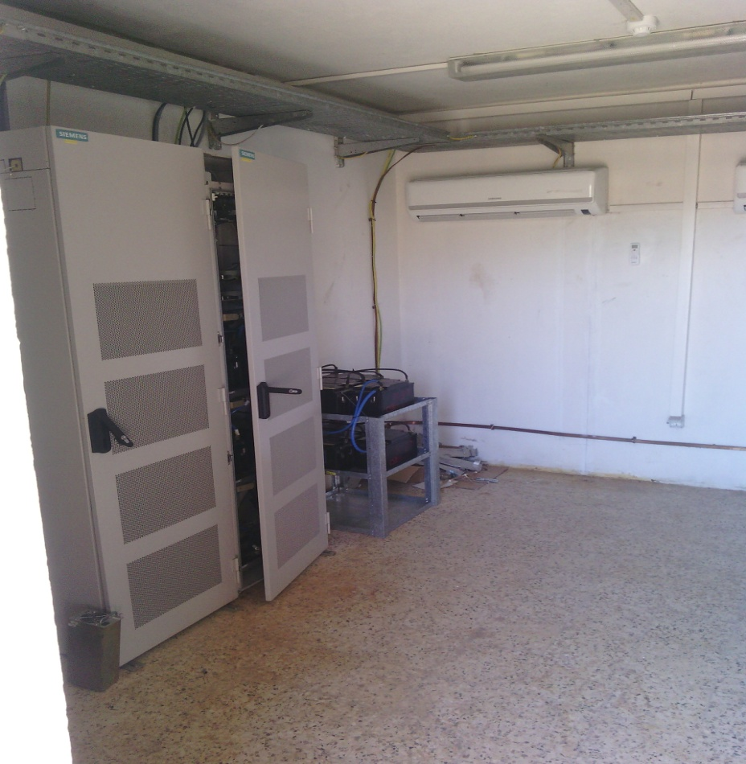
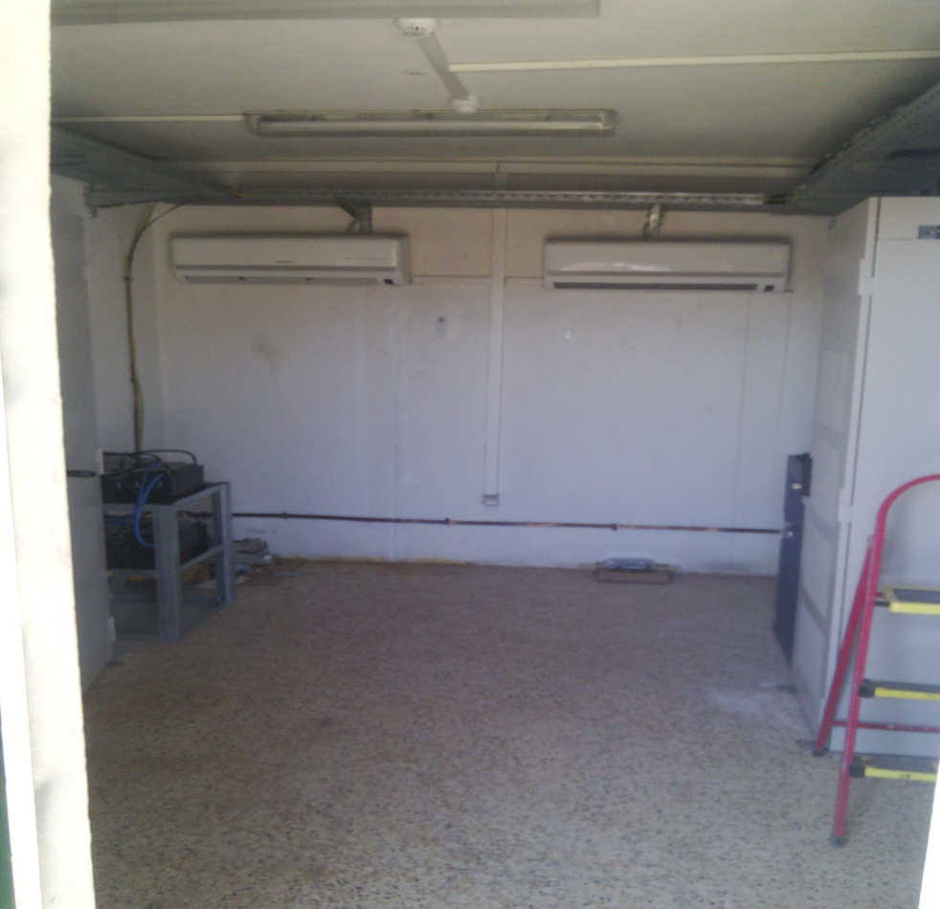
View Genarel INDOOR after/CLINUP

Slide 17
Notes:
Les antennes sont desinstallés d’un autre site avec le même code site O13X131

