Slide 1


OTA 2G&3G Modernization Project
Site Photos
Subcontractor: MGIC
Site ID: C36X028
Installation/Swap Date: 24/07/2016
Name: HAICHEUR HADJER
Department: Documentation (OTA Project)
Mail: haicheur.hadjer@zte.com.cn

Slide 2
Work Done ( Please to list bellow the work items done on the site)
INSTALL New BTS 2G /NOTE B
4 TRIPLIXER
2 TMA
1 BARRETTE DE TERRE
SWAP ANTENNE
SWAP 2G /3G
….

Slide 3
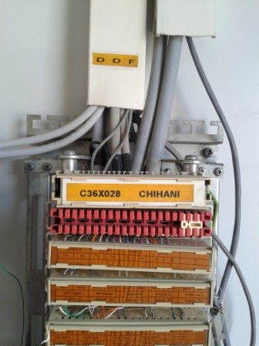
Site Identification
Paste the Picture here

Slide 4
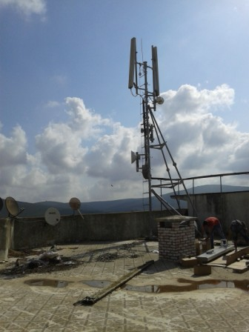
Site View outdoor
Paste the Picture here

Slide 5
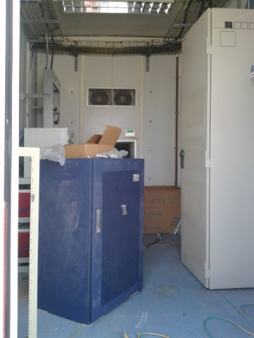
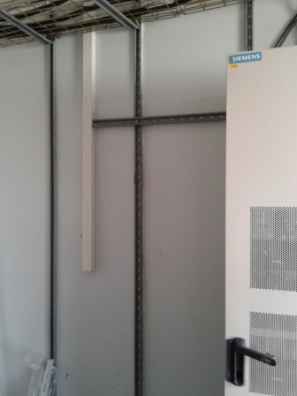
Site View Indoor
Paste the Picture here

Slide 6
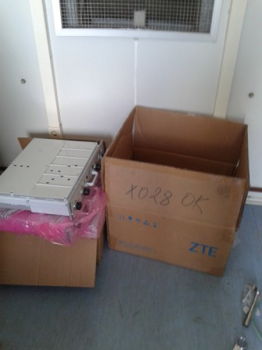
Equipments delivered
Paste the Picture here

Slide 7
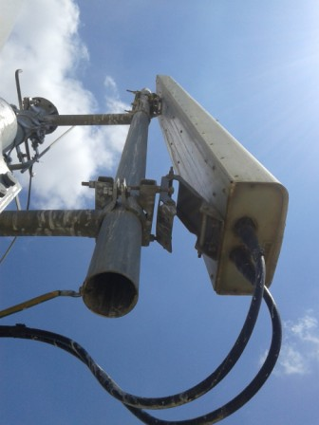
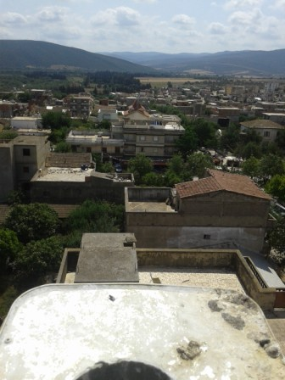
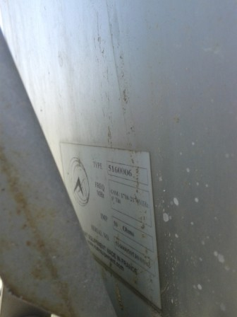
SECTOR 1

Slide 8
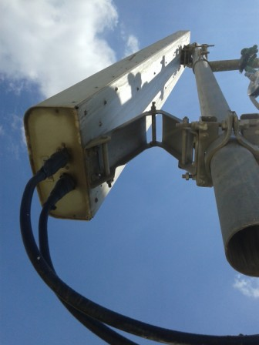
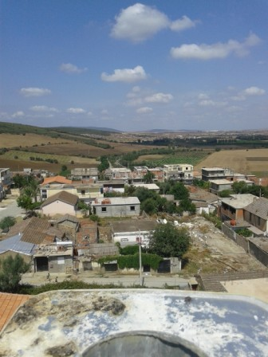
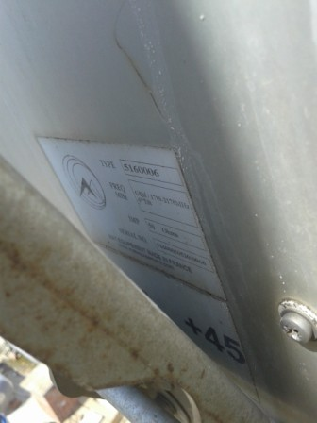
SECTOR 2

Slide 9
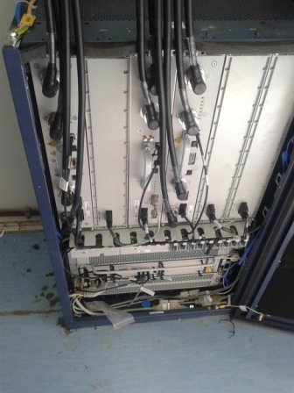
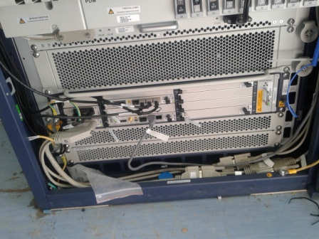
BTS/BBU
Paste the Picture here

Slide 10
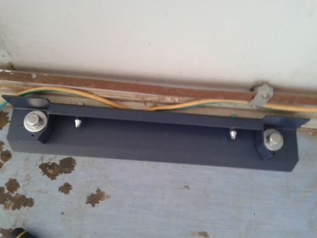
BTS fixation
Paste the Picture here

Slide 11
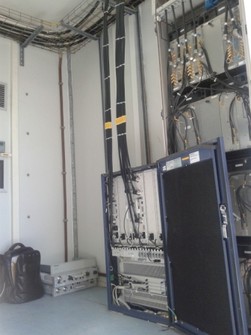
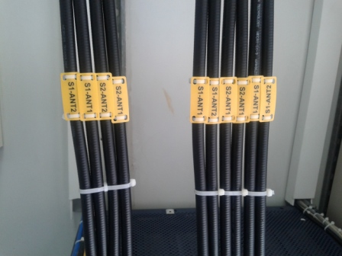
Indoor Jumpers + label
Paste the Picture here

Slide 12
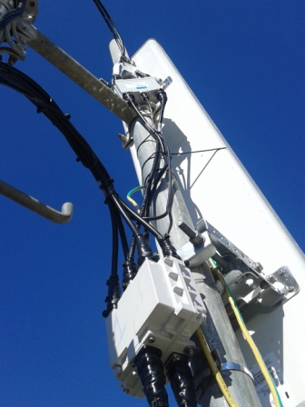
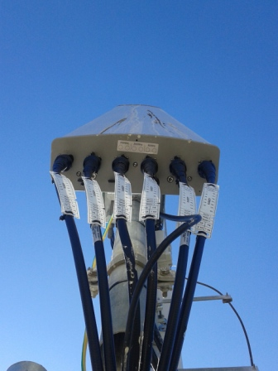
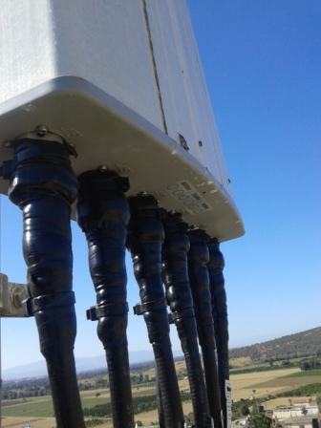
Outdoor Jumpers
Paste the Picture here

Slide 13
Outdoor Jumpers
Paste the Picture here

Slide 14
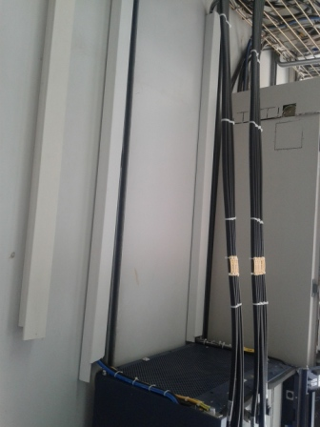
Cable Tray
Paste the Picture here

Slide 15
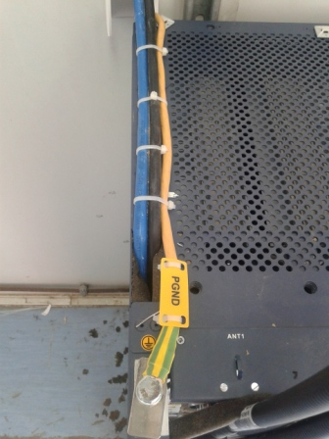
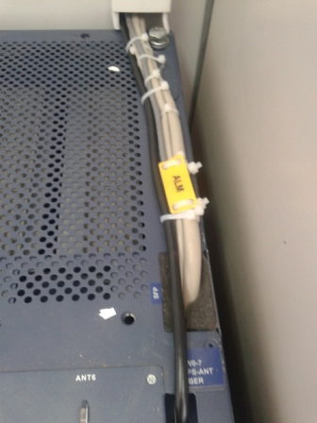
BBU (Connectivity and labeling)
Paste the Picture here

Slide 16
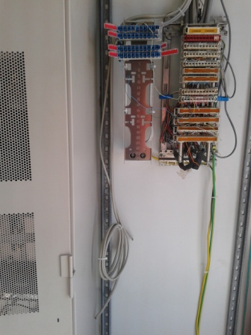
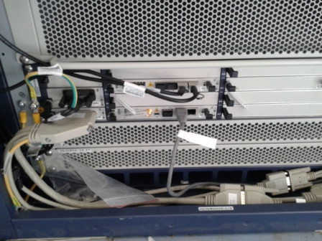
Alarme,E1,ETHERNET

Slide 17
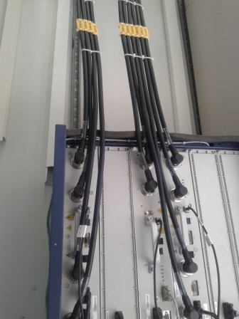
RSU
Paste the Picture here

Slide 18
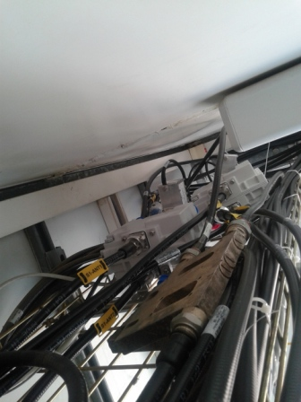
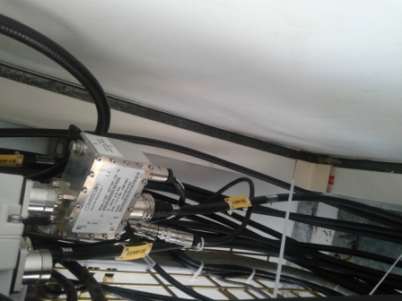
Triplixer INDOOR

Slide 19
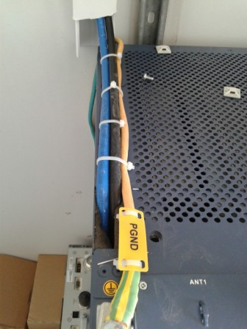
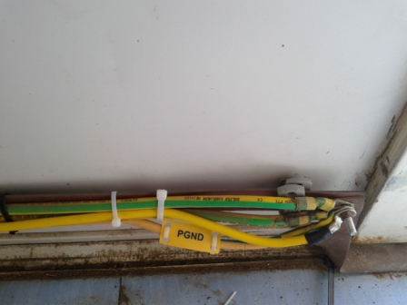
Grounding Indoor
Paste the Picture here

Slide 20
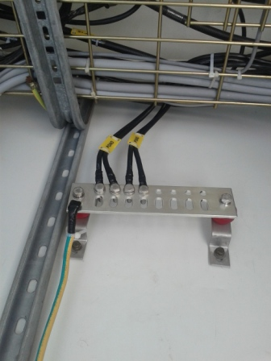
Grounding / Grounding Bar (Indoor and/or Outdoor)
Paste the Picture here

Slide 21
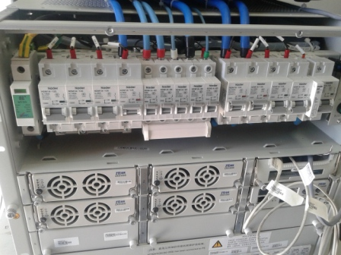
DC Breaker
Paste the Picture here

Slide 22
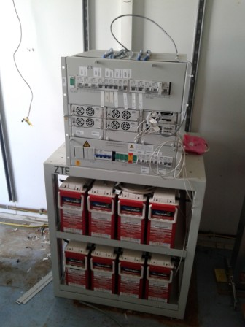
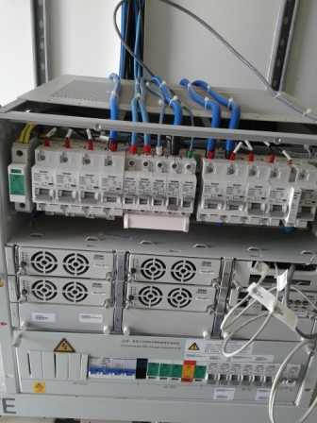
Power Supply
Paste the Picture here

Slide 23
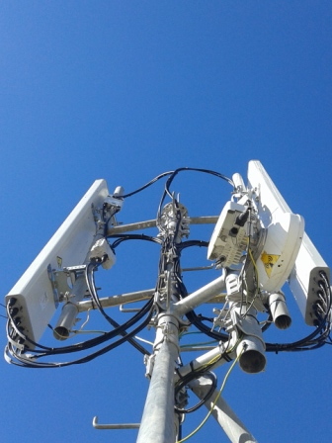
Antennas
Paste the Picture here

Slide 24
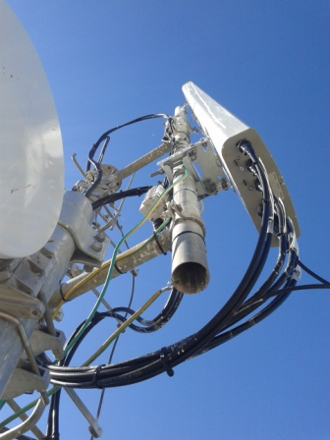
Antenna Sector 1 (Feeder,Waterproofing,label)
Paste the Picture here

Slide 25
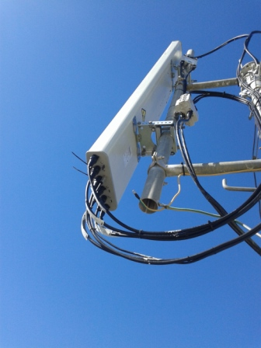
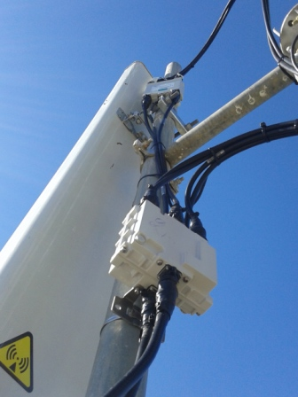
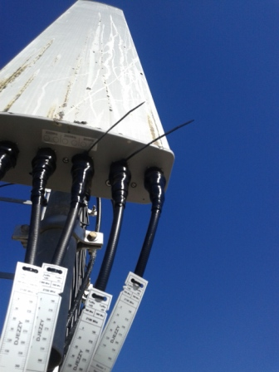
Antenna Sector 2(Feeder,Waterproofing,label)
Paste the Picture here

Slide 26
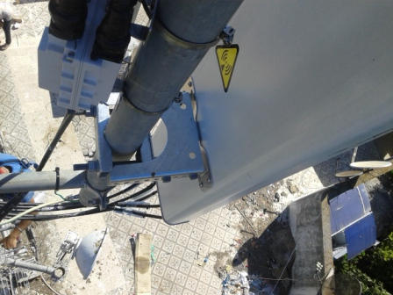
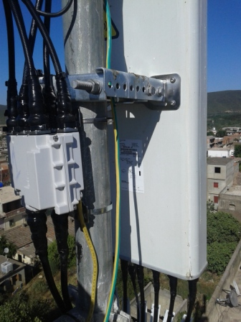
Antenna Bracket
Paste the Picture here

Slide 27
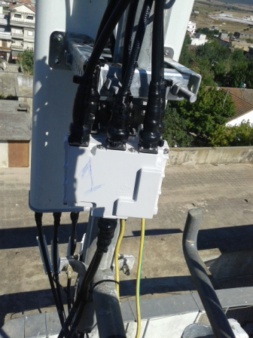
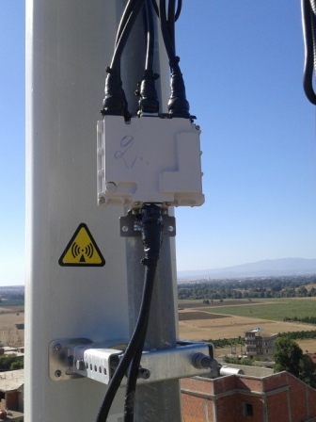
Triplexer S1 S2 (Waterproofing+Label)
Paste the Picture here

Slide 28
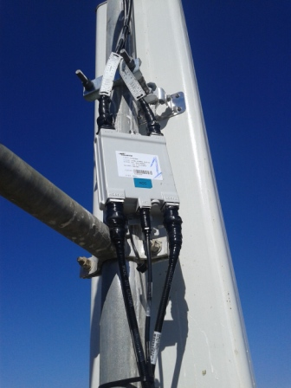
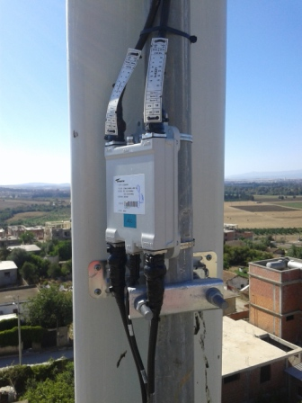
TMA S1S2
Paste the Picture here

Slide 29
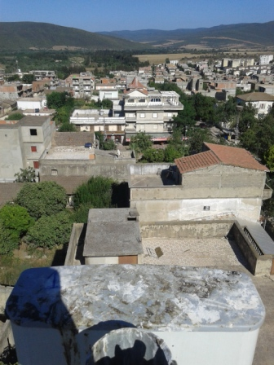
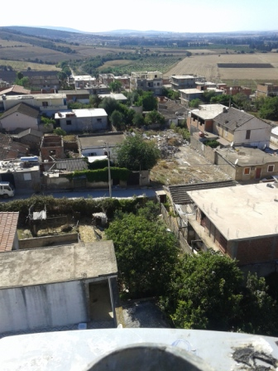
VUE S1 S2

Slide 30
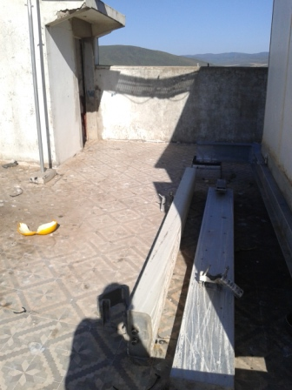
DESINSTALL ANTENNAS

Slide 31
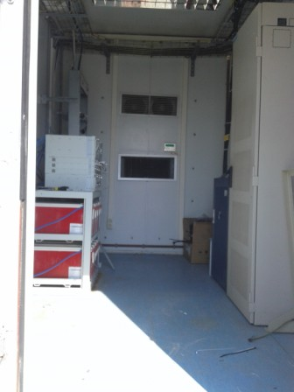
Cleanup
Paste the Picture here

Slide 32
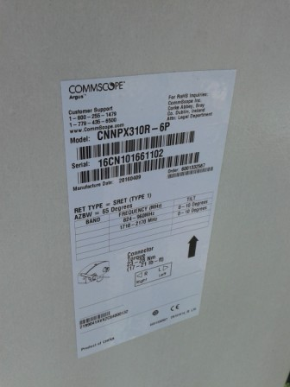
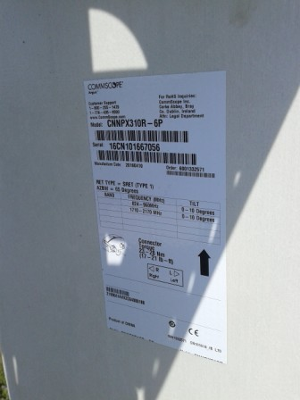
MODEL ANTENNA
Paste the Picture here

