Slide 1


OTA 2G&3G Modernization Project
Site Photos
Subcontractor: MGNIC
Site ID: C36X062
Installation/Swap Date: 20/07/2016
Name: HAICHEUR HADJER
Department: Documentation (OTA Project)
Mail: haicheur.hadjer@zte.com.cn

Slide 2
Work Done ( Please to list bellow the work items done on the site)
SITE VIEW INDOOR/OUTDOOR
INSTALL NEW BBU
RRU /POWER/FIBRE
LABELING
CLEAN SITE
….

Slide 3
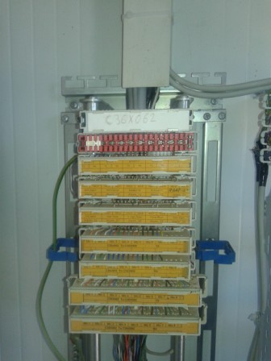
Site Identification
Paste the Picture here

Slide 4
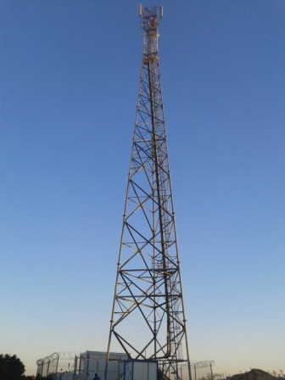
Site View outdoor
Paste the Picture here

Slide 5
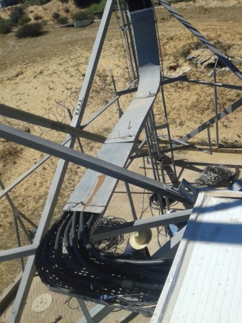
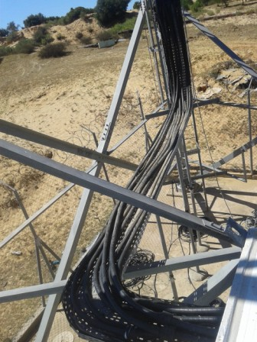
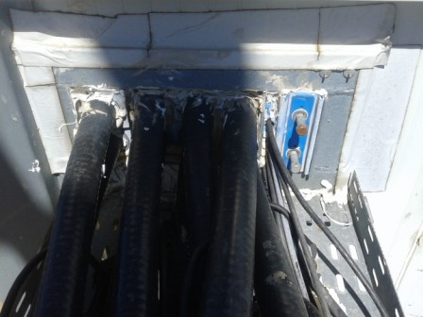
Capos+Roxtec

Slide 6
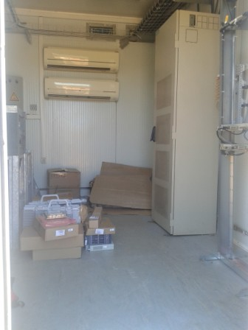
Site View Indoor
Paste the Picture here

Slide 7
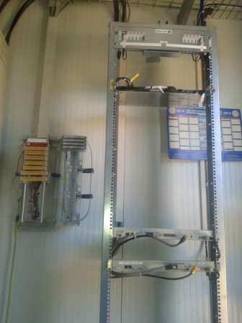
IDU

Slide 8
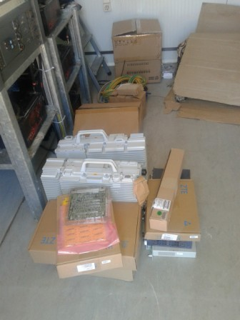
Equipments delivered
Paste the Picture here

Slide 9
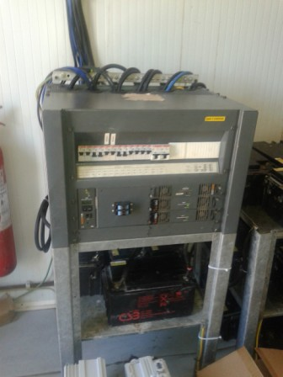
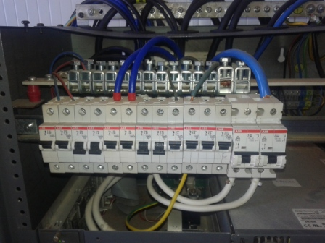
Power Suplly

Slide 10
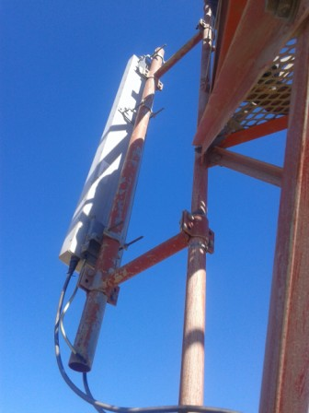
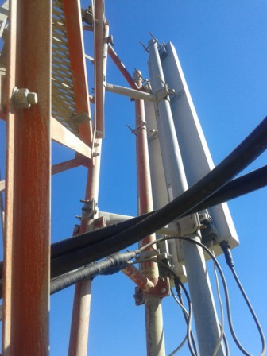
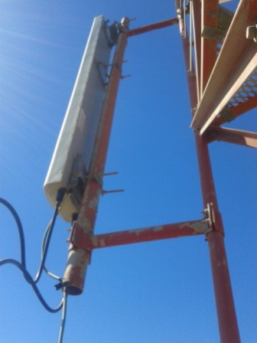
S1,S2,S3

Slide 11
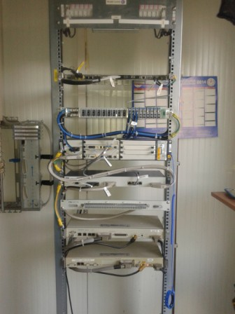
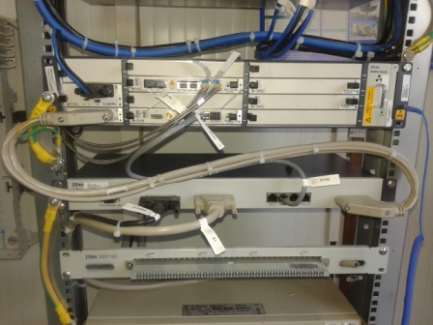
BBU
Paste the Picture here

Slide 12
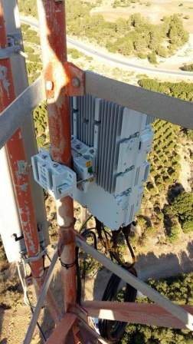
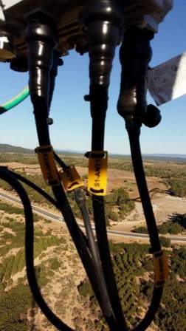
RRU,Jumper ,label,Secteur 1
Paste the Picture here

Slide 13
Outdoor Jumpers,Power RRU,Fibre,Secteur 1
Paste the Picture here

Slide 14
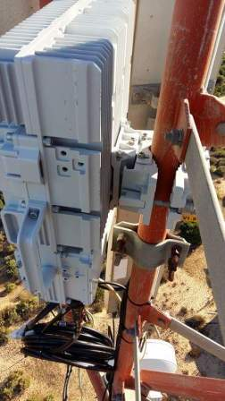
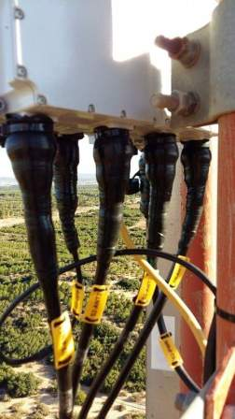
RRU,Jumper,Label,Power RRU,Fibre,Secteur 2

Slide 15
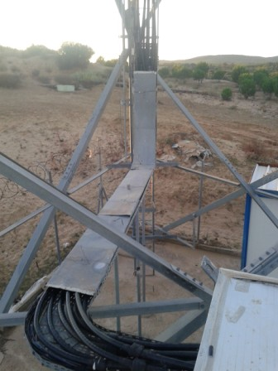
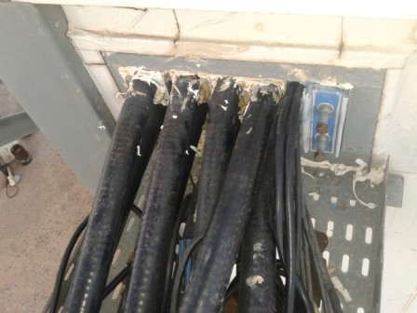
Cable Tray
Paste the Picture here

Slide 16
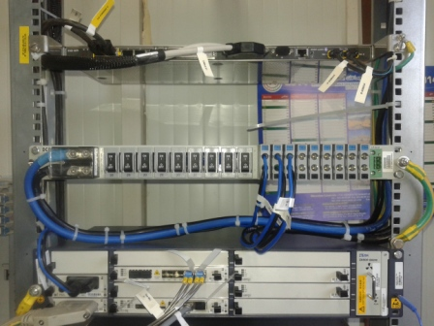
BBU (Connectivity and labeling)
Paste the Picture here

Slide 17
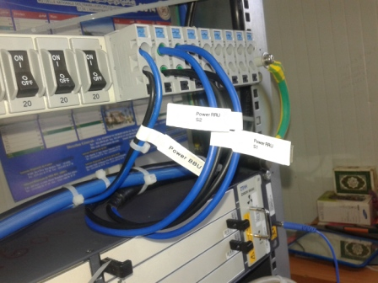
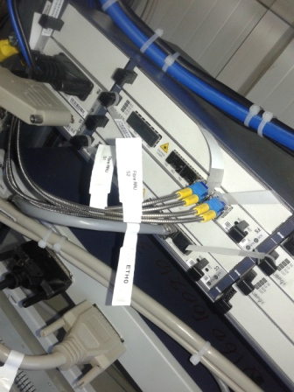
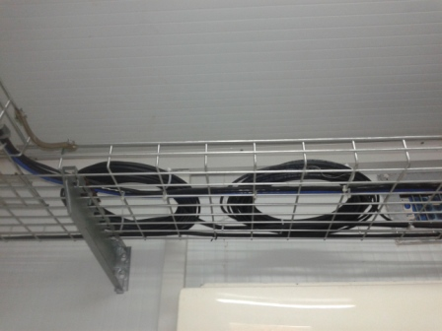
Power,Fibre RRU,label
Paste the Picture here

Slide 18
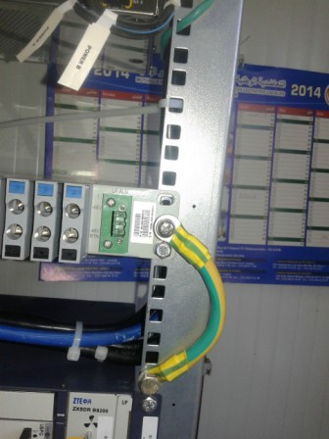
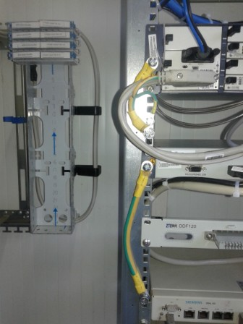
Grounding Indoor
Paste the Picture here

Slide 19
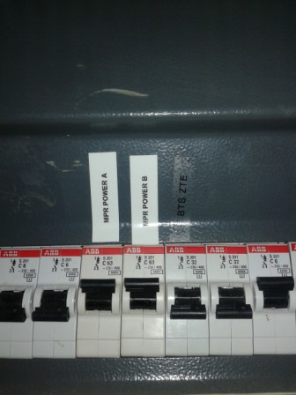
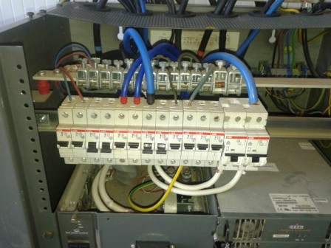
Power Supply
Paste the Picture here

Slide 20
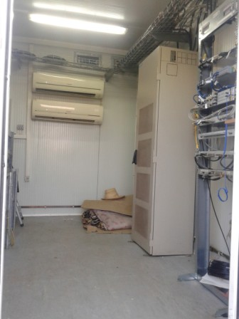
Cleanup
Paste the Picture here

Slide 21
Others
Paste the Picture here

