Slide 1


OTA 2G&3G Modernization Project
Site Photos
Subcontractor: MGNIC
Site ID: C36X071
Installation/Swap Date: 30/07/2016
Name: HAICHEUR HADJER
Department: Documentation (OTA Project)
Mail: haicheur.hadjer@zte.com.cn

Slide 2
Work Done ( Please to list bellow the work items done on the site)
SITE VIEW INDOOR/OUTDOOR
INSTAL NEW BTS 2G
JUMPER LABEL
CLEAN UP
LIVRAISON
….

Slide 3
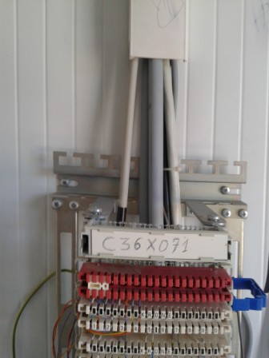
Site Identification
Paste the Picture here

Slide 4
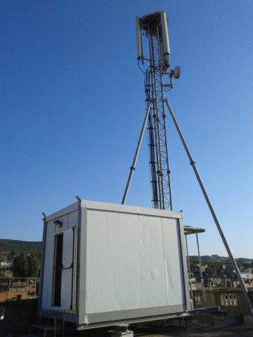
Site View outdoor
Paste the Picture here

Slide 5
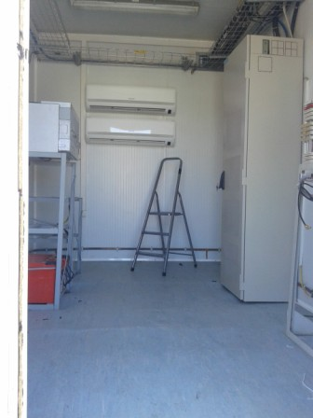
Site View Indoor
Paste the Picture here

Slide 6
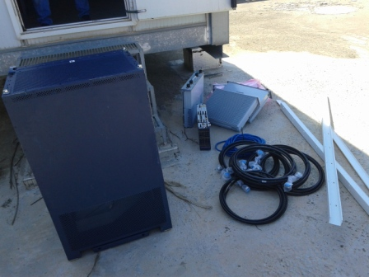
Equipments delivered
Paste the Picture here

Slide 7
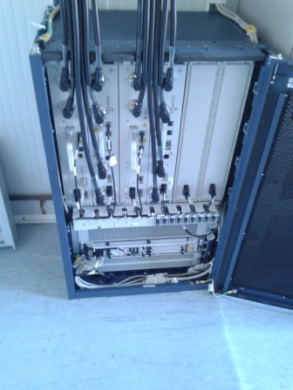
BTS
Paste the Picture here

Slide 8
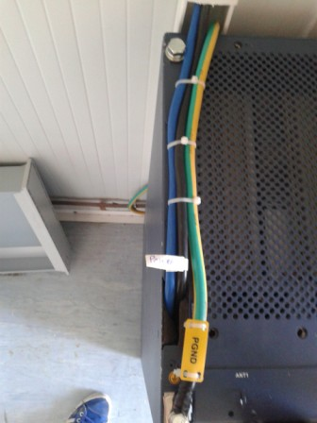
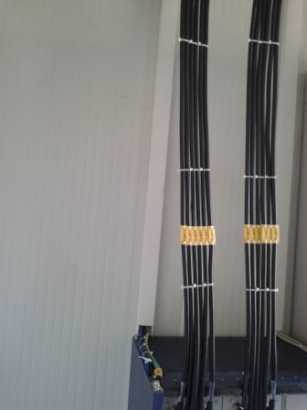
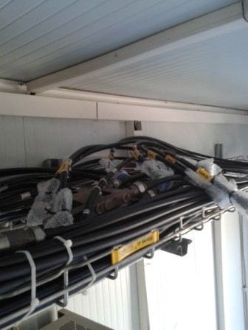
Cabel Tray

Slide 9
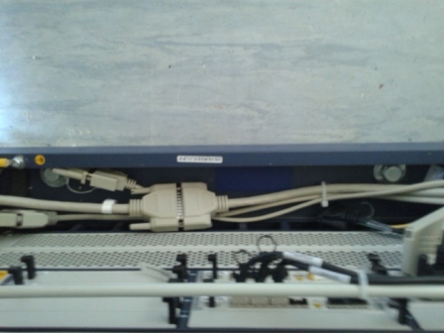
BTS Cabinet fixation
Paste the Picture here

Slide 10
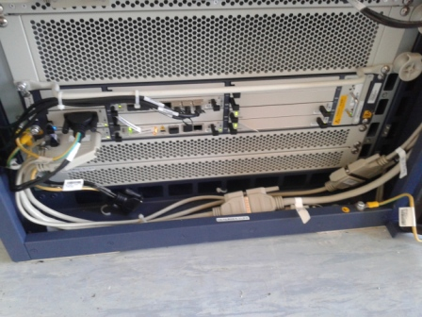
BBU Connectivity and labeling

Slide 11
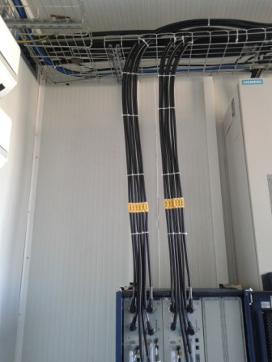
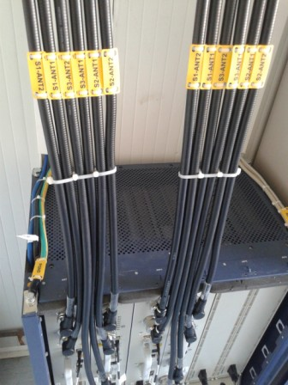
Indoor Jumpers + label
Paste the Picture here

Slide 12
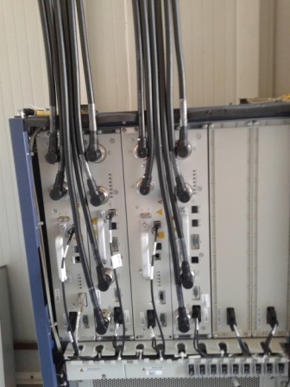
RSU
Paste the Picture here

Slide 13
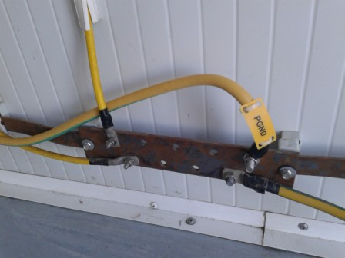
Grounding Indoor
Paste the Picture here

Slide 14
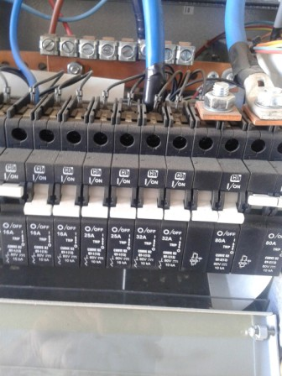
DC Breaker
Paste the Picture here

Slide 15
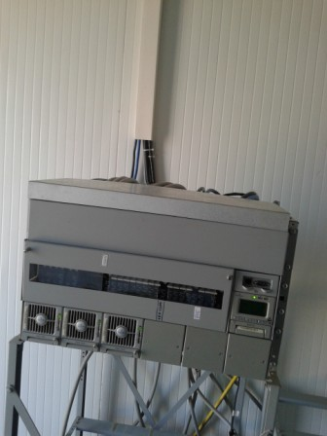
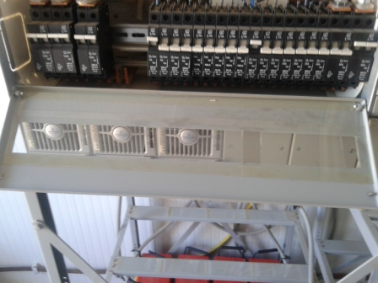
Power Supply
Paste the Picture here

Slide 16
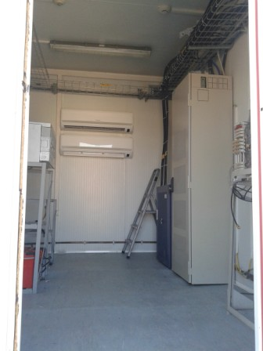
Cleanup
Paste the Picture here

Slide 17
Others
Paste the Picture here

