Slide 1


OTA 2G&3G Modernization Project
Site Photos
Subcontractor: MGNIC
Site ID: C36X081
Installation/Swap Date: 17/07/2016
Name: HAICHEUR HADJER
Department: Documentation (OTA Project)
Mail: haicheur.hadjer@zte.com.cn

Slide 2
Work Done ( Please to list bellow the work items done on the site)
Site Identification
Site View Indoor/Outdoor
Install New BTS 2G
BBU/RRU Connectivity,labeling
Power Supply
Clean
….

Slide 3
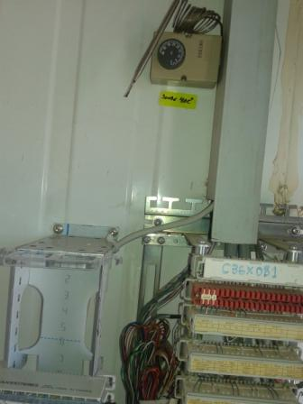
Site Identification
Paste the Picture here

Slide 4
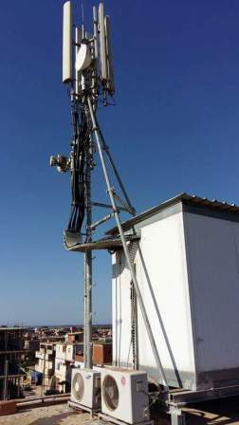
Site View outdoor
Paste the Picture here

Slide 5
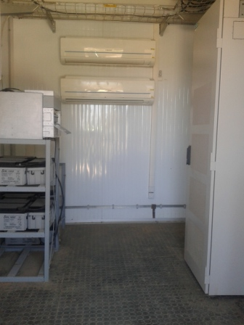
Site View Indoor
Paste the Picture here

Slide 6
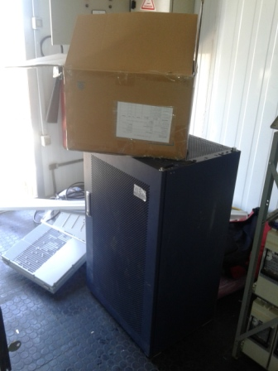
Equipments delivered
Paste the Picture here

Slide 7
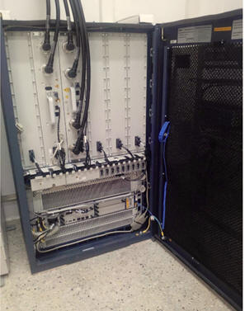
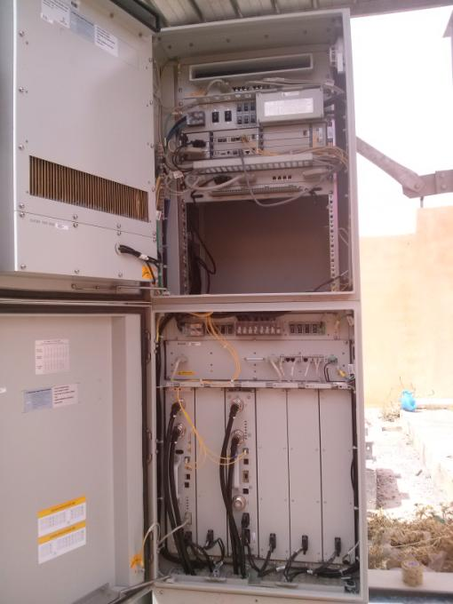
BTS/NodeB Cabinet
Paste the Picture here

Slide 8
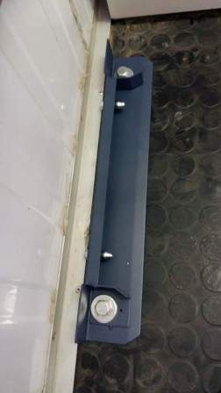
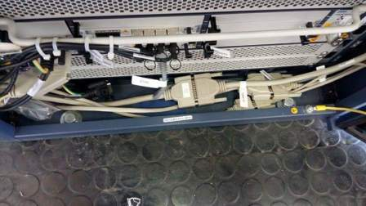
BTS Cabinet fixation
Paste the Picture here

Slide 9
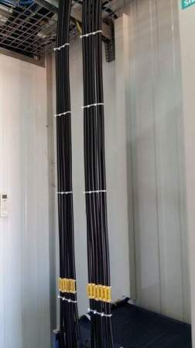
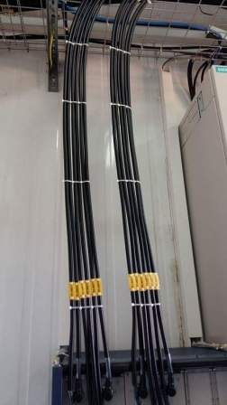
Indoor Jumpers + label
Paste the Picture here

Slide 10
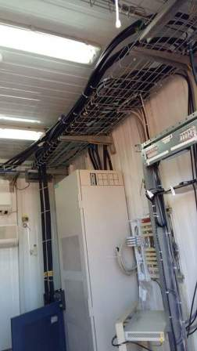
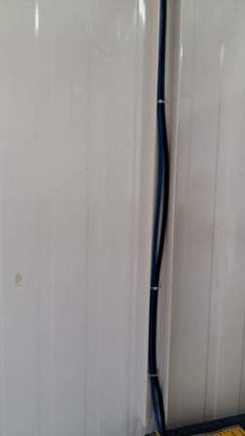
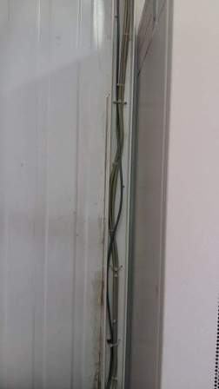
Cable Tray
Paste the Picture here

Slide 11
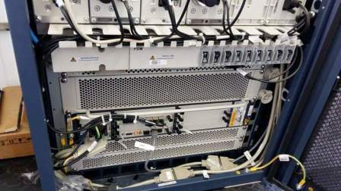
BBU (Connectivity and labeling)
Paste the Picture here

Slide 12
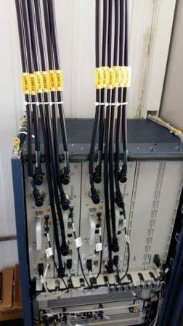
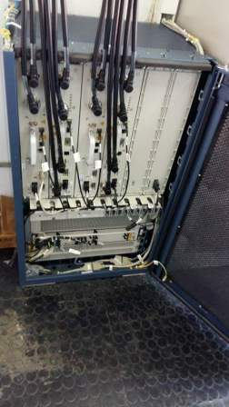
RSU/RRU
Paste the Picture here

Slide 13
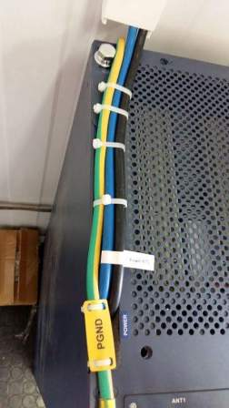
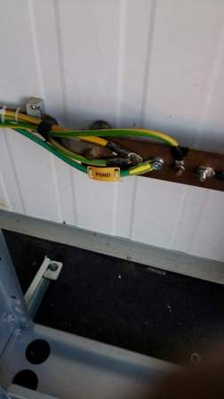
Grounding Indoor
Paste the Picture here

Slide 14
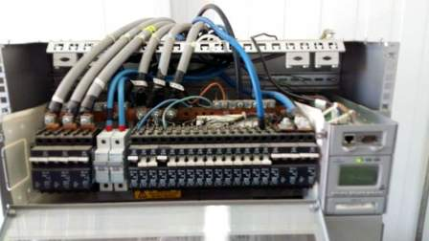
DC Breaker
Paste the Picture here

Slide 15
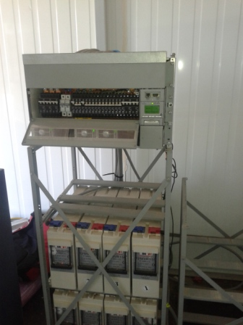
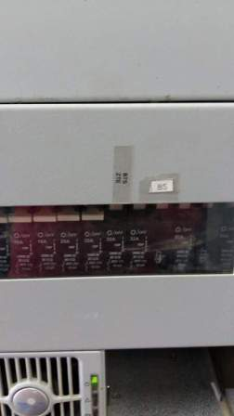
Power Supply
Paste the Picture here

Slide 16
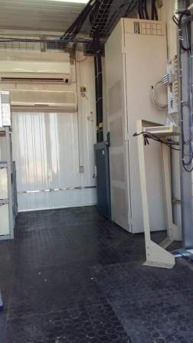
Cleanup
Paste the Picture here

Slide 17
Others
Paste the Picture here

