Slide 1


OTA 2G&3G Modernization Project
Site Photos
Subcontractor: MGNIC
Site ID: C36X094
Installation/Swap Date: 20/07/2016
Name: HAICHEUR HADJER
Department: Documentation (OTA Project)
Mail: haicheur.hadjer@zte.com.cn

Slide 2
Work Done ( Please to list bellow the work items done on the site)
Site Identification
Site View indoor
Site View Indoor BEFOR
Equipments delivered
Node B Cabinet NOT DILEVRED at site C36X094
RSU/RRU
View Genarele

Slide 3
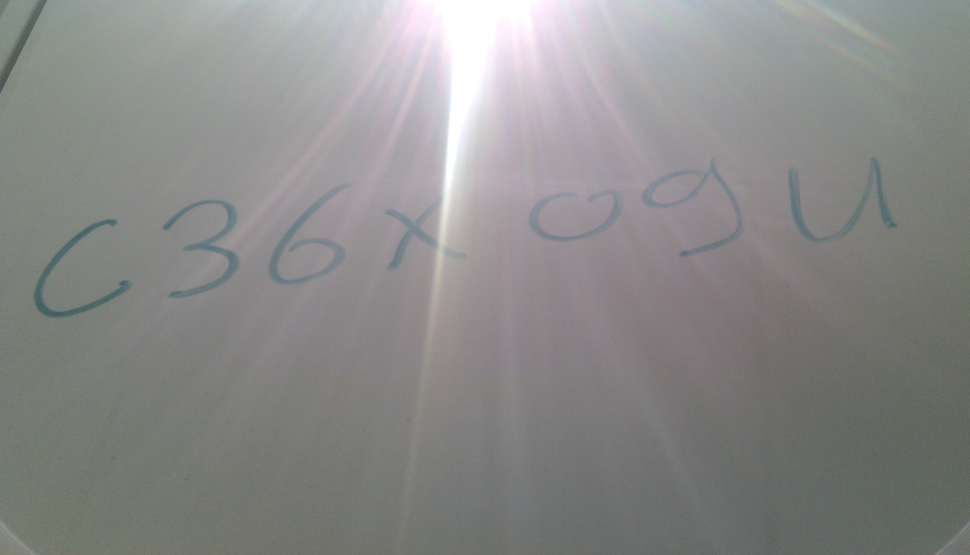
Site Identification
Paste the Picture here

Slide 4
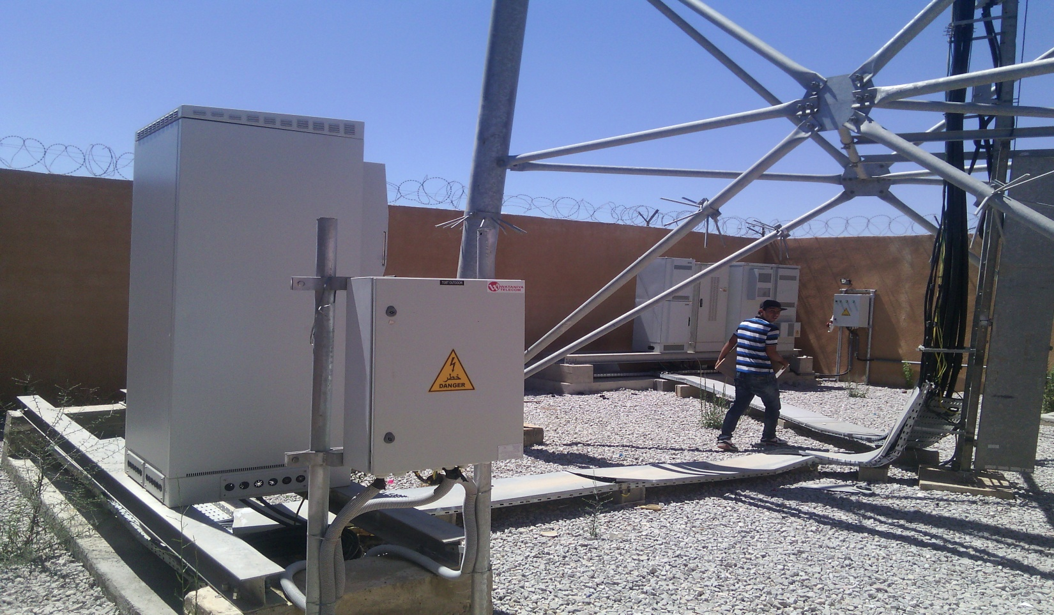
Site View Indoor
Paste the Picture here

Slide 5
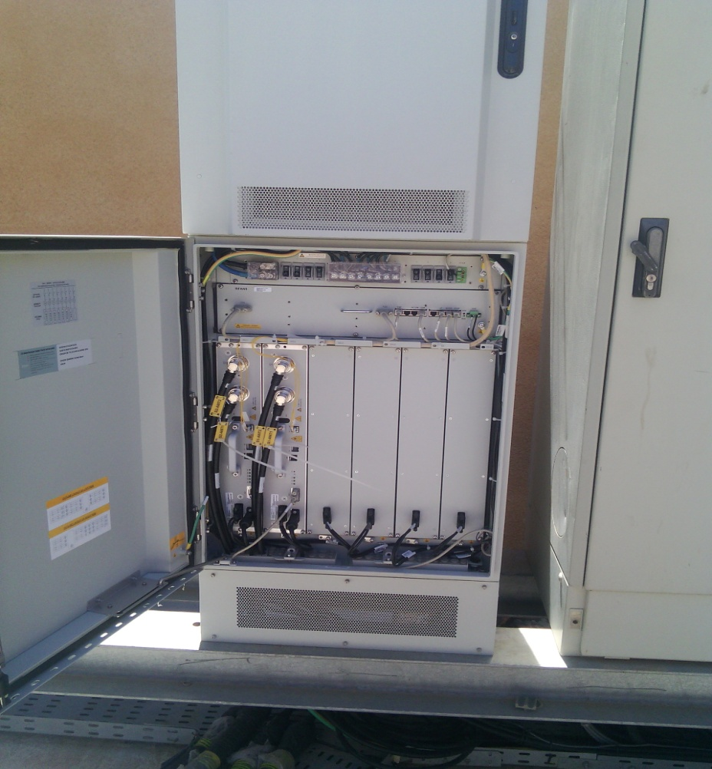
Site View Indoor BEFOR
Paste the Picture here

Slide 6
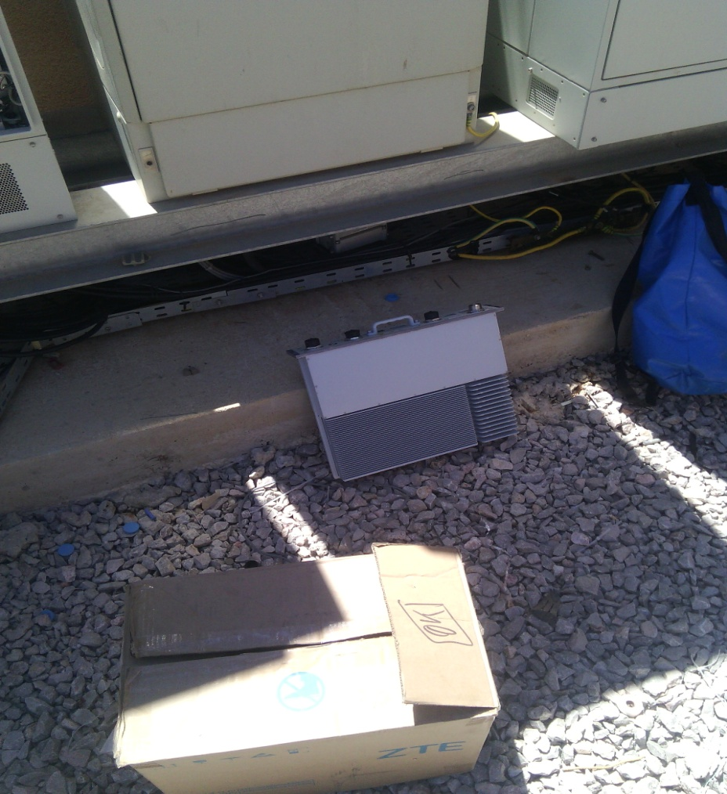
Equipments delivered
Paste the Picture here

Slide 7

Node B Cabinet at site BEFOR
Paste the Picture here

Slide 8
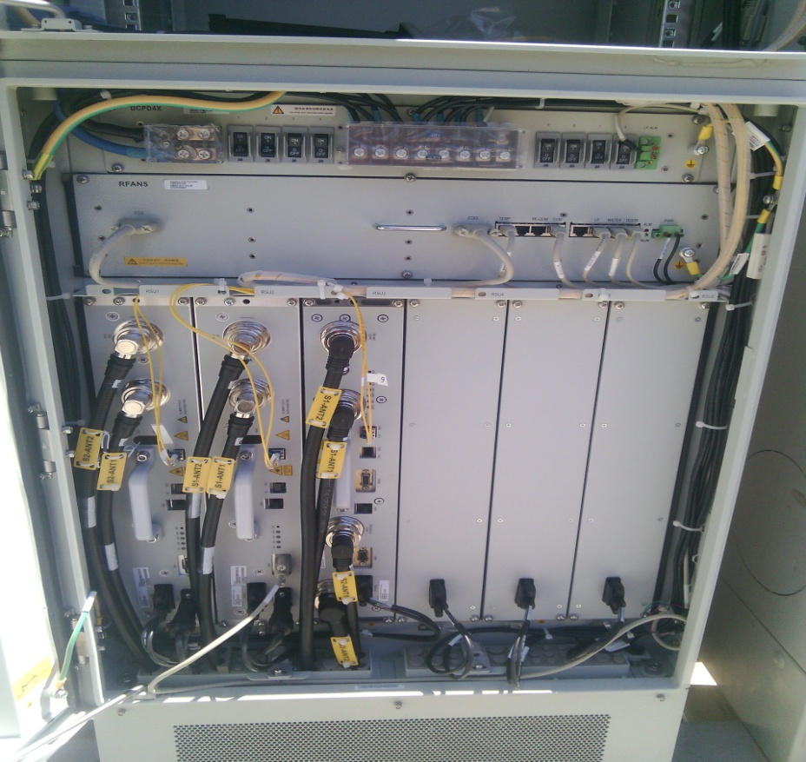
RSU/RRU
Paste the Picture here

Slide 9
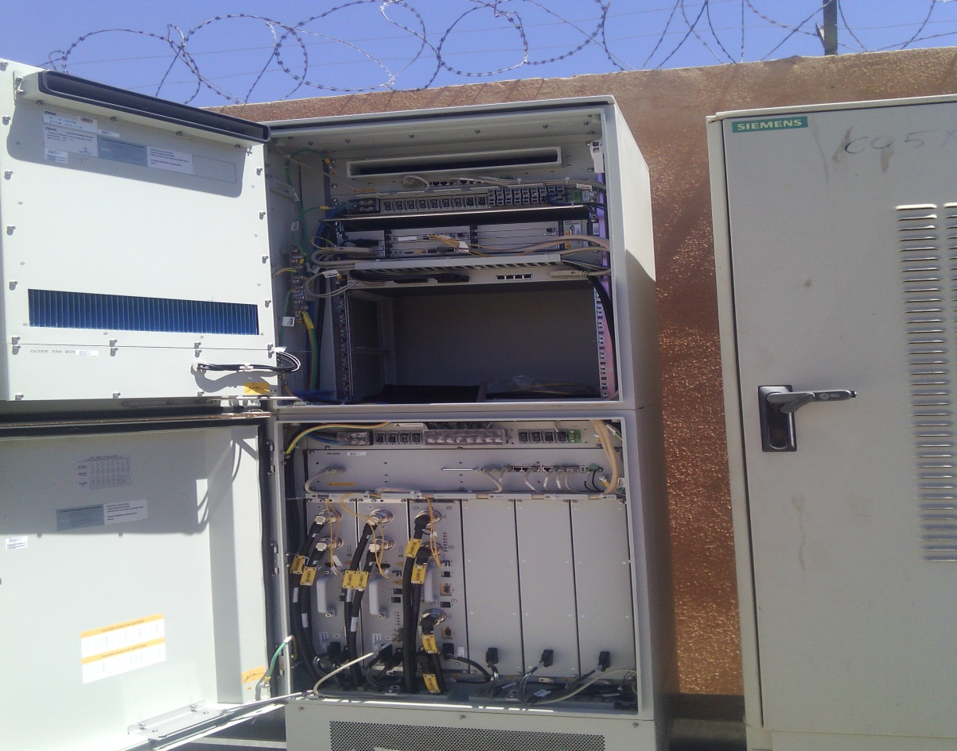
Node B Cabinet at site AFTER

Slide 10
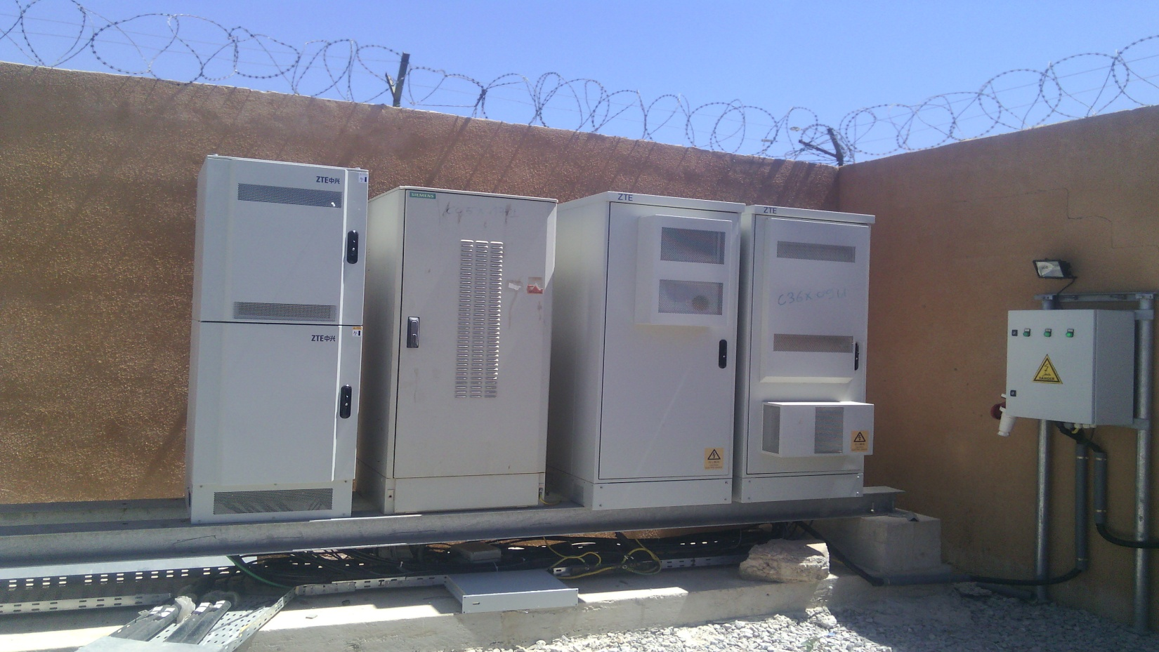
View Génarale
Paste the Picture here

Slide 11
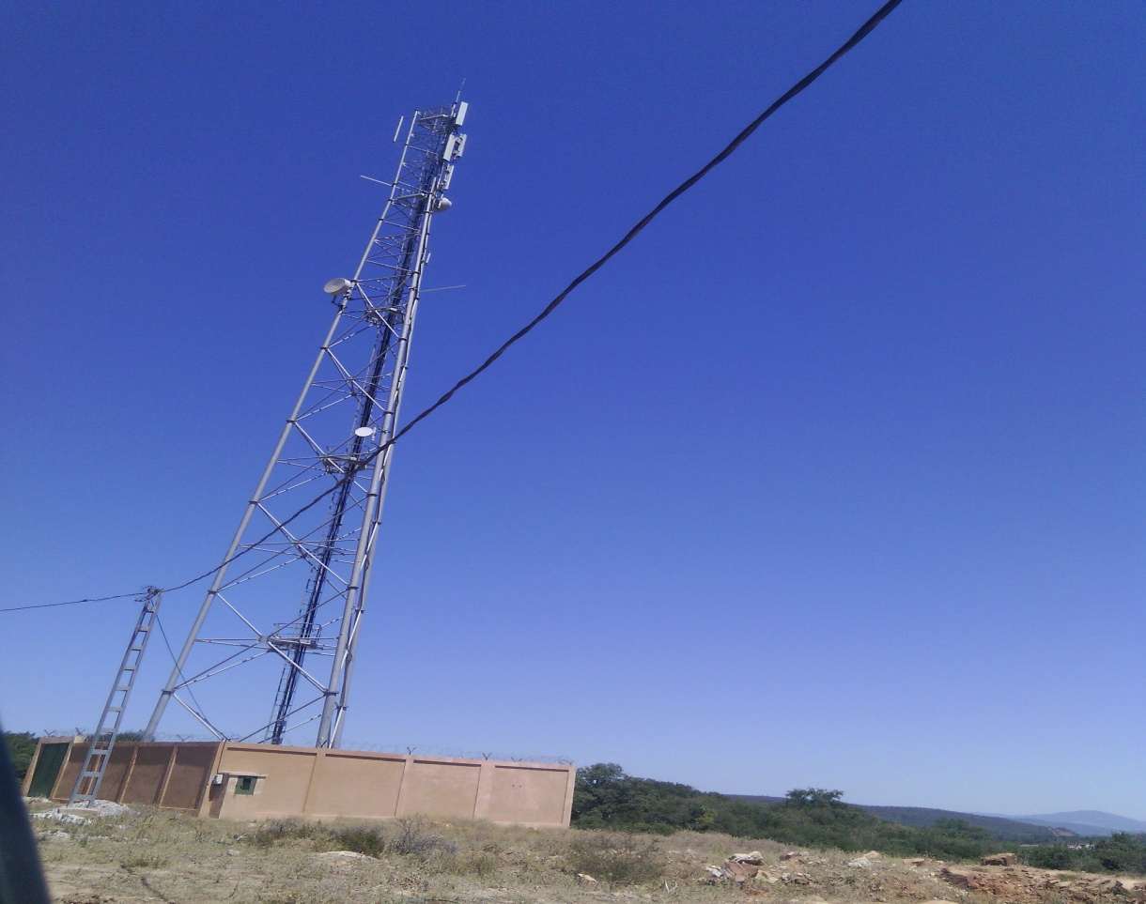
View Générale

Slide 12
Notes:
Les antennes sont desinstallés d’un autre site avec le même code site O13X131

