Slide 1


OTA 4G Modernization Project
Site Photos
Subcontractor: MGNIC
Site ID: A17X037
Installation/Swap Date: 19/07/2016
Name: HAICHEUR HADJER
Department: Documentation (OTA Project)
Mail: haicheur.hadjer@zte.com.cn

Slide 2
Work Done ( Please to list bellow the work items done on the site)
HOUSSEM BELGHITH
MOHAMED NAZIM AFREDJ
MOHAMED OTHEMANI
RHAHLIA ZOHIR

Slide 3
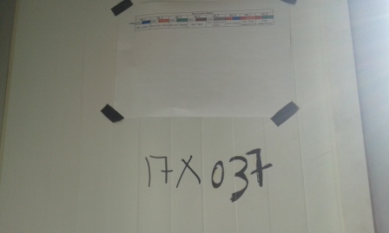
Site Identification
Paste the Picture here

Slide 4
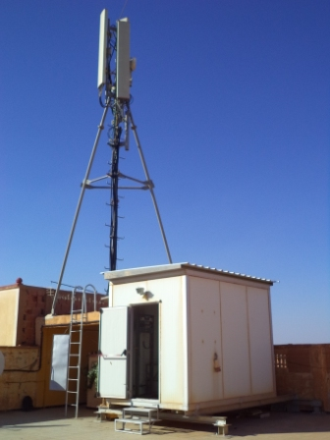
Site View outdoor
Paste the Picture here

Slide 5
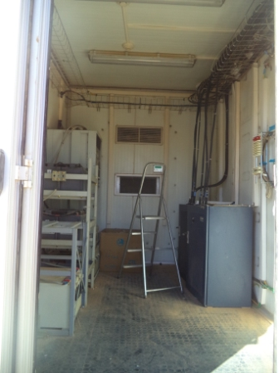
Site View indoor
Paste the Picture here

Slide 6
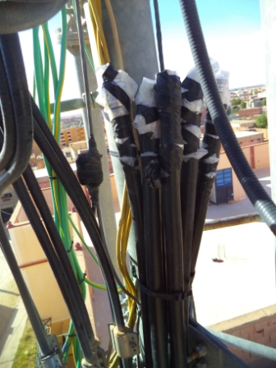
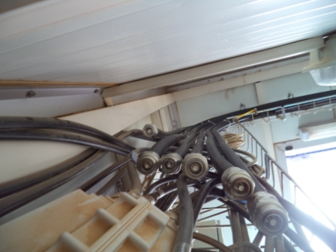
Conecteur

Slide 7
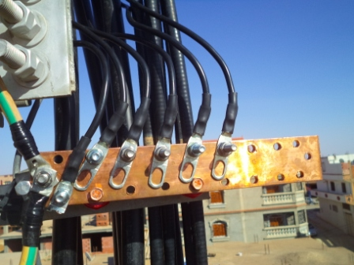
Barrette de terre

Slide 8
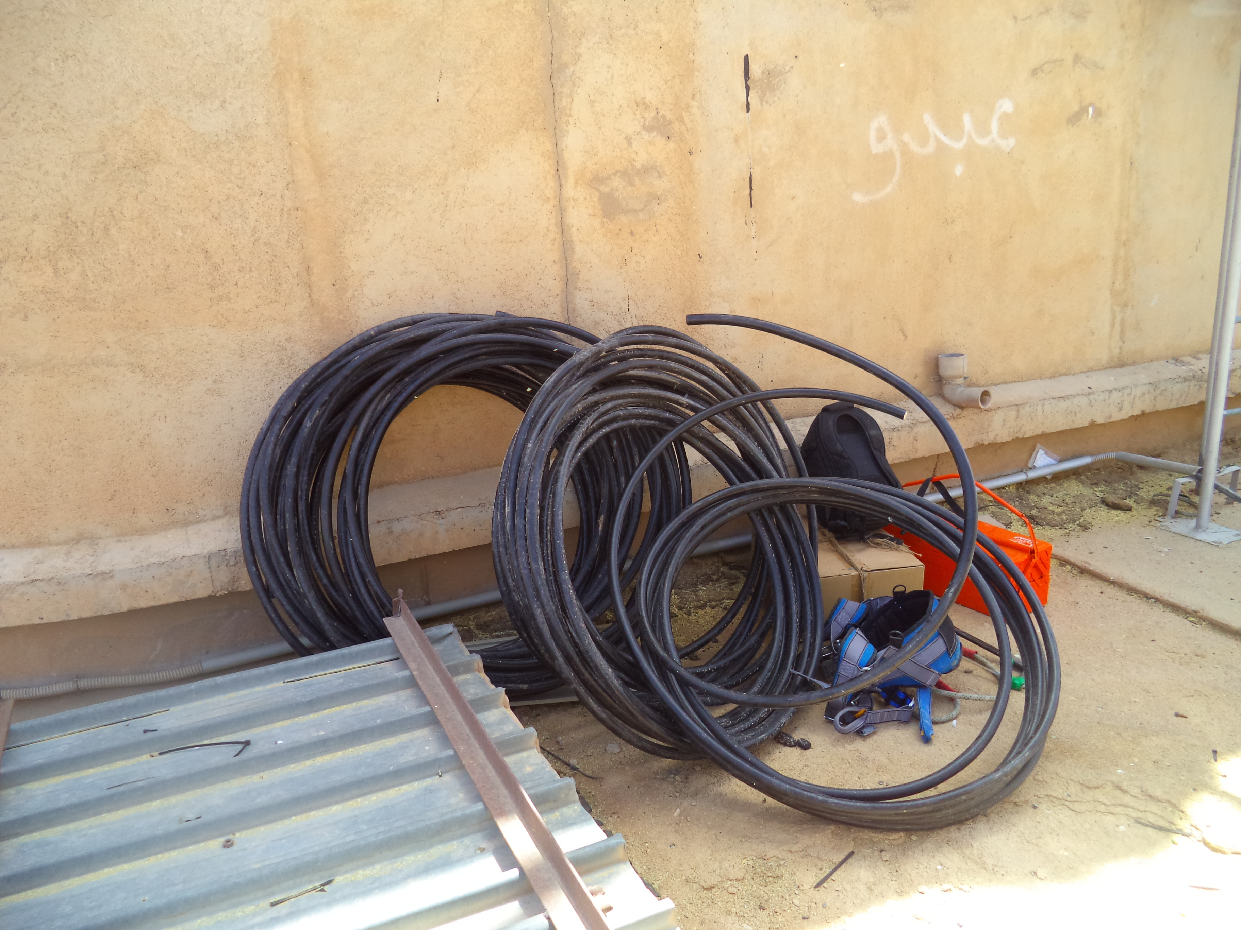
Equipments delivered
Paste the Picture here

Slide 9
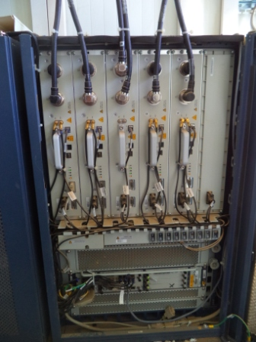
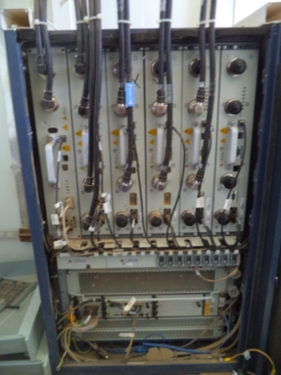
BTS Avant BTS après
Paste the Picture here
Notes:
Pas de clef de BTS sur site

Slide 10
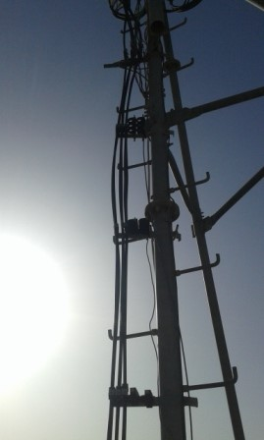
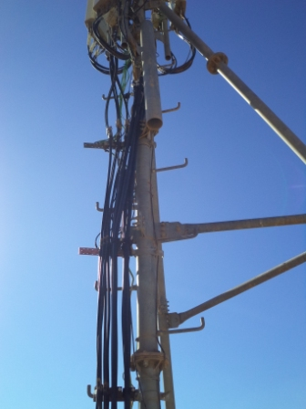
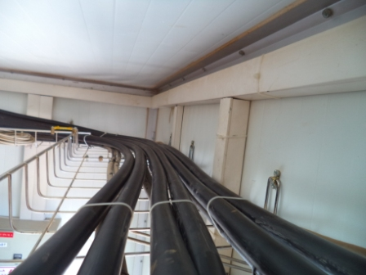
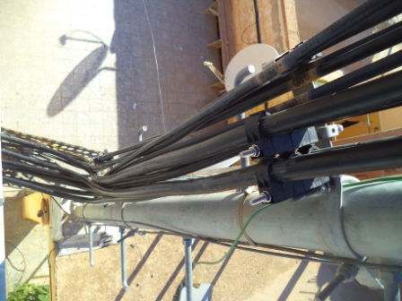
feeder
Paste the Picture here

Slide 11
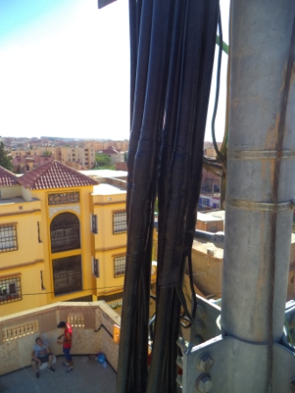
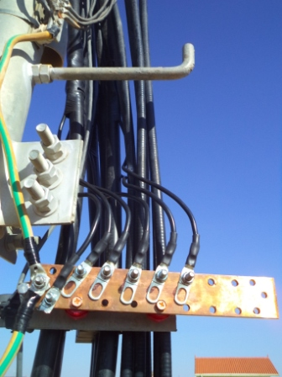
Kit de masse
Paste the Picture here
Notes:
Installation d’une nouvelle barrette

Slide 12
RSU
Paste the Picture here
Notes:
AJOUT DE DEUX RSU 082/1800

Slide 13
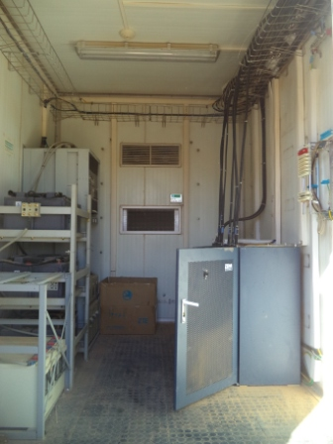
Cleanup
Paste the Picture here

Slide 14
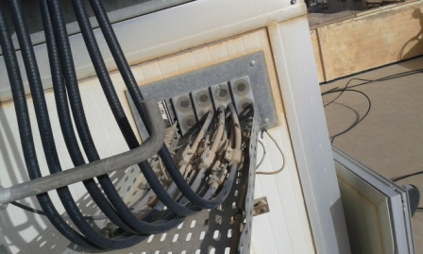
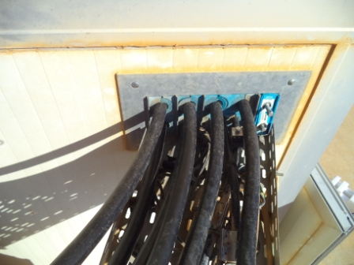
Feeder Window
Feeder Window Before Feeder Window After
Paste the Picture here

