Slide 1


OTA 4G Modernization Project
Site Photos
Subcontractor: MGNIC
Site ID: A17X063
Installation/Swap Date: 17/07/2016
Name: HAICHEUR HADJER
Department: Documentation (OTA Project)
Mail: haicheur.hadjer@zte.com.cn

Slide 2
Work Done ( Please to list bellow the work items done on the site)
HOUSSEM BELGHITH
MOHAMED NAZIM AFREDJ
MOHAMED OTHEMANI
RHAHLIA ZOHIR

Slide 3
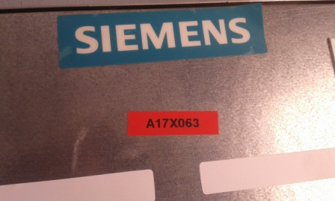
Site Identification
Paste the Picture here

Slide 4
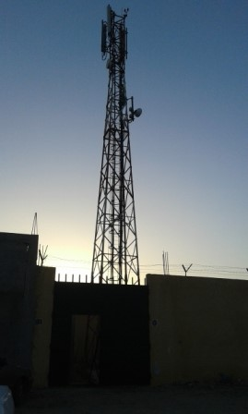
Site View outdoor
Paste the Picture here

Slide 5
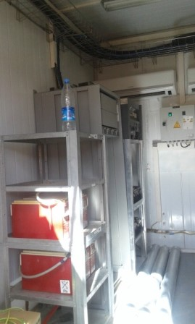
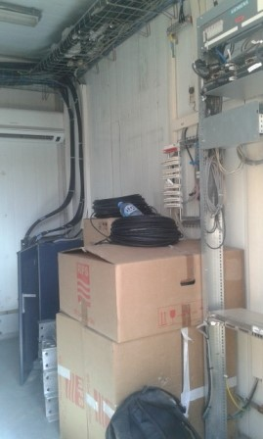
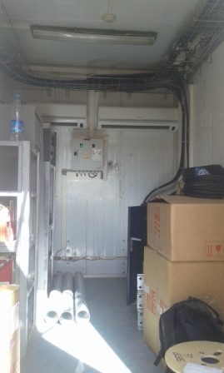
Site View Indoor
Paste the Picture here

Slide 6
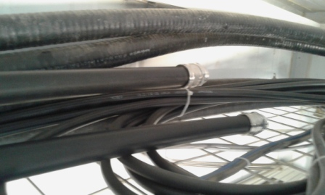
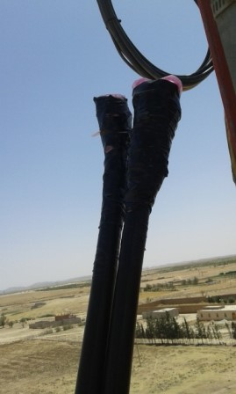
Conecteur indoor/outdoor

Slide 7
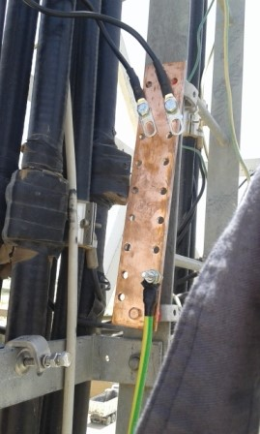
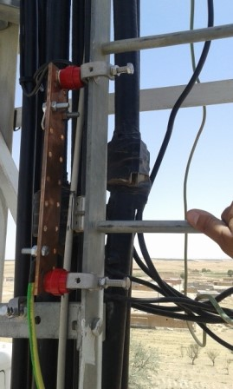
Barrette de terre

Slide 8
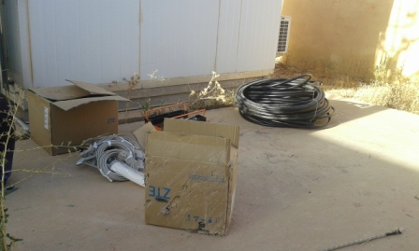
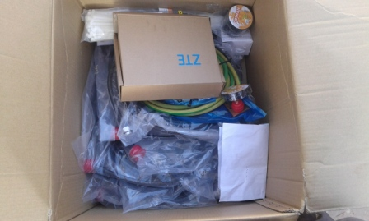
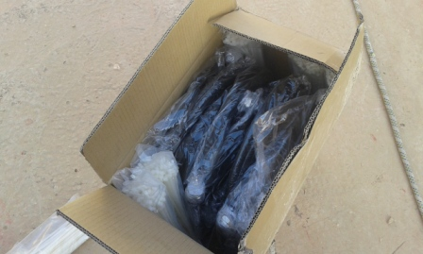
Equipments delivered
Paste the Picture here

Slide 9
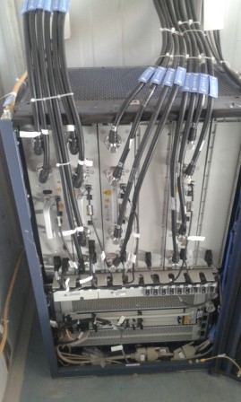
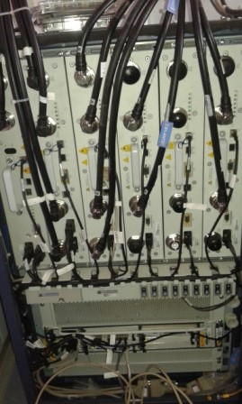
avant BTS apres
Paste the Picture here

Slide 10
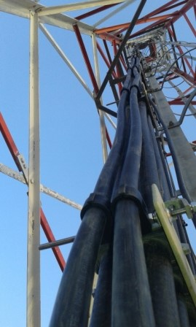
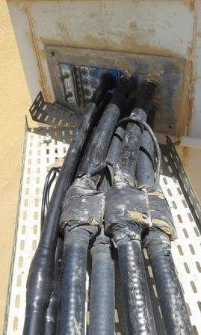
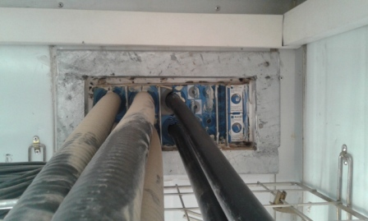
feeder
Paste the Picture here

Slide 11
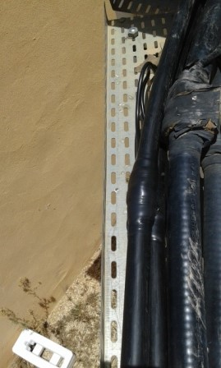
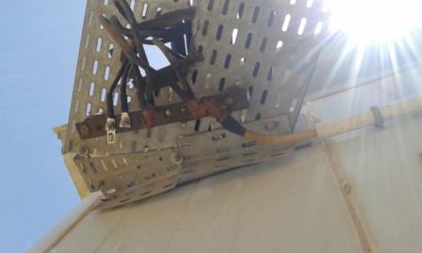
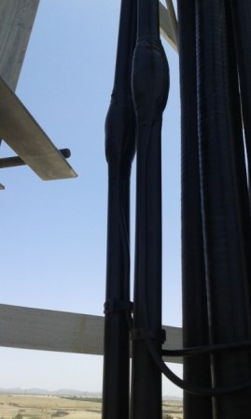
Kit de masse
Paste the Picture here
Notes:
Installation d’une nouvelle barrette

Slide 12
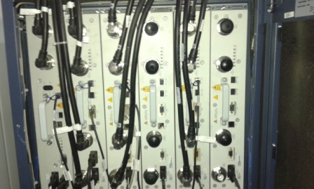
RSU
Paste the Picture here
Notes:
AJOUT DE DEUX RSU 082/1800

Slide 13
Cleanup
Paste the Picture here

Slide 14
Roxtec
Paste the Picture here

