Slide 1


OTA 4G Modernization Project
Site Photos
Subcontractor: MGNIC
Site ID: A17X117
Installation/Swap Date: 21/07/2016
Name: HAICHEUR HADJER
Department: Documentation (OTA Project)
Mail: haicheur.hadjer@zte.com.cn

Slide 2
Work Done ( Please to list bellow the work items done on the site)
HOUSSEM BELGHITH
MOHAMED NAZIM AFREDJ
MOHAMED OTHEMANI
RHAHLIA ZOHIR

Slide 3
Site Identification
A17X117

Slide 4
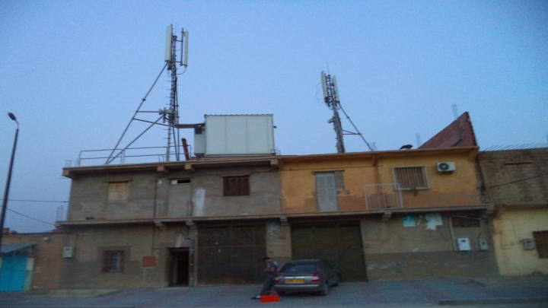
Site View outdoor
Paste the Picture here

Slide 5
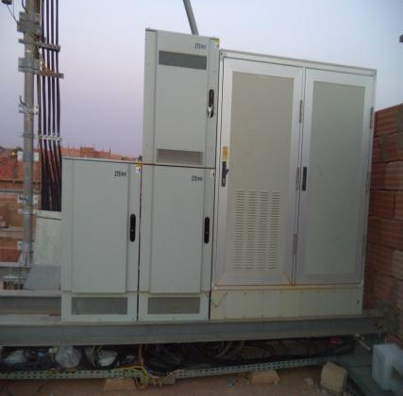
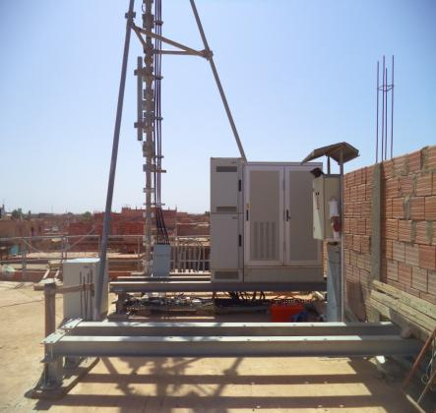
Site View outdoor
Paste the Picture here

Slide 6
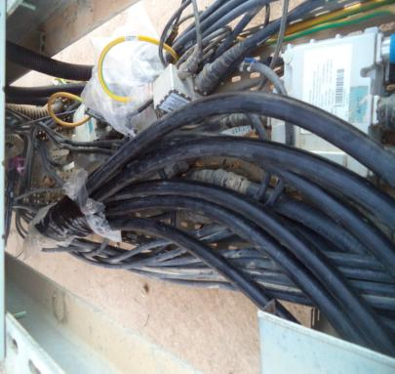
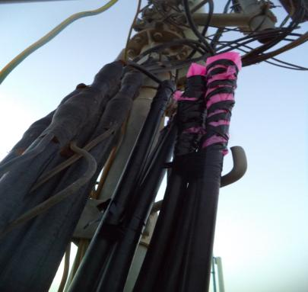
Conecteur

Slide 7
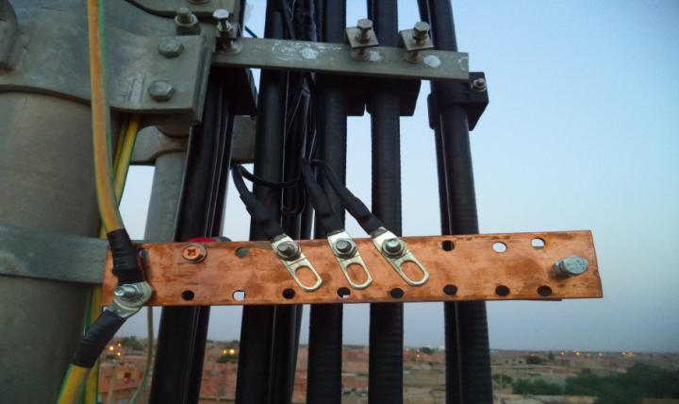
Barrette de terre
Notes:
Aajout nouvelle barette

Slide 8
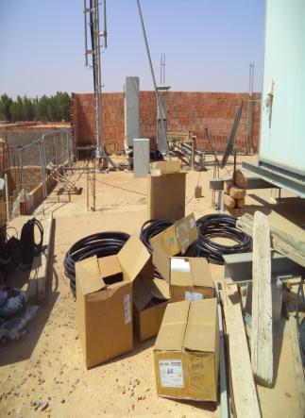
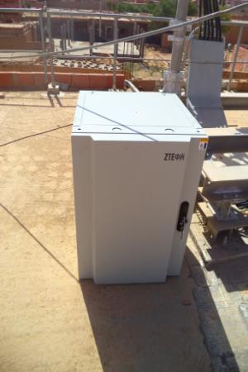
Equipments delivered
Paste the Picture here

Slide 9
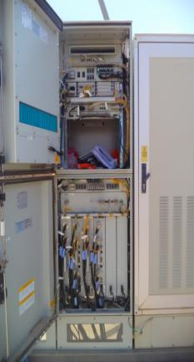
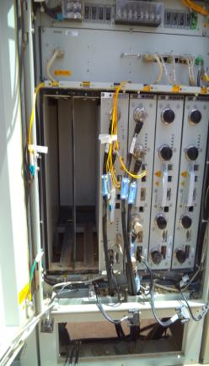
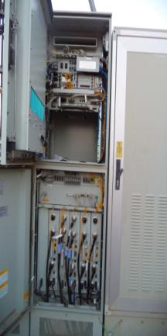
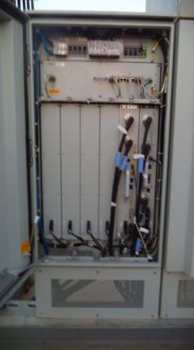
Avant BTS apres
Paste the Picture here
Notes:
Swap deux RSU et ajout de troi nouveau RSU

Slide 10
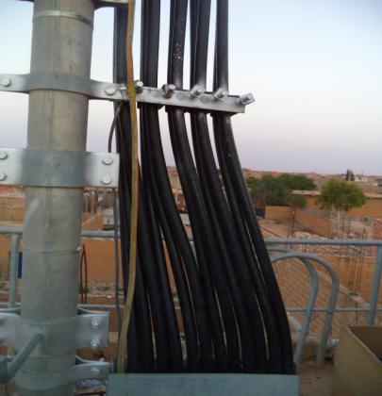
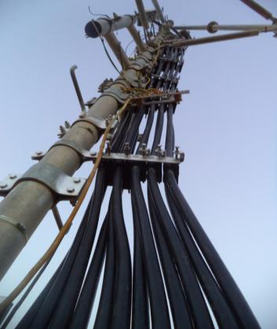
feeder
Paste the Picture here

Slide 11
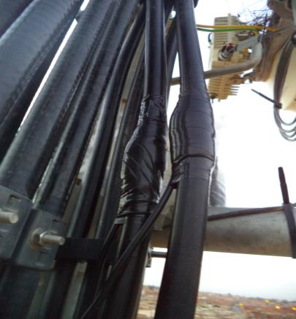
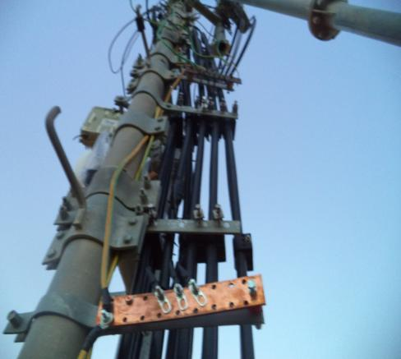
Kit de masse
Paste the Picture here
Notes:
Installation d’une nouvelle barrette

Slide 12
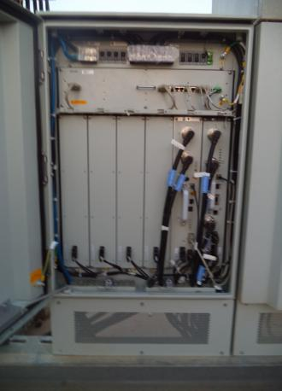
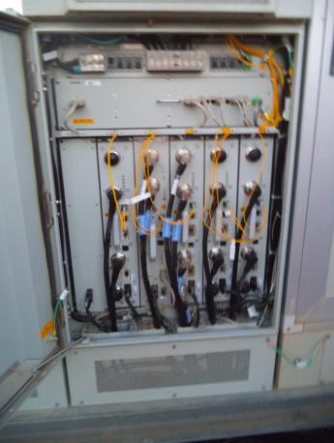
RSU
Paste the Picture here

Slide 13
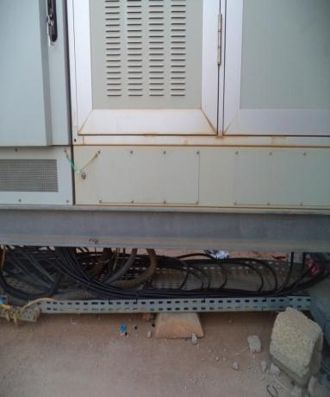
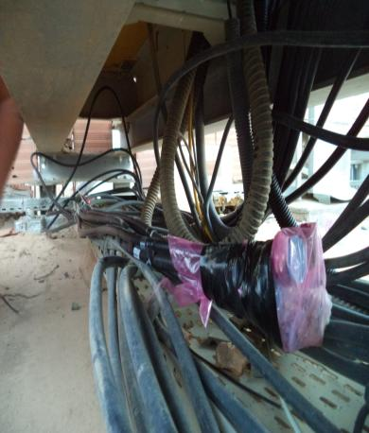
outdoor Jumpers + label
Paste the Picture here

Slide 14
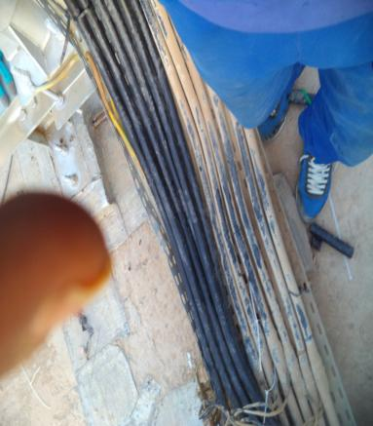
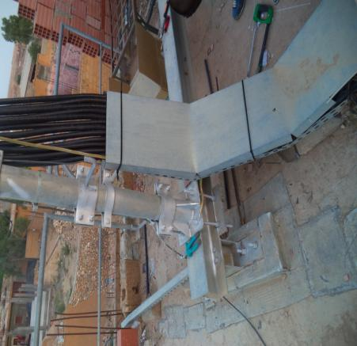
Cable Tray
Paste the Picture here

Slide 15
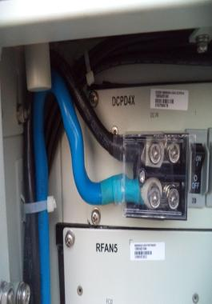
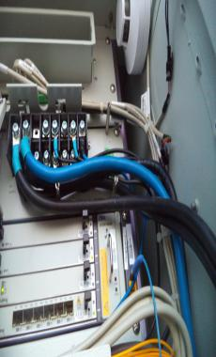
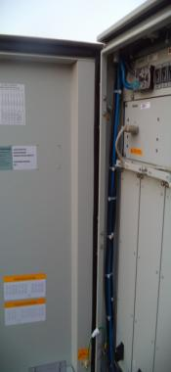
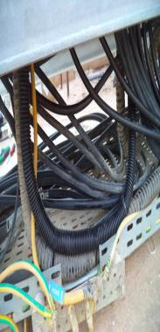
Power
Paste the Picture here

Slide 16
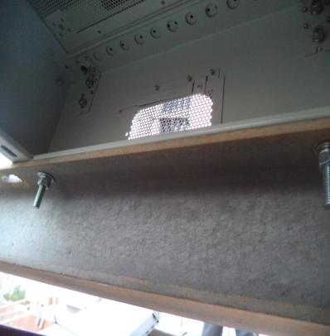
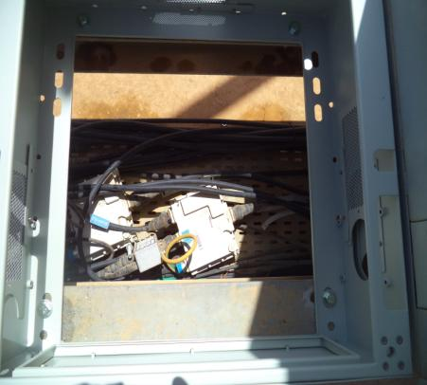
BTS/NodeB Cabinet fixation
Paste the Picture here

