Slide 1

Antenna Swap Report
Project Name: | Ooredoo Algeria LTE Project
Site Code: | AL6231
Site Name: | KIRIA
Site Engineer | MOHAMED RHAHLIA
Subcontractor: | MGNIC
Operation Date: | 11/08/2016

Slide 2
Antenna Swap Report
Site ID | Sector | Old Antenna Type/SN | New Antenna Type/SN | Azimut (°) | HBA (m) from beginning of tower | M-Tilt |  | E-Tilt_900M |  | E-Tilt_1800M |  | E-Tilt_2100M
 |  |  |  |  |  | Before | After | Before | After | Before | After | Before | After
AL6231 | A | CVVPX310R/SN:12CN104023279 | 15CN101859159 | 20 | 6 | 0 | 0 | 5 | 5 | 4 | 4 | 5 | 5
 | B | CVVPX310R//SN:12CN104033866 | 15CN102131970 | 160 | 4 | 0 | 0 | 5 | 5 | 7 | 7 | 5 | 5
 | C | CVVPX310R//SN:12CN104012308 | 15CN102131959 | 240 | 6 | 0 | 0 | 6 | 6 | 5 | 5 | 6 | 6

Slide 3
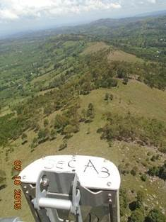
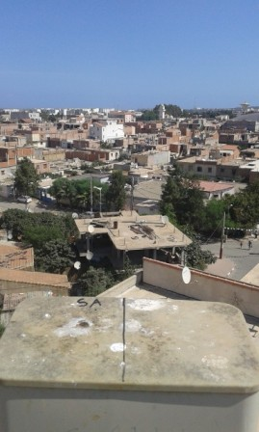
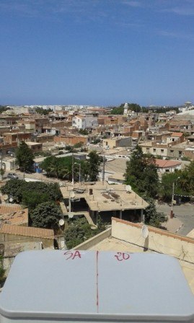
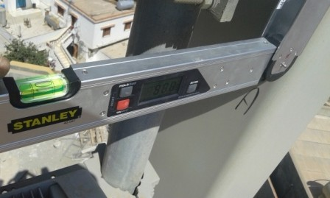
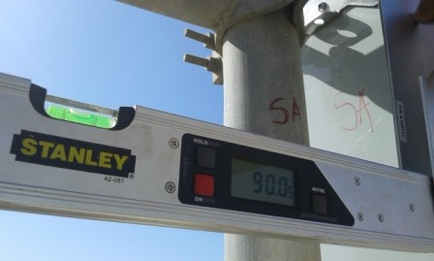
Sector A Antenna Swap
Before swap azimuth( 20°) |  | After swap azimuth( 20 °)
Before swap Mechanical Tilt( 0 °) |  | After swap Mechanical Tilt( 0°)

Slide 4
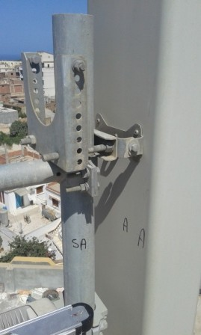
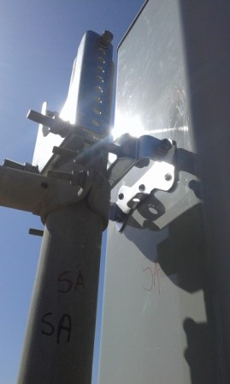
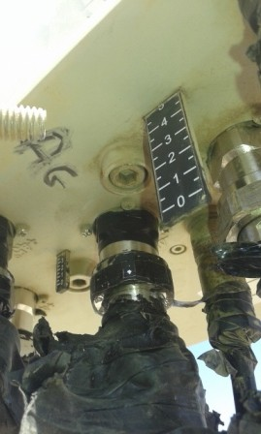
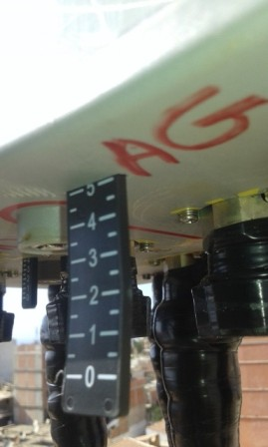
Sector A Antenna Swap
Before swap Mechanical Tilt( 0 °) |  | After swap Mechanical Tilt( 0 °)
Before swap 900M Electric Tilt( 5 °) |  | After swap 900M Electric Tilt 5°)

Slide 5
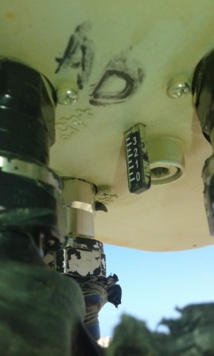
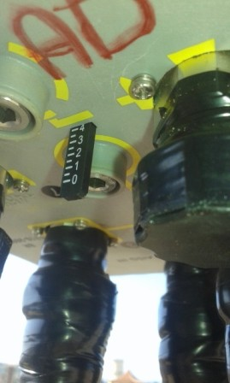
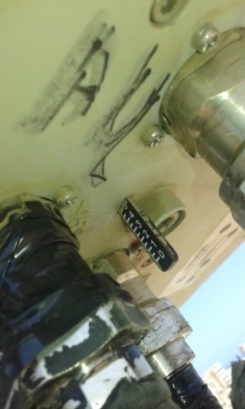
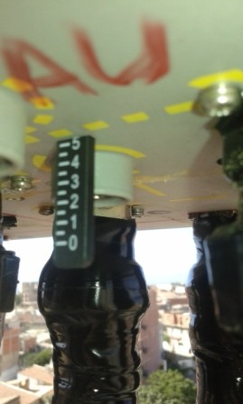
Sector A Antenna Swap
Before swap 1800M Electric Tilt( 4°) |  | After swap 1800M Electric Tilt( 4 °)
Before swap 2100M Electric Tilt( 5 °) |  | After swap 2100M Electric Tilt( 5 °)

Slide 6
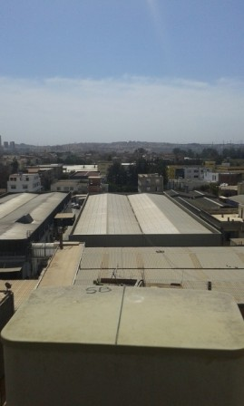
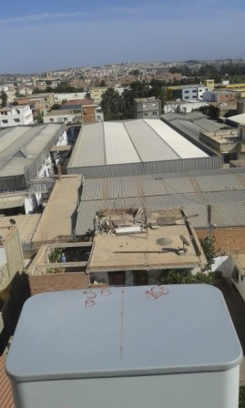
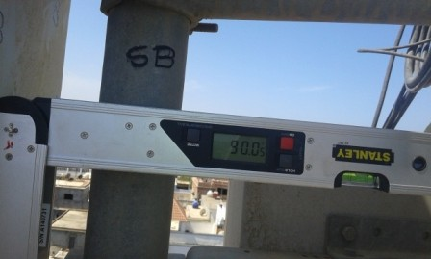
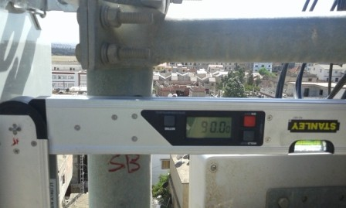
Sector B Antenna Swap
Before swap azimuth( 160 °) |  | After swap azimuth( 160 °)
Before swap Mechanical Tilt( °) |  | After swap Mechanical Tilt( 0 °)

Slide 7
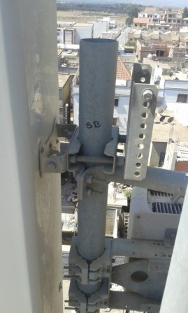
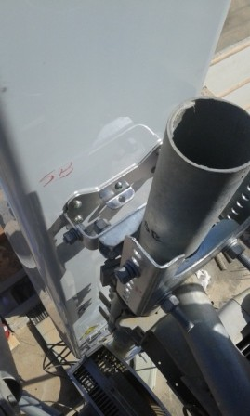
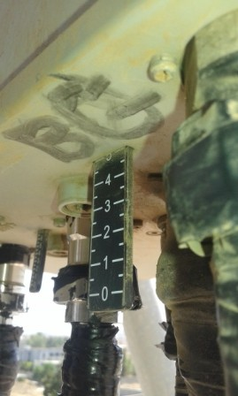
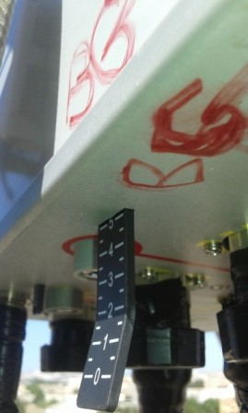
Sector B Antenna Swap
Before swap Mechanical Tilt( 0°) |  | After swap Mechanical Tilt( 0°)
Before swap 900M Electric Tilt( 5°) |  | After swap 900M Electric Tilt( 5 °)

Slide 8
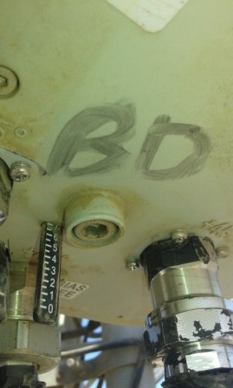
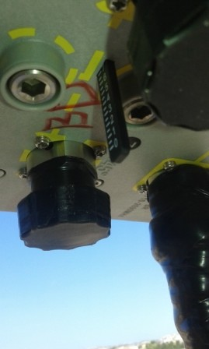
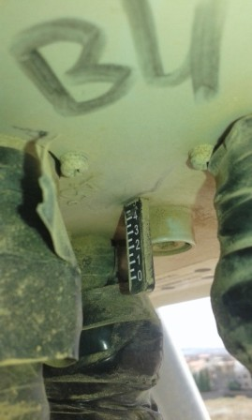
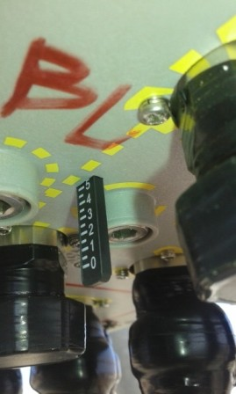
Sector B Antenna Swap
Before swap 1800M Electric Tilt( 7 °) |  | After swap 1800M Electric Tilt( 7°)
Before swap 2100M Electric Tilt( 5°) |  | After swap 2100M Electric Tilt( 5 °)

Slide 9
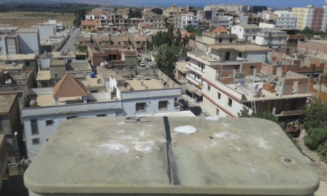
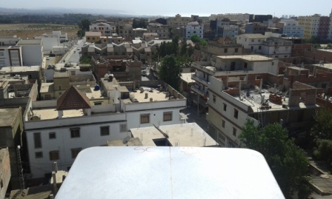
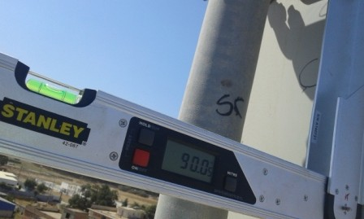
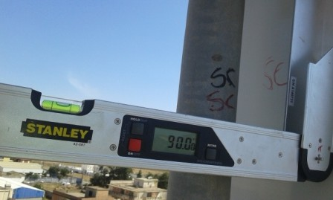
Sector C Antenna Swap
Before swap azimuth( 240°) |  | After swap azimuth( 240 °)
Before swap Mechanical Tilt( 0 °) |  | After swap Mechanical Tilt( 0°)

Slide 10
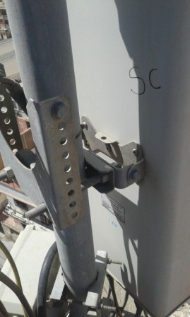
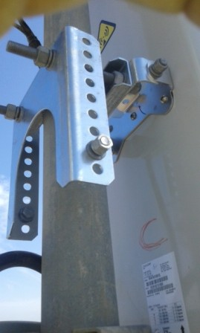
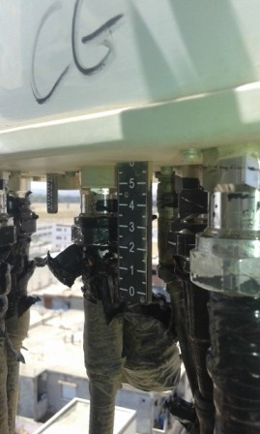
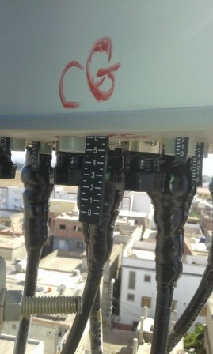
Sector C Antenna Swap
Before swap Mechanical Tilt( 0 °) |  | After swap Mechanical Tilt( °)
Before swap 900M Electric Tilt( 6 °) |  | After swap 900M Electric Tilt( 6 °)

Slide 11
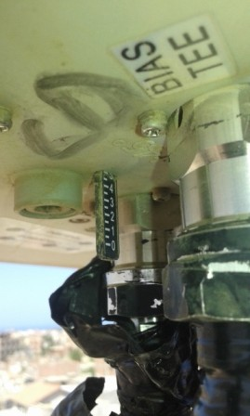
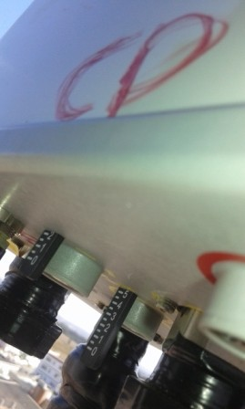
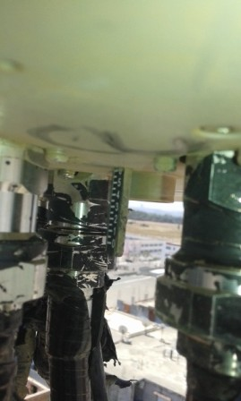
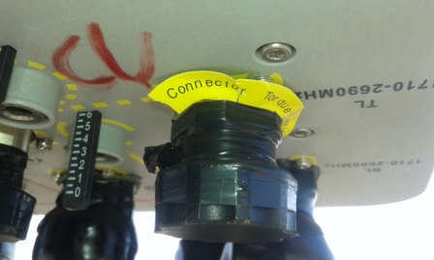
Sector C Antenna Swap
Before swap 1800M Electric Tilt( 5 °) |  | After swap 1800M Electric Tilt( 5°)
Before swap 2100M Electric Tilt( 6°) |  | After swap 2100M Electric Tilt( 6 °)

Slide 12
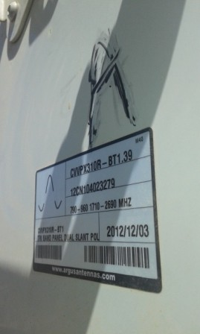
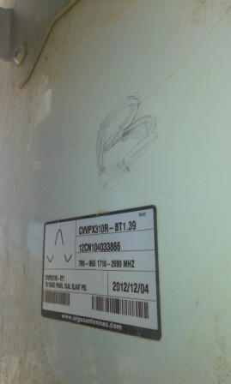
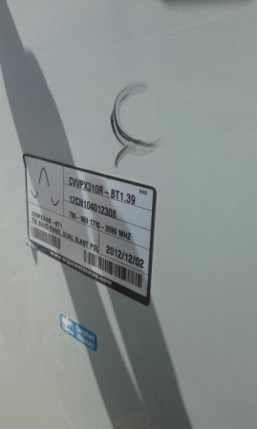
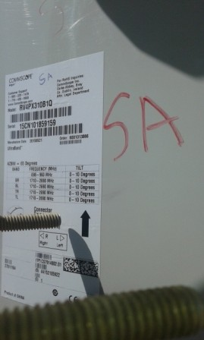
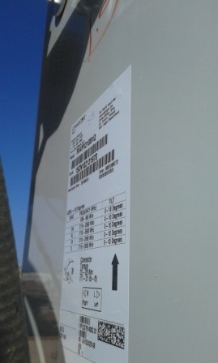
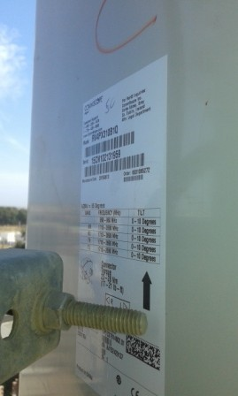
Antenna Type and SN
Sector A Before | Sector B Before | Sector C Before
Sector A After | Sector B After | Sector C After

Slide 13
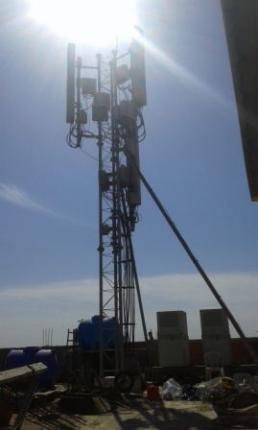
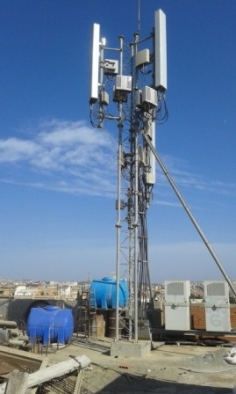
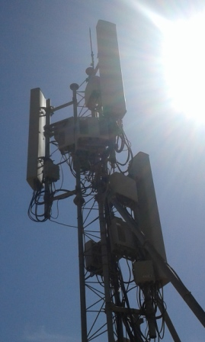
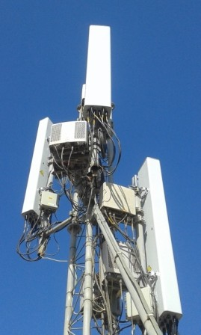
Site Clean Up
Before Swap | After Swap
Site General View
Before Swap | After Swap

Slide 14
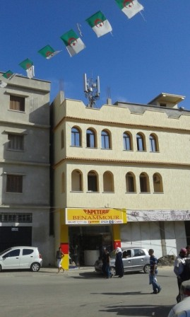
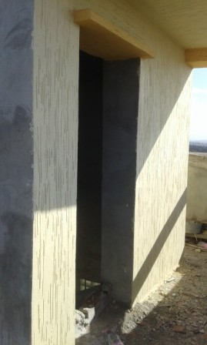
Site Access

Slide 15
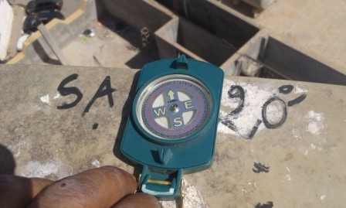



SectorA Before swap azimuth( 20°) |  | SectorA after swap azimuth( 20°)
SectorB Before swap azimuth( 160°) |  | SectorB after swap azimuth( 160 °)

Slide 16


Sector C Before swap azimuth |  | Sector C after swap azimuth

Slide 17

Antenna Pole Sector A

Slide 18

Antenna Pole Sector B

Slide 19

Antenna Pole Sector C

Slide 20
THE END

