Slide 1


OTA 2G&3G Modernization Project
Site Photos
Subcontractor: MGNIC
Site ID: O13X131
Installation/Swap Date: 18/06/2016
Name: HAICHEUR HADJER
Department: Documentation (OTA Project)
Mail: haicheur.hadjer@zte.com.cn

Slide 2
Work Done ( Please to list bellow the work items done on the site)
Site view outdoor
Equipments delivred
Not B Cabinet
Power Suplly
Rack battery
Install les antennes
Grounding
Labeling Indoor/Outdoor
Desintall ancien site O13X131
Desintalles les 3 antenns
View Genrale after
….

Slide 3
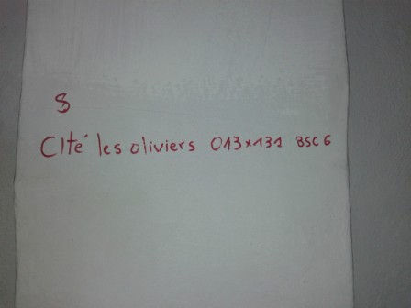
Site Identification
Paste the Picture here

Slide 4
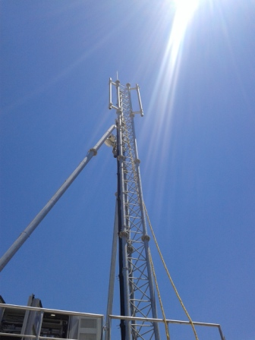
Site View outdoor
Paste the Picture here

Slide 5
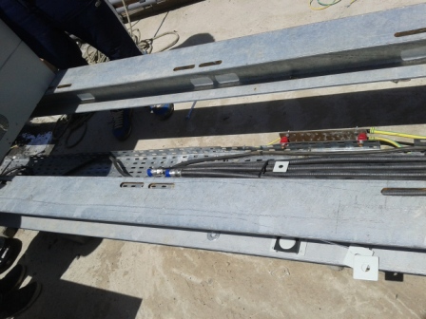
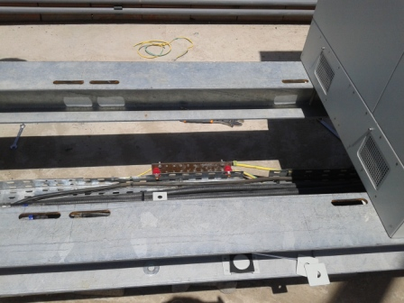
Site View outdoor
Paste the Picture here

Slide 6
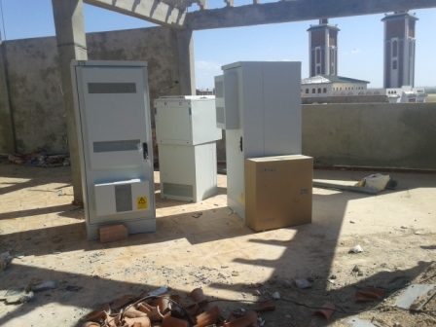
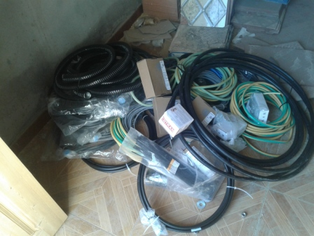
Equipments delivered
Paste the Picture here

Slide 7
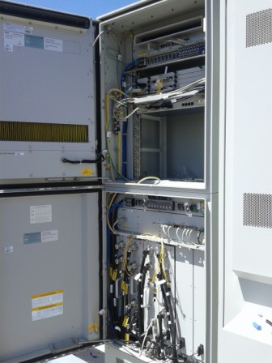
Node B Cabinet
Paste the Picture here

Slide 8
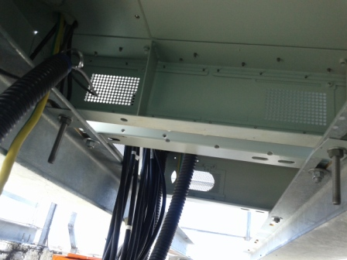
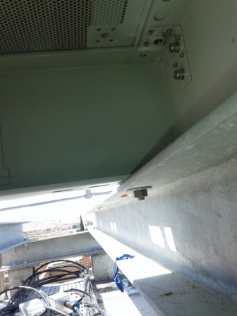
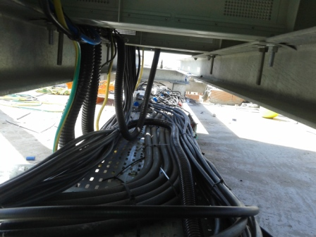
Node B Cabinet fixation
Paste the Picture here

Slide 9
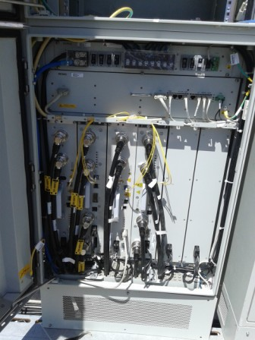
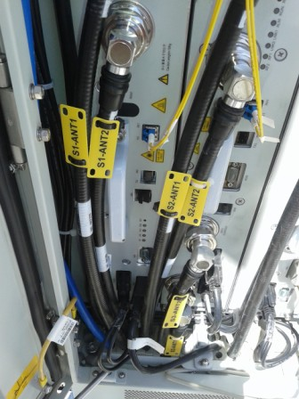
Indoor Jumpers + label
Paste the Picture here

Slide 10
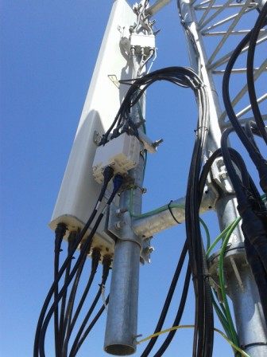
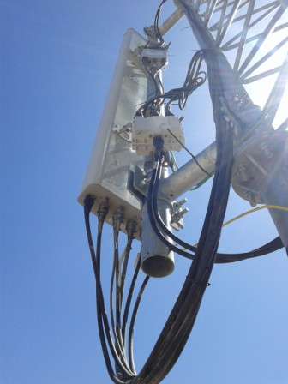
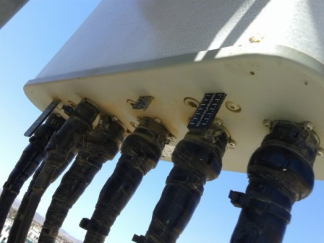
Outdoor Jumpers
Paste the Picture here

Slide 11
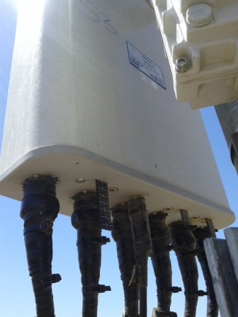
Outdoor Jumpers
Paste the Picture here

Slide 12
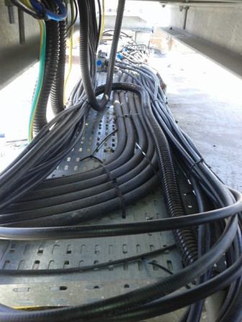
Cable Tray
Paste the Picture here

Slide 13
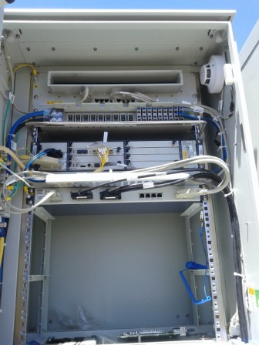
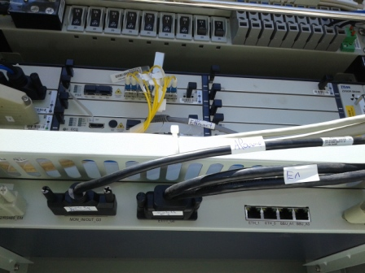
BBU (Connectivity and labeling)
Paste the Picture here

Slide 14
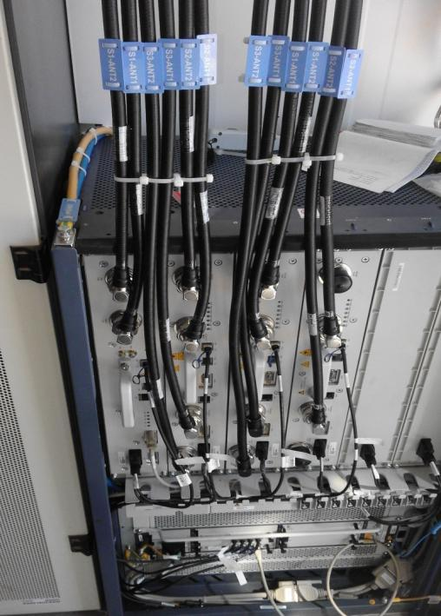
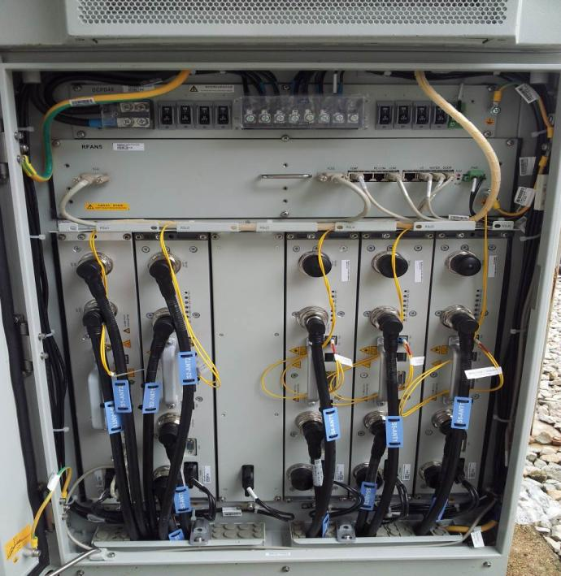
RSU/RRU
Paste the Picture here

Slide 15
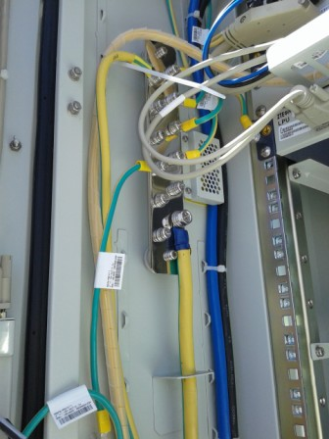
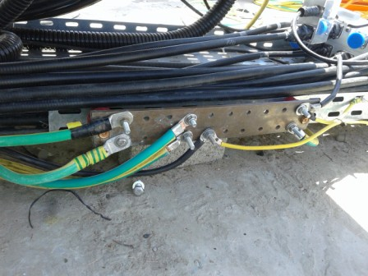
Grounding / Grounding Bar (Indoor and/or Outdoor)
Paste the Picture here

Slide 16
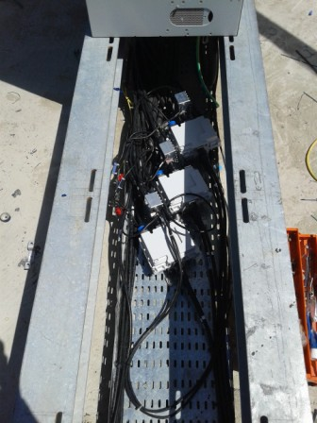
Triplexer

Slide 17
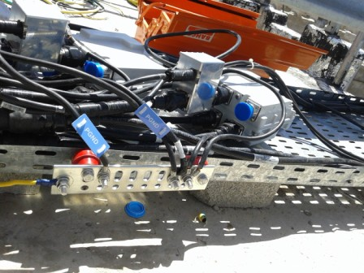
Grounding / Grounding Bar (Outdoor)
Paste the Picture here

Slide 18
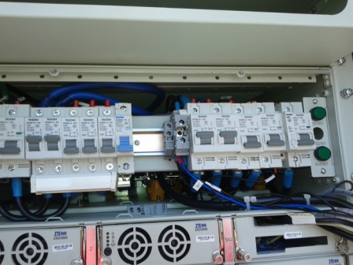
DC Breaker
Paste the Picture here

Slide 19
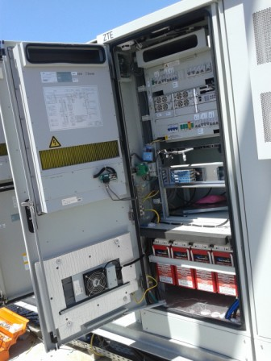
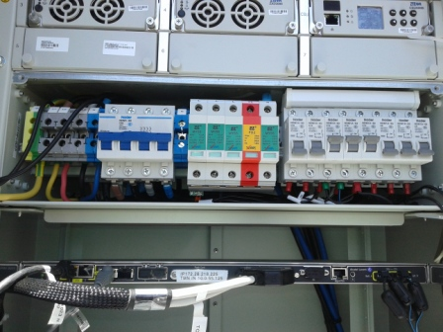
Power Supply
Paste the Picture here

Slide 20
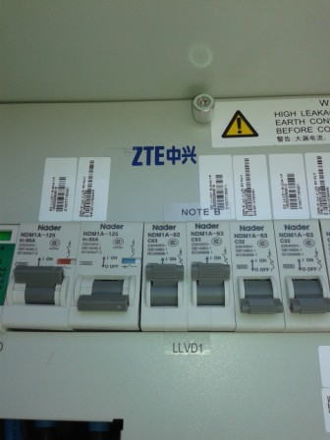
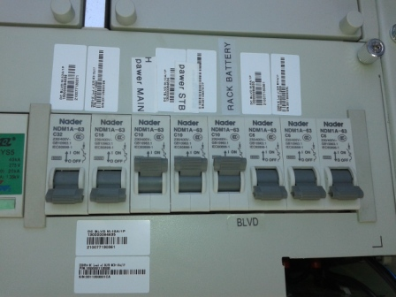
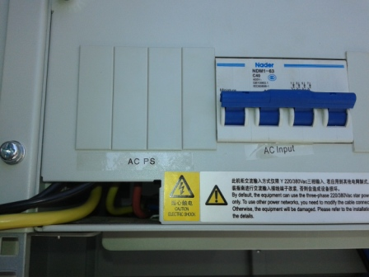
Power Supply labeling

Slide 21
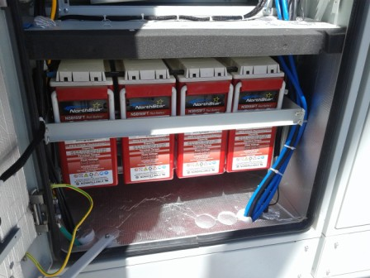
Batteries Power Suplly
Paste the Picture here

Slide 22
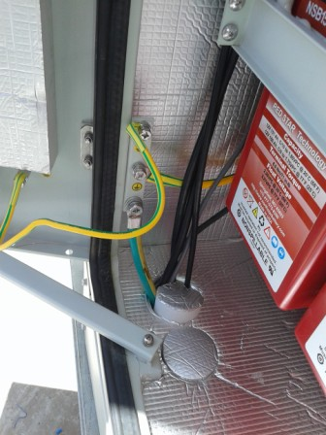
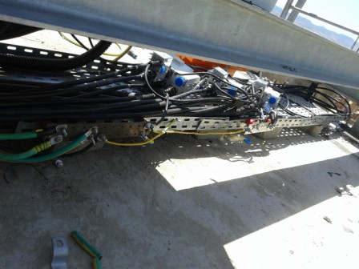
Grounding Power Suplly

Slide 23
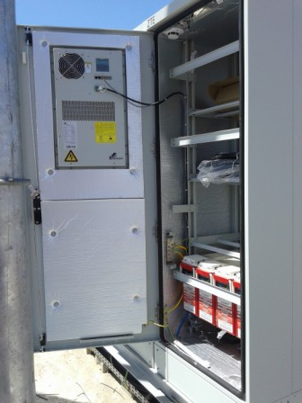
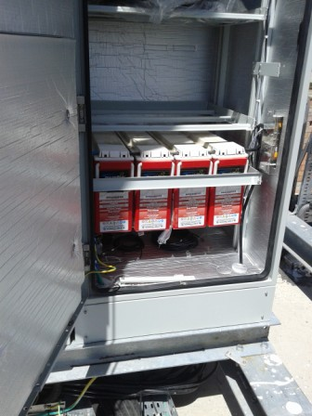
Rack Battery

Slide 24
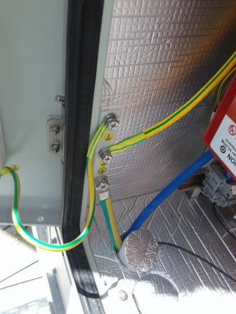
Grounding Rack Battery

Slide 25
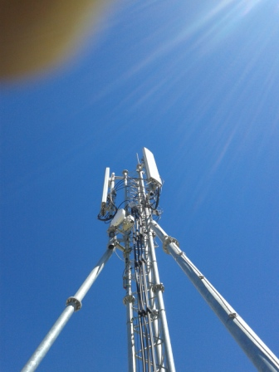
Antennas
Paste the Picture here

Slide 26
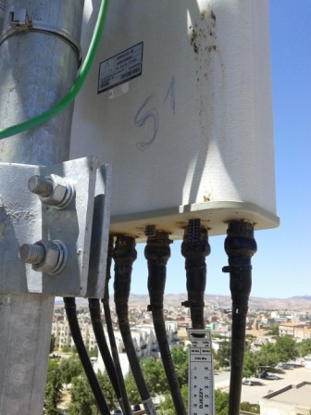
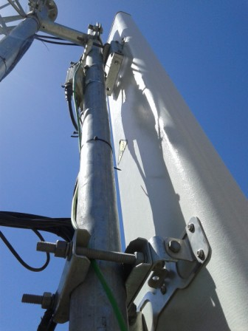
Antenna Sector 1 (Feeder,Waterproofing,label)
Paste the Picture here

Slide 27
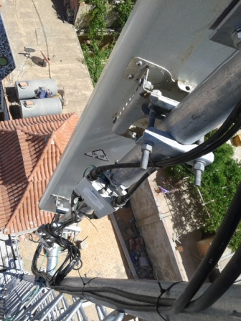
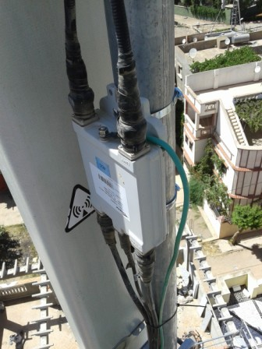
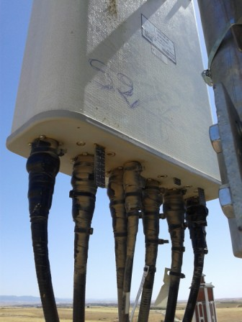
Antenna Sector 2(Feeder,Waterproofing,label)
Paste the Picture here

Slide 28
Antenna Sector 3(Feeder,Waterproofing,label)
Paste the Picture here

Slide 29
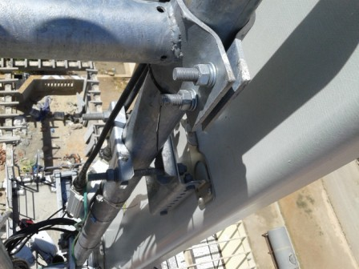
Antenna Bracket
Paste the Picture here

Slide 30
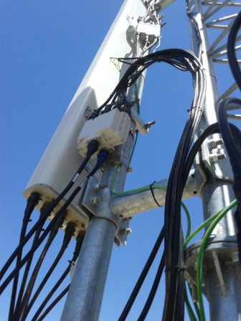
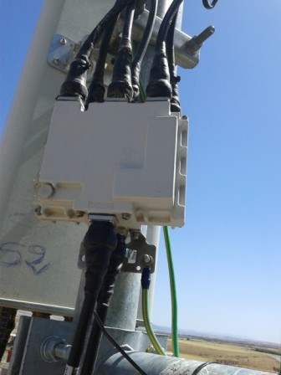
Triplexer S1 S2 S3(Waterproofing+Label)
Paste the Picture here

Slide 31
TMA
Paste the Picture here

Slide 32
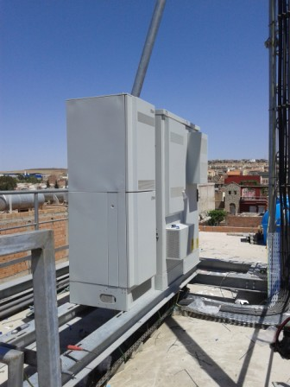
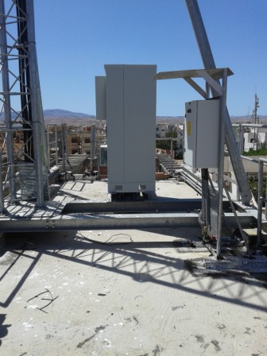
Cleanup
Paste the Picture here

Slide 33
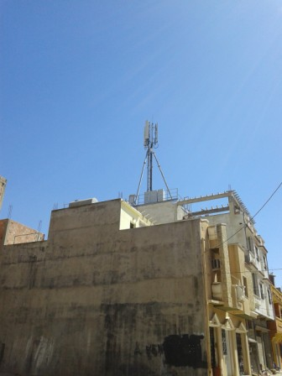
View Génarale
Paste the Picture here

Slide 34
Site Identification

Slide 35
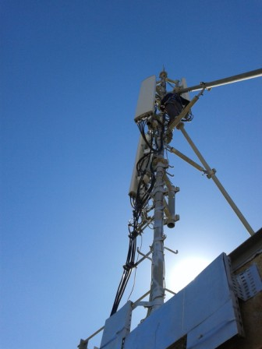

Genarale View After

Slide 36


Site View Indoor

Slide 37

Power SUPLLY

Slide 38

TGBT

Slide 39


Genarale View Before
Notes:
L’état des antennes après les désintalles

Slide 40

View Genarele after

Slide 41
Notes:
Les antennes sont desinstallés d’un autre site avec le même code site O13X131

