Slide 1
INSTALLATION O22X116

Slide 2
AVANT CLEAN UP

Slide 3
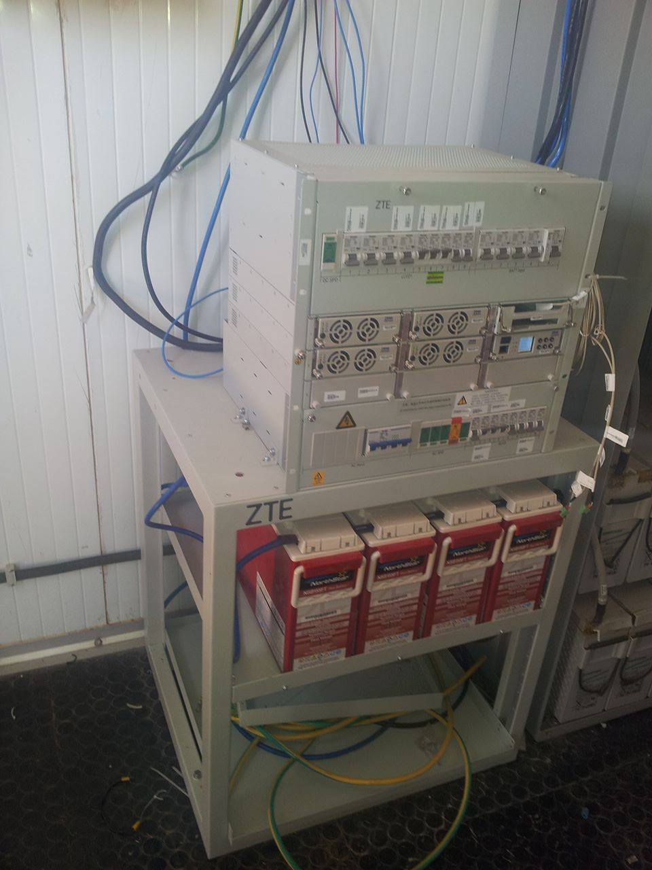

Slide 4
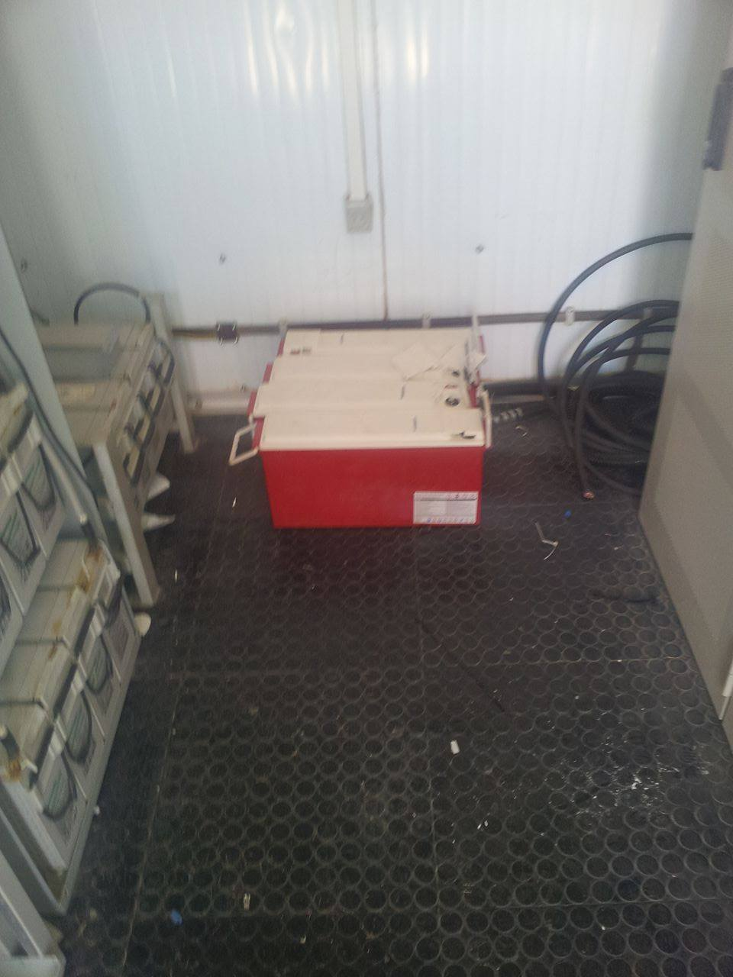

Slide 5
APRES CLEAN UP

Slide 6
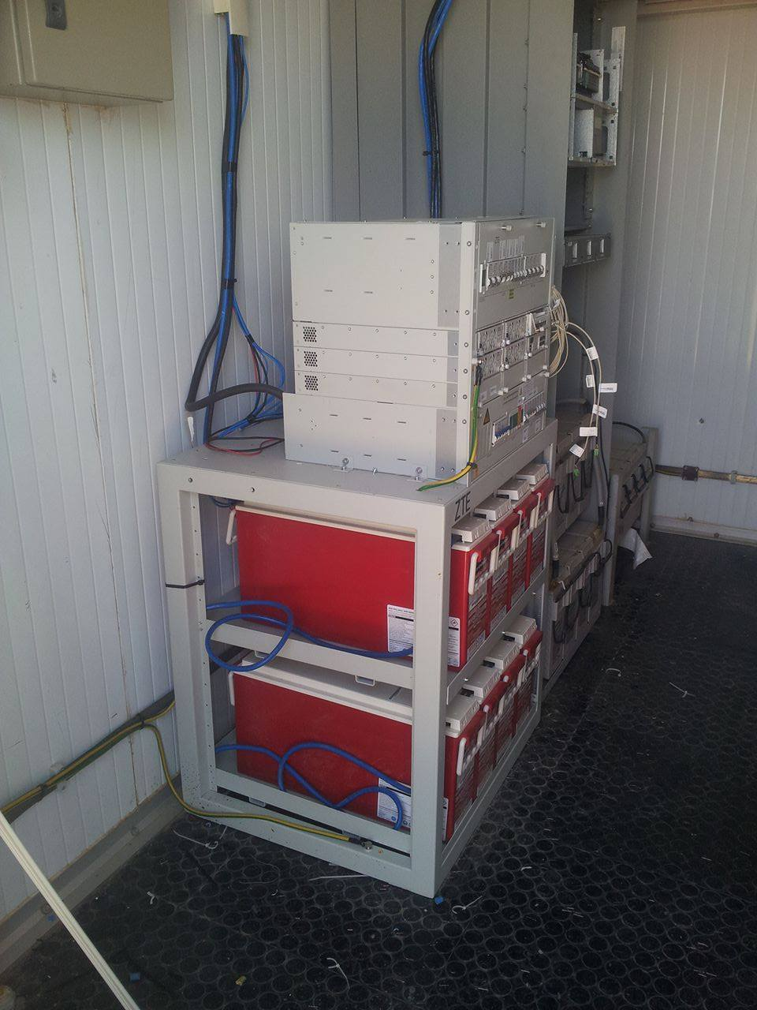

Slide 7
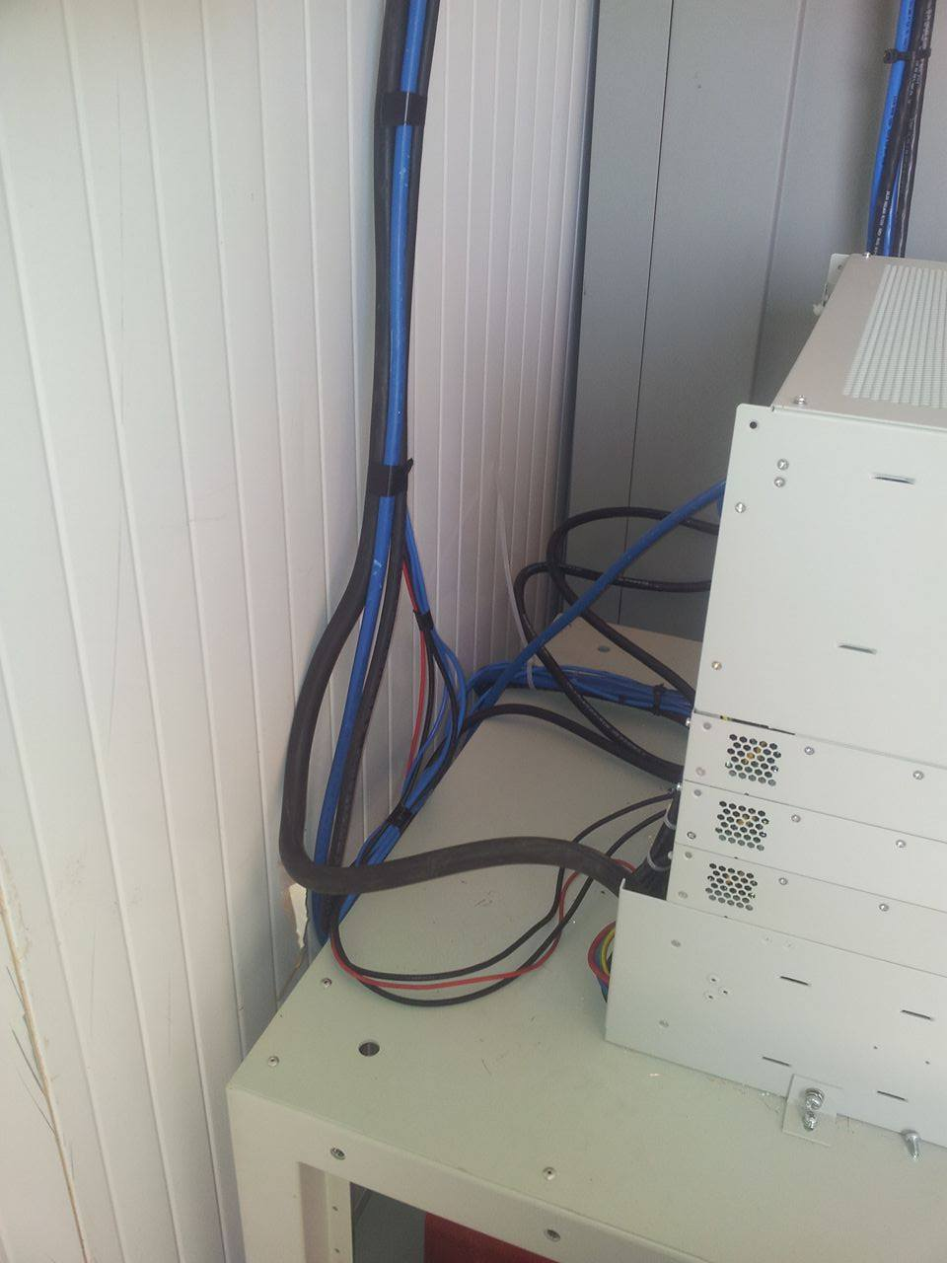

Slide 8
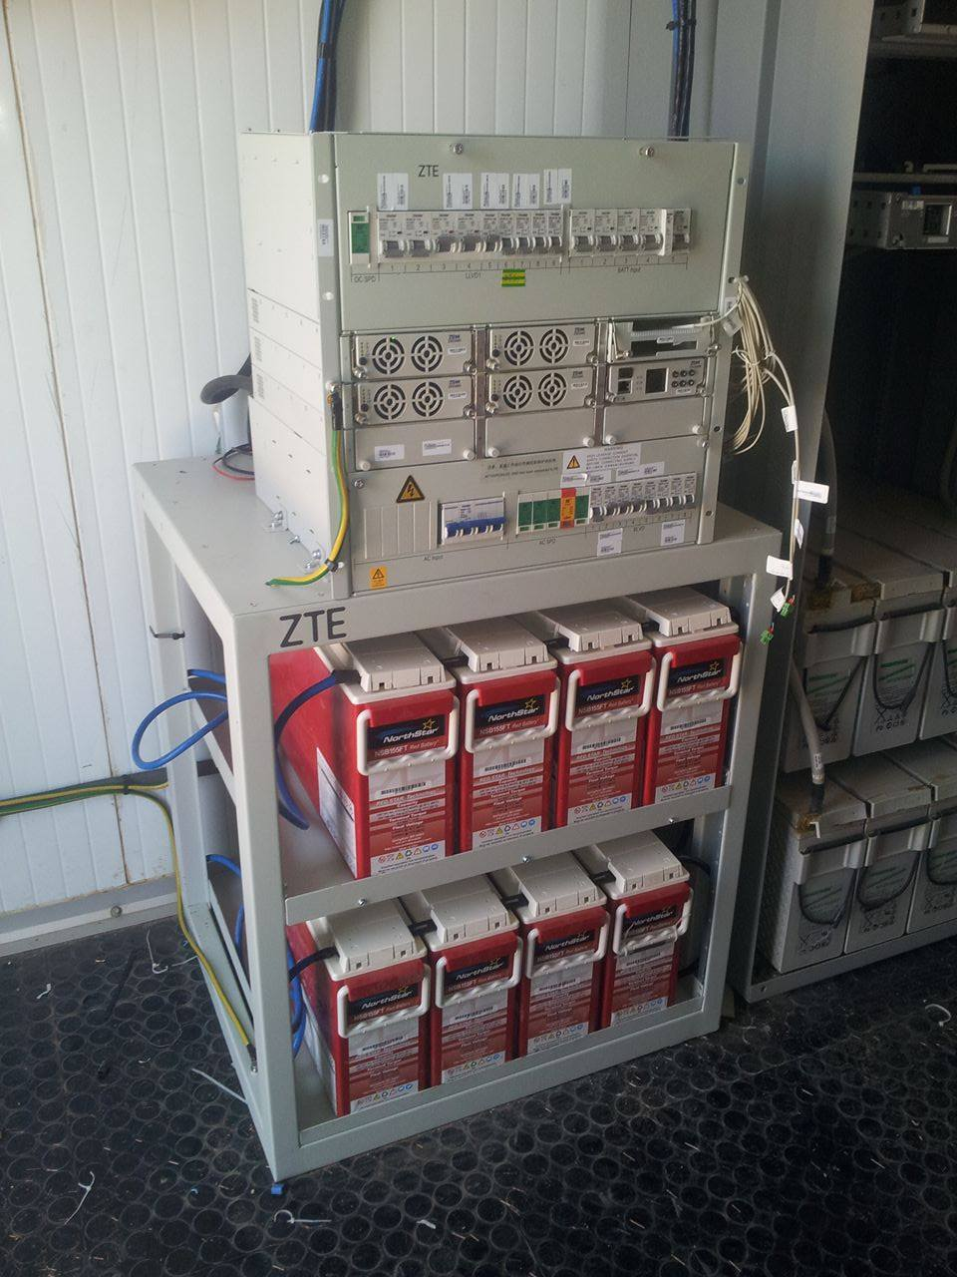

Slide 9
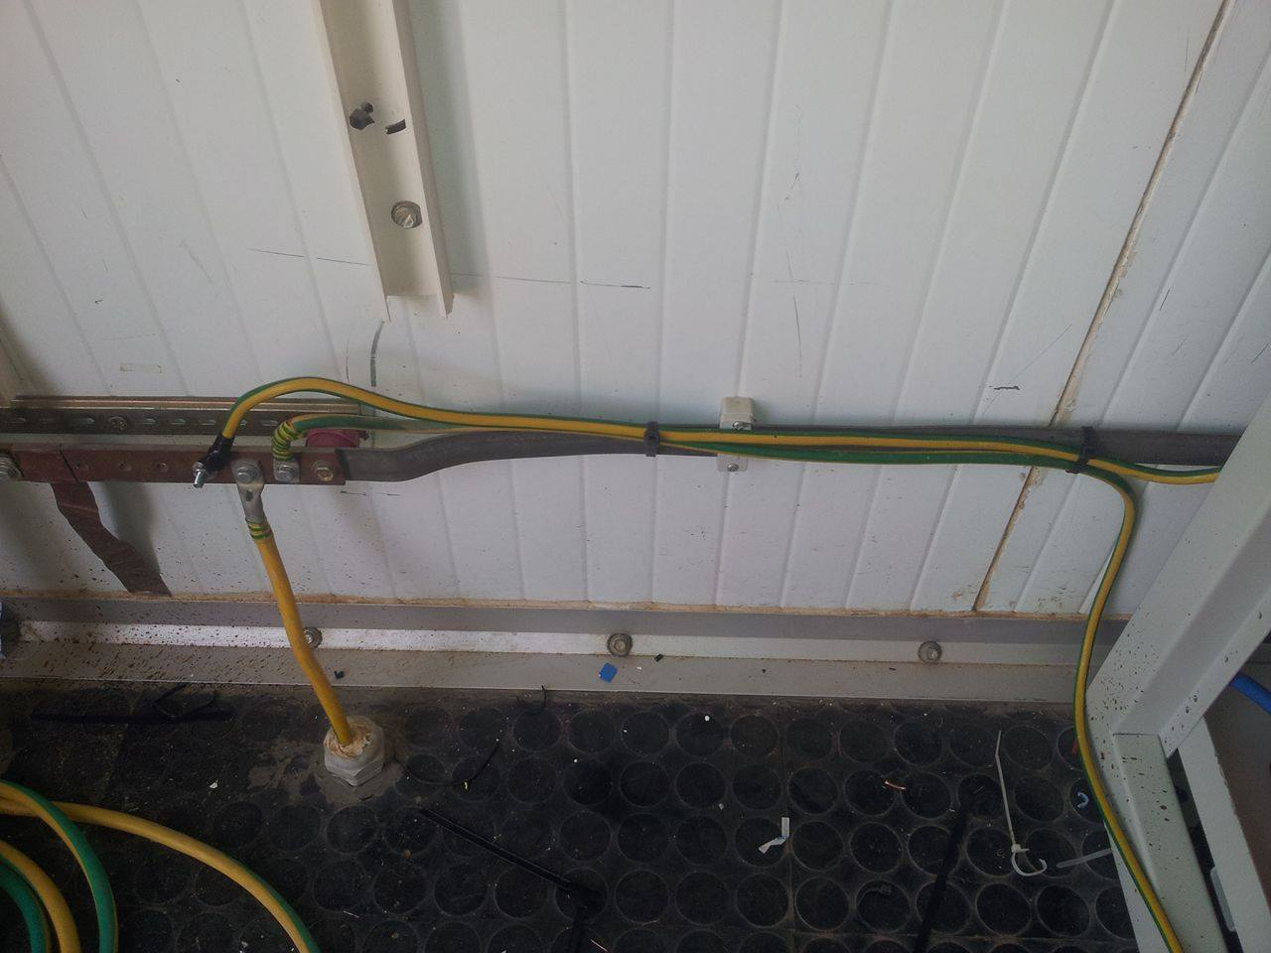

Slide 12
