Slide 1


OTA 2G&3G Modernization Project
Site Photos
Subcontractor: MGNIC
Site ID: C05X229
Installation/Swap Date: 19/06/2016
Name: HAICHEUR HADJER
Department: Documentation (OTA Project)
Mail: haicheur.hadjer@zte.com.cn

Slide 2
Work Done ( Please to list bellow the work items done on the site)
Site View outdoor
BTS/NodeB Cabinet
BTS/NodeB Cabinet fixation .
Indoor Jumpers + label
Outdoor Jumpers
Cable Tray
BBU (Connectivity and labeling)
RSU/RRU
PROTECTION
Grounding / Grounding Bar (Indoor and/or Outdoor).
Cleanup
….

Slide 3
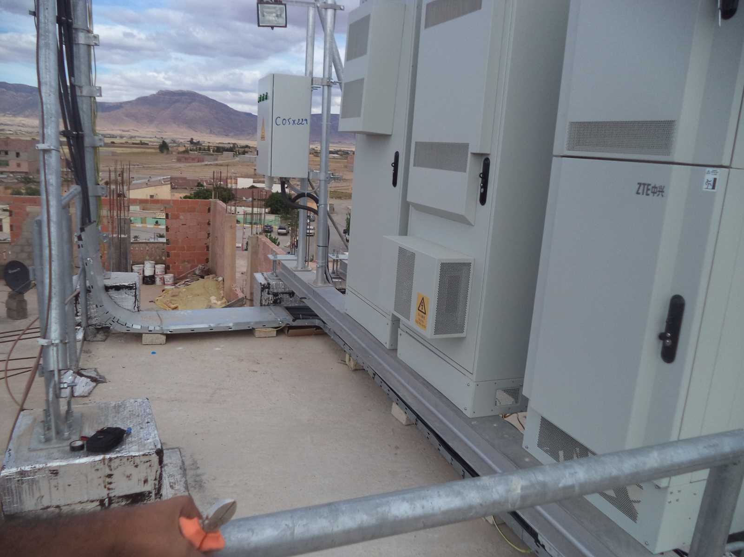
Site View outdoor
Paste the Picture here

Slide 4
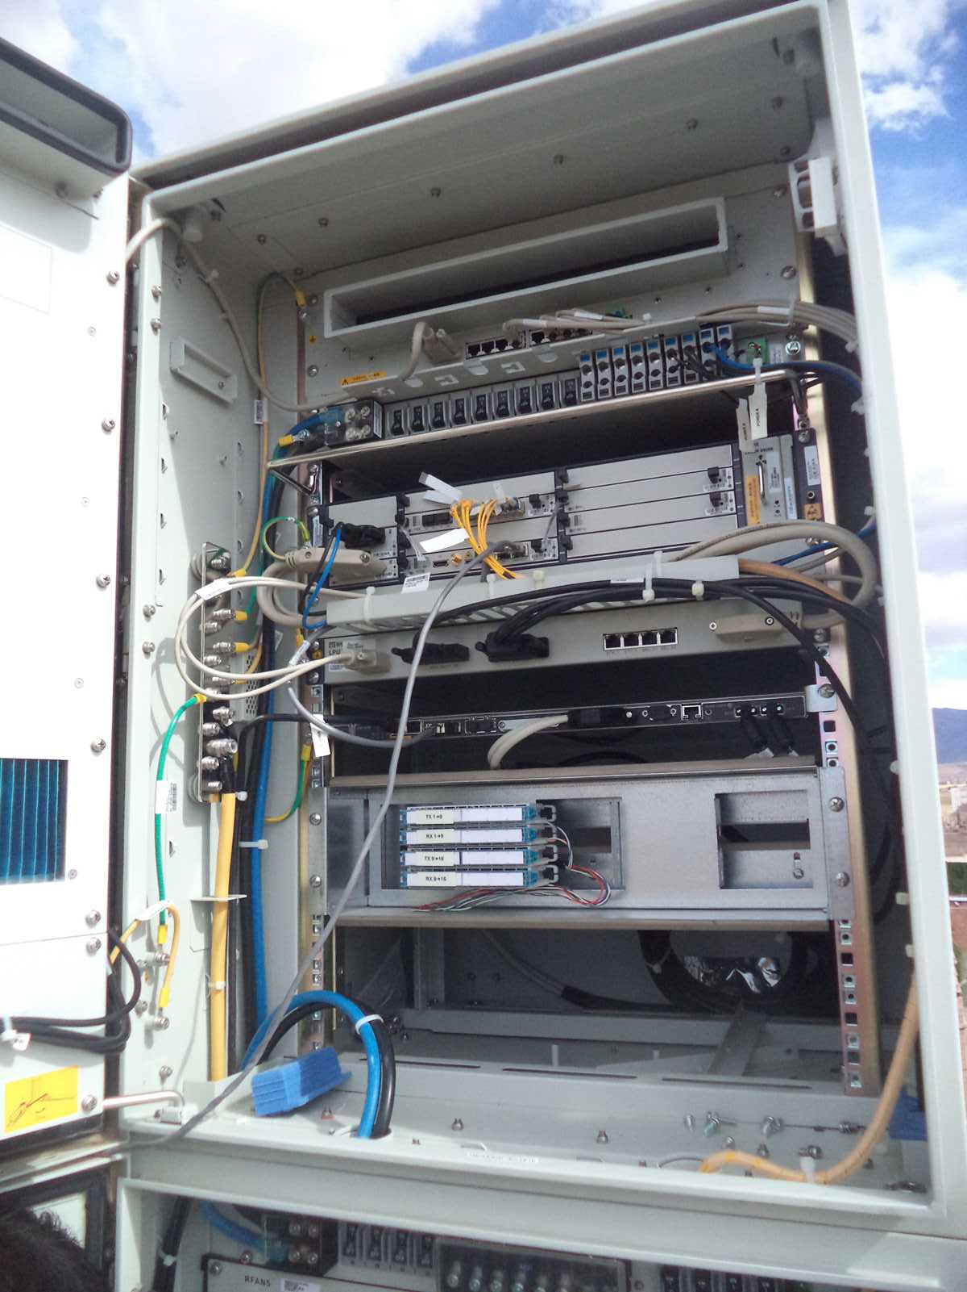
BTS/NodeB Cabinet
Paste the Picture here

Slide 5
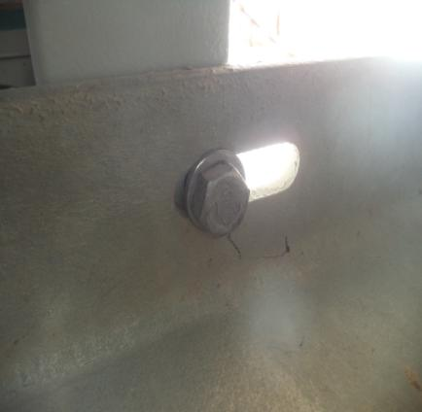
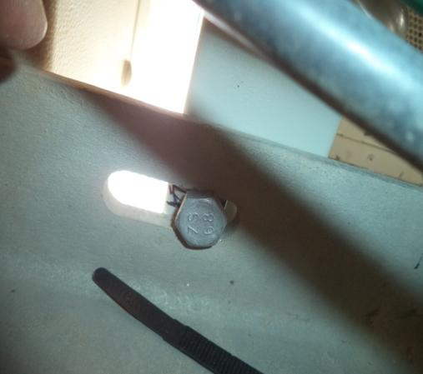
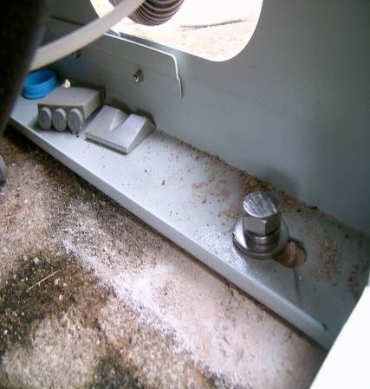
BTS/NodeB Cabinet fixation
Paste the Picture here

Slide 6
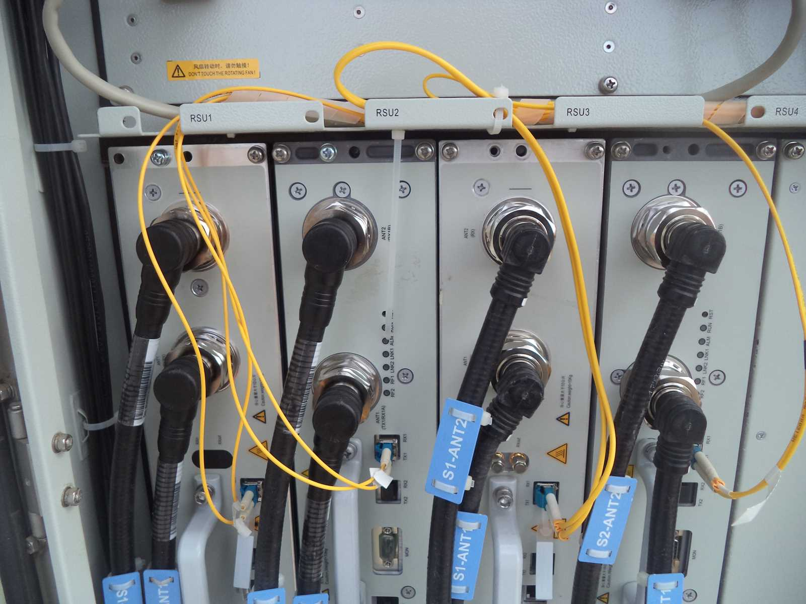
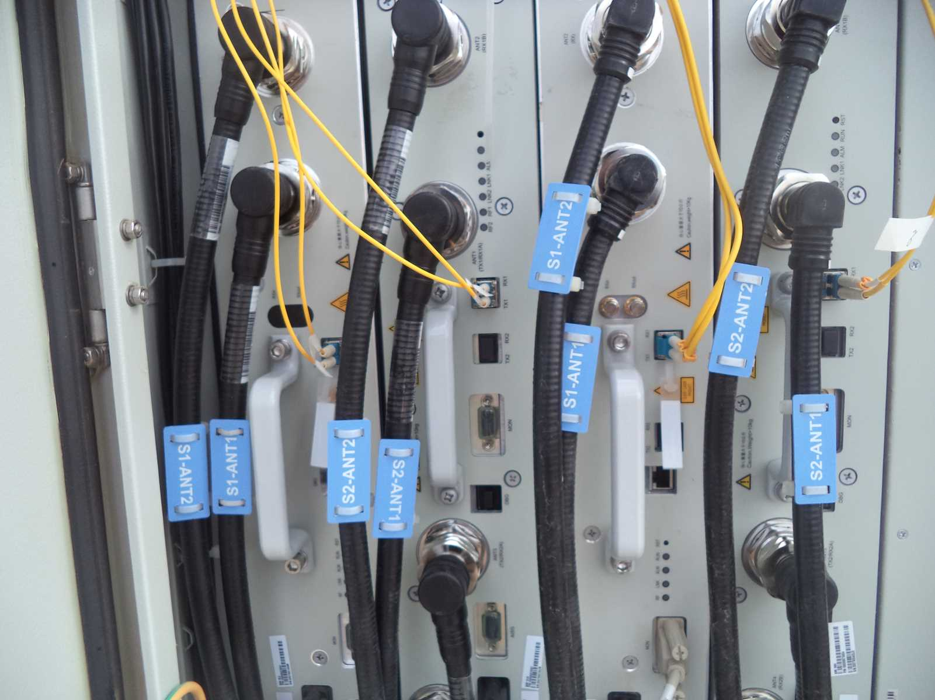
Indoor Jumpers + label
Paste the Picture here

Slide 7
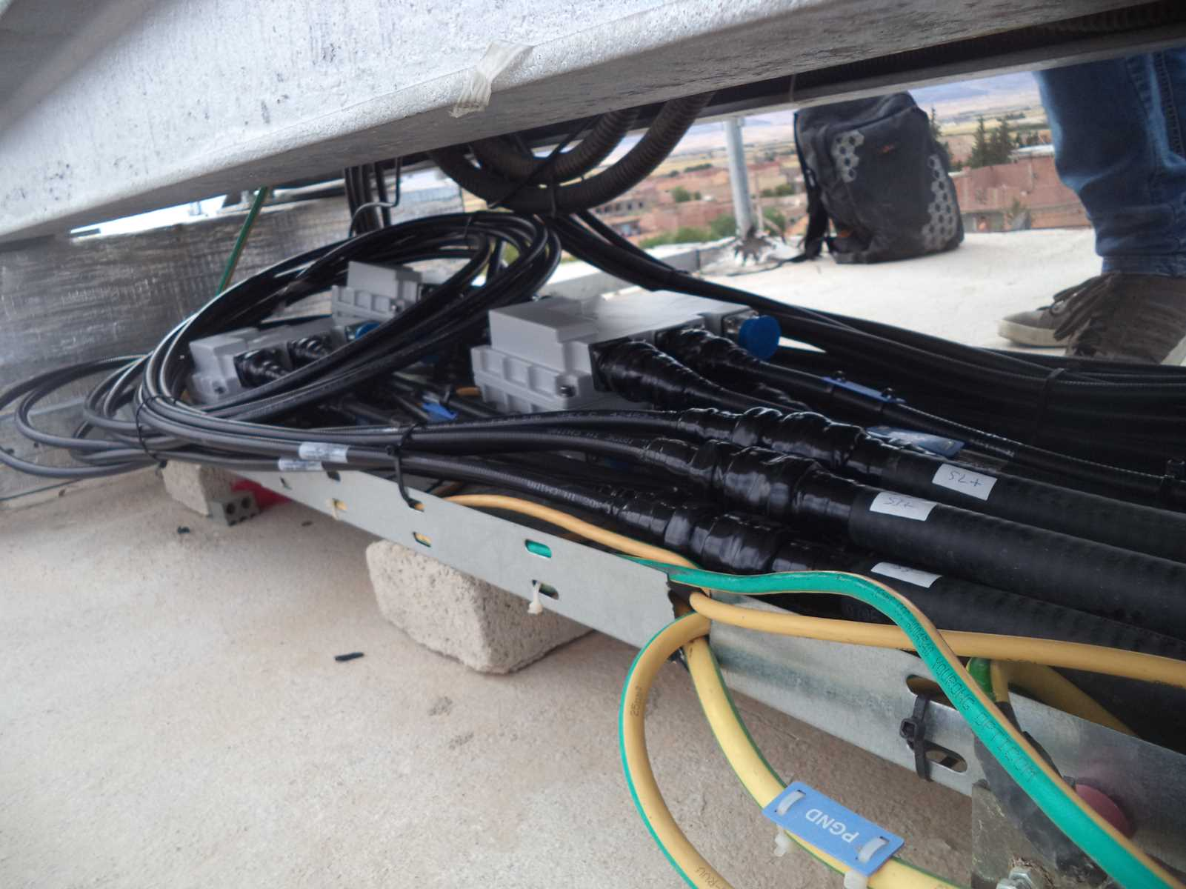
Outdoor Jumpers
Paste the Picture here

Slide 8
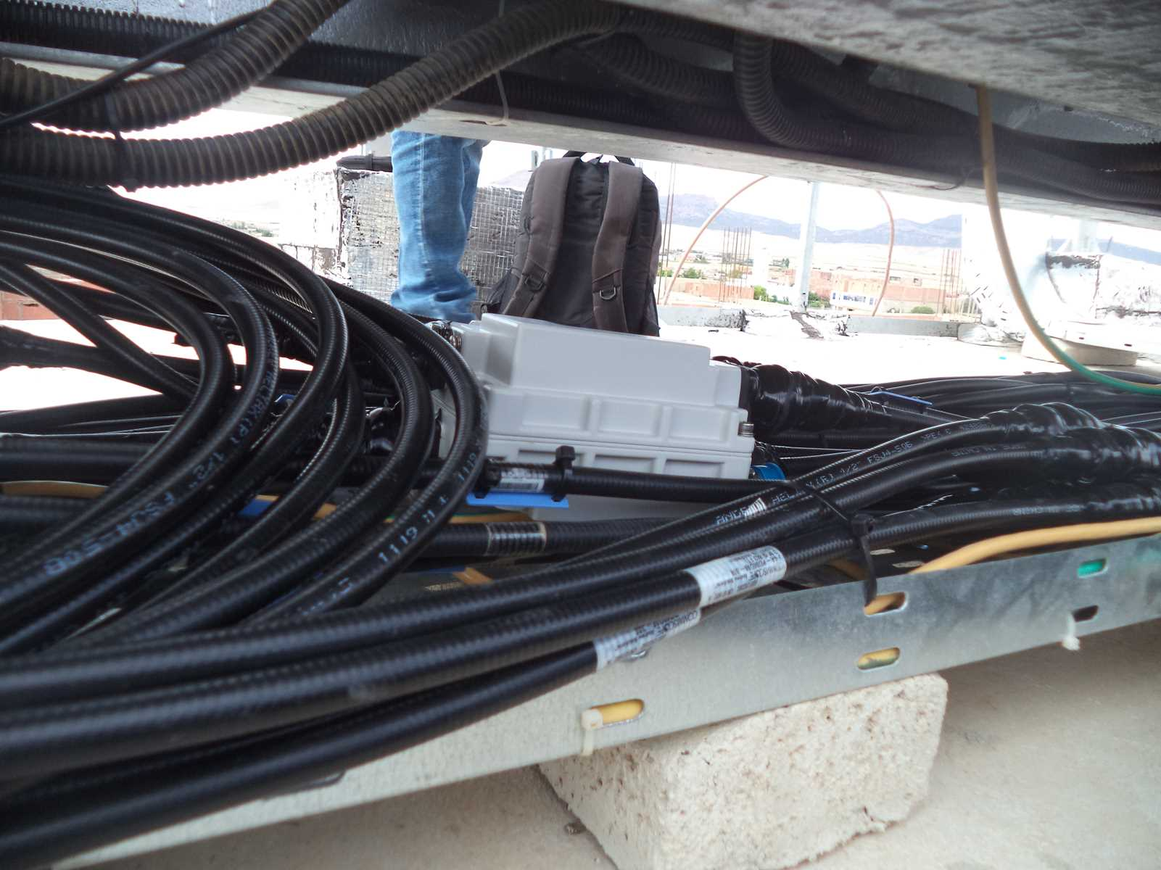
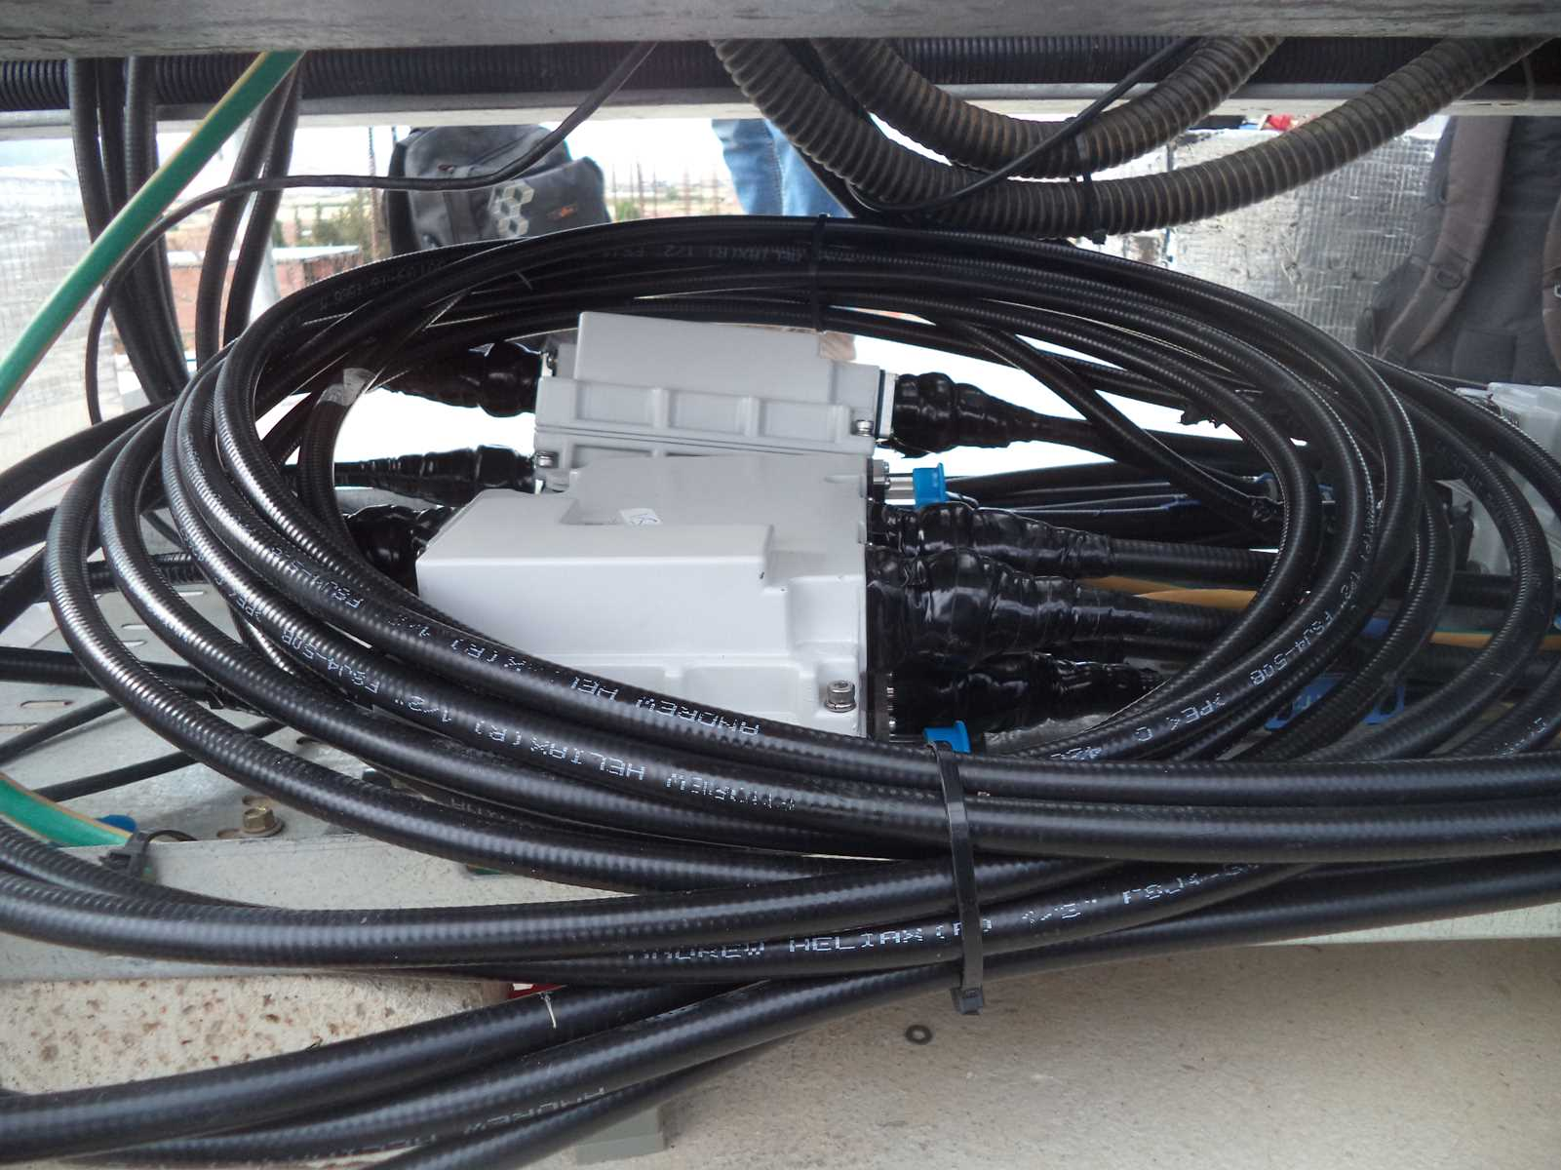
Outdoor Jumpers
Paste the Picture here

Slide 9
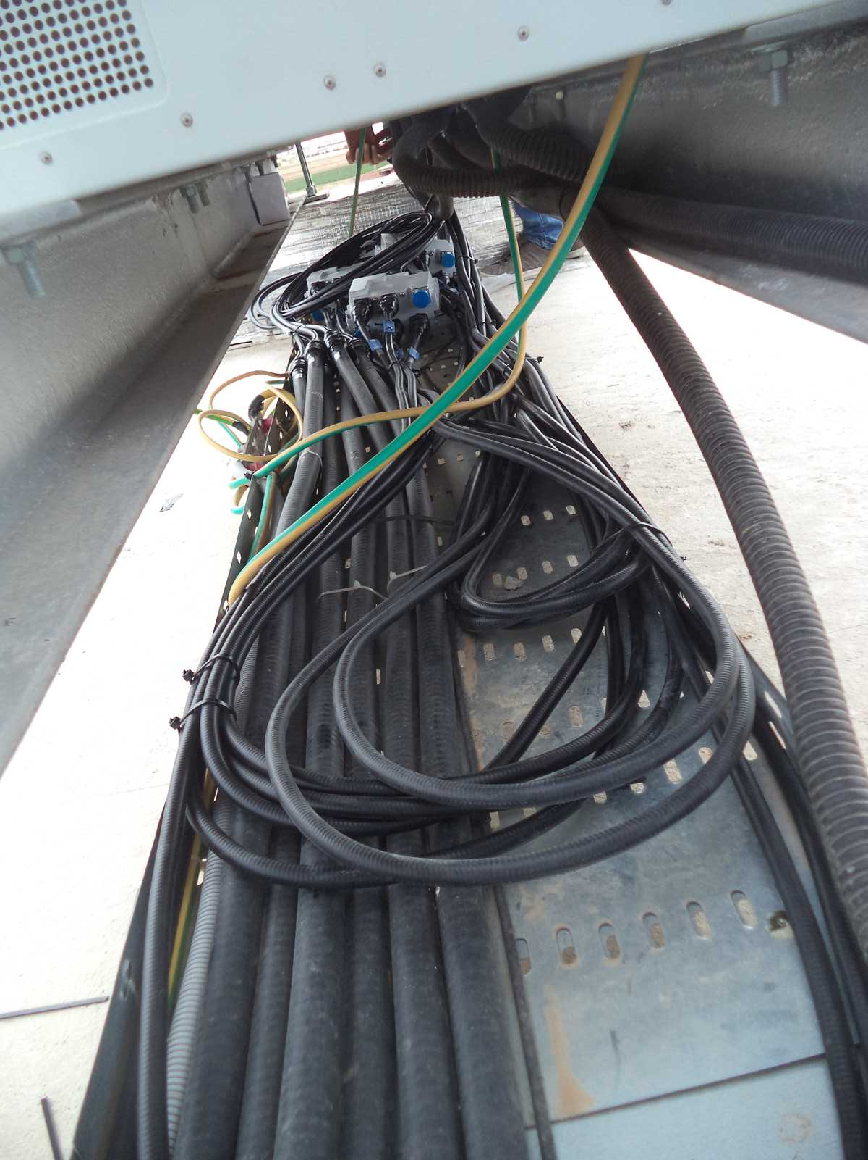
Cable Tray
Paste the Picture here

Slide 10
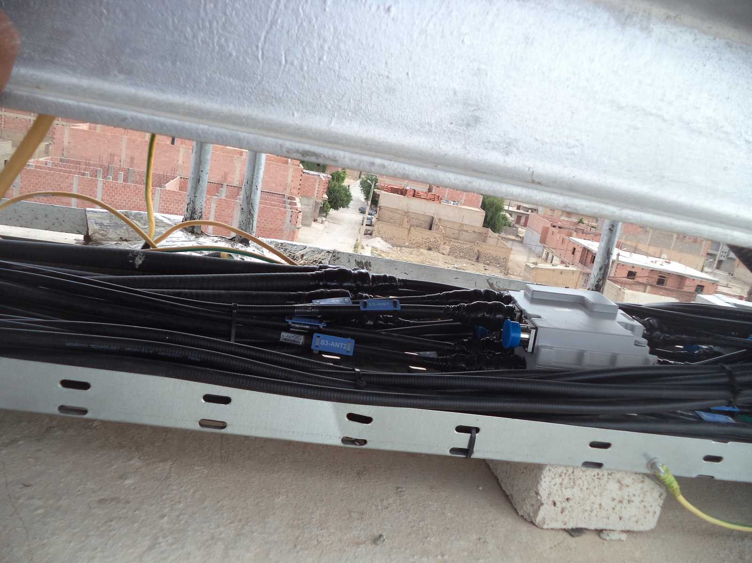
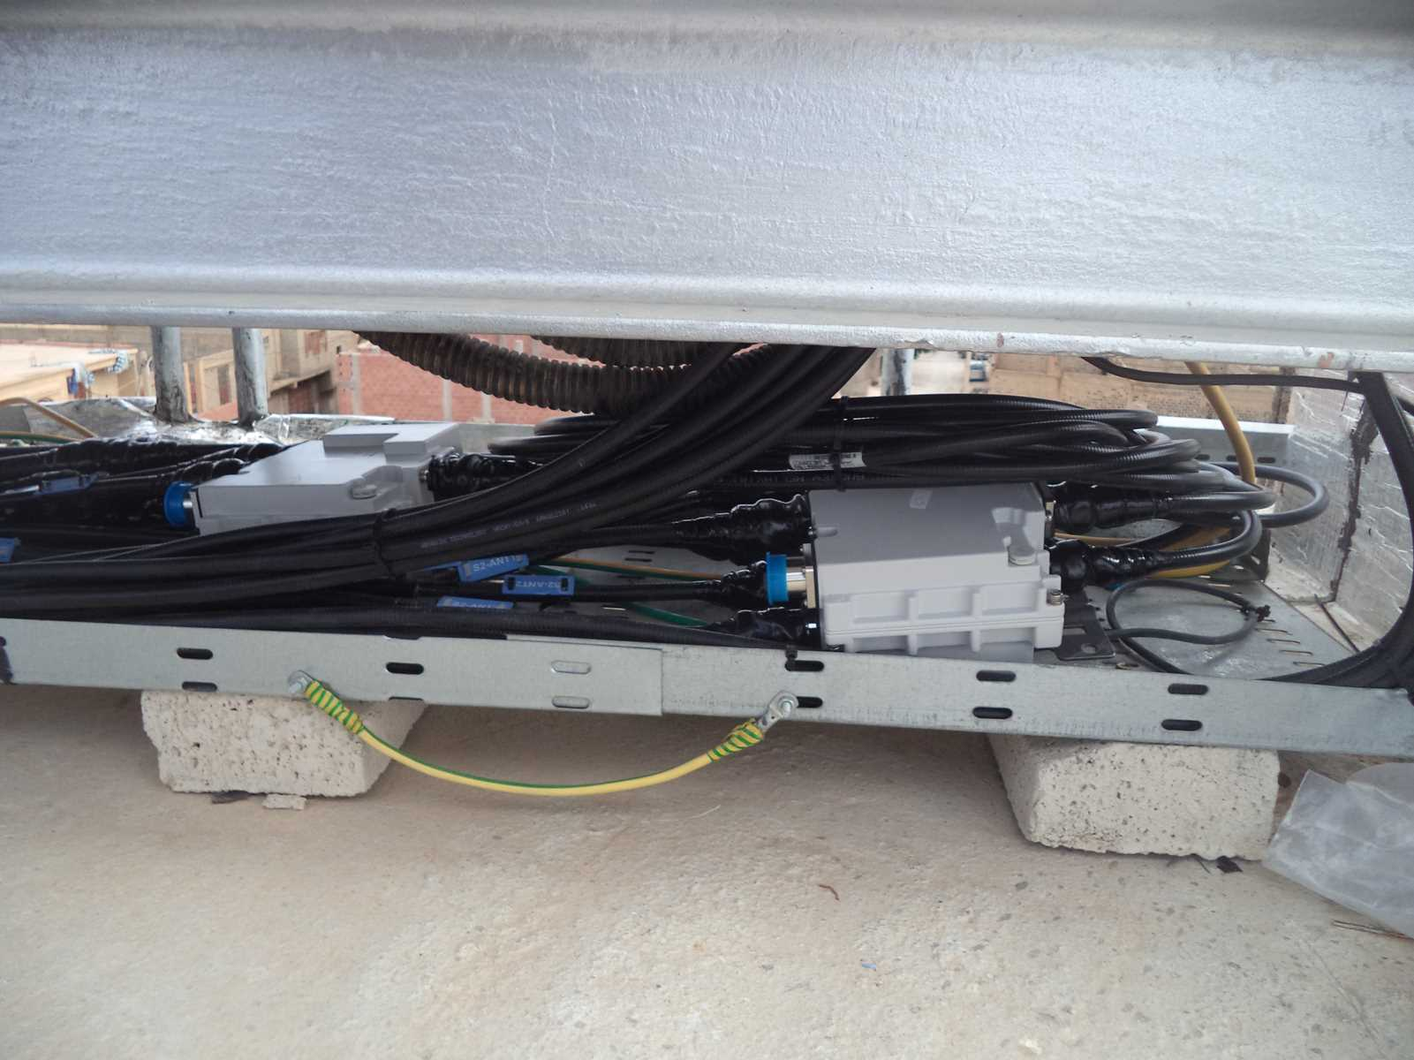
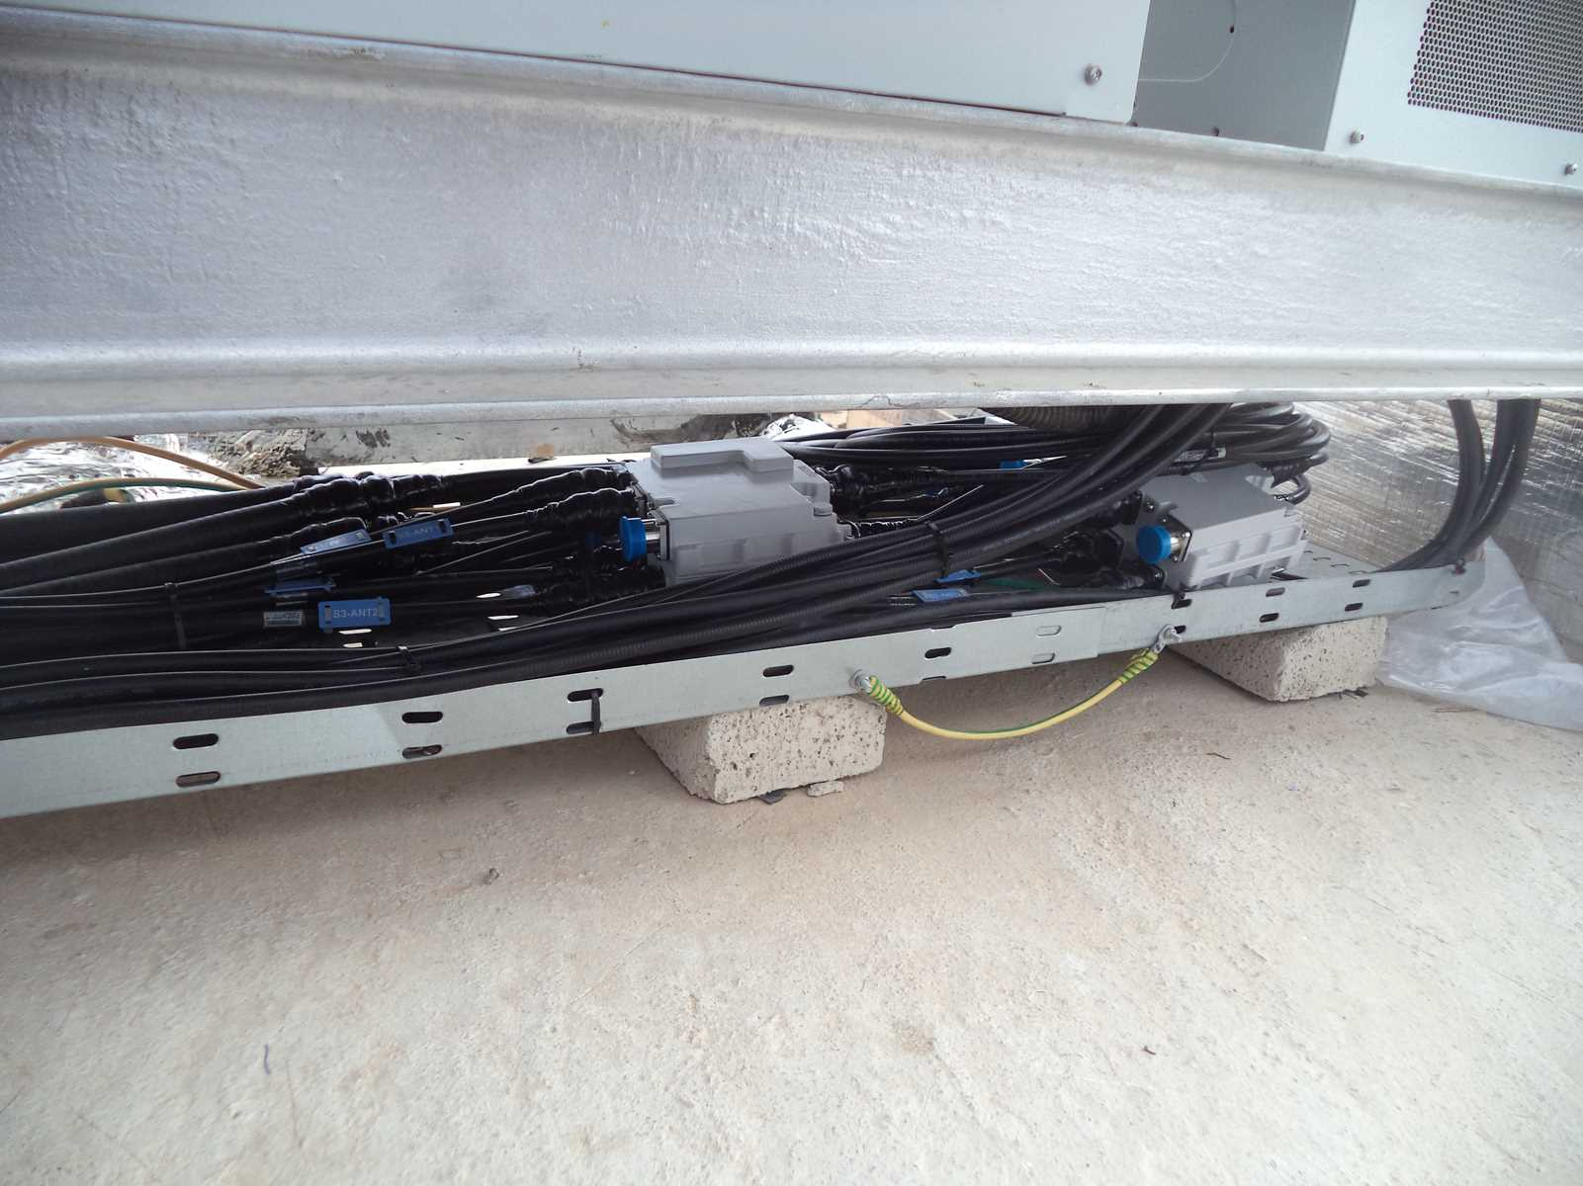

Slide 11
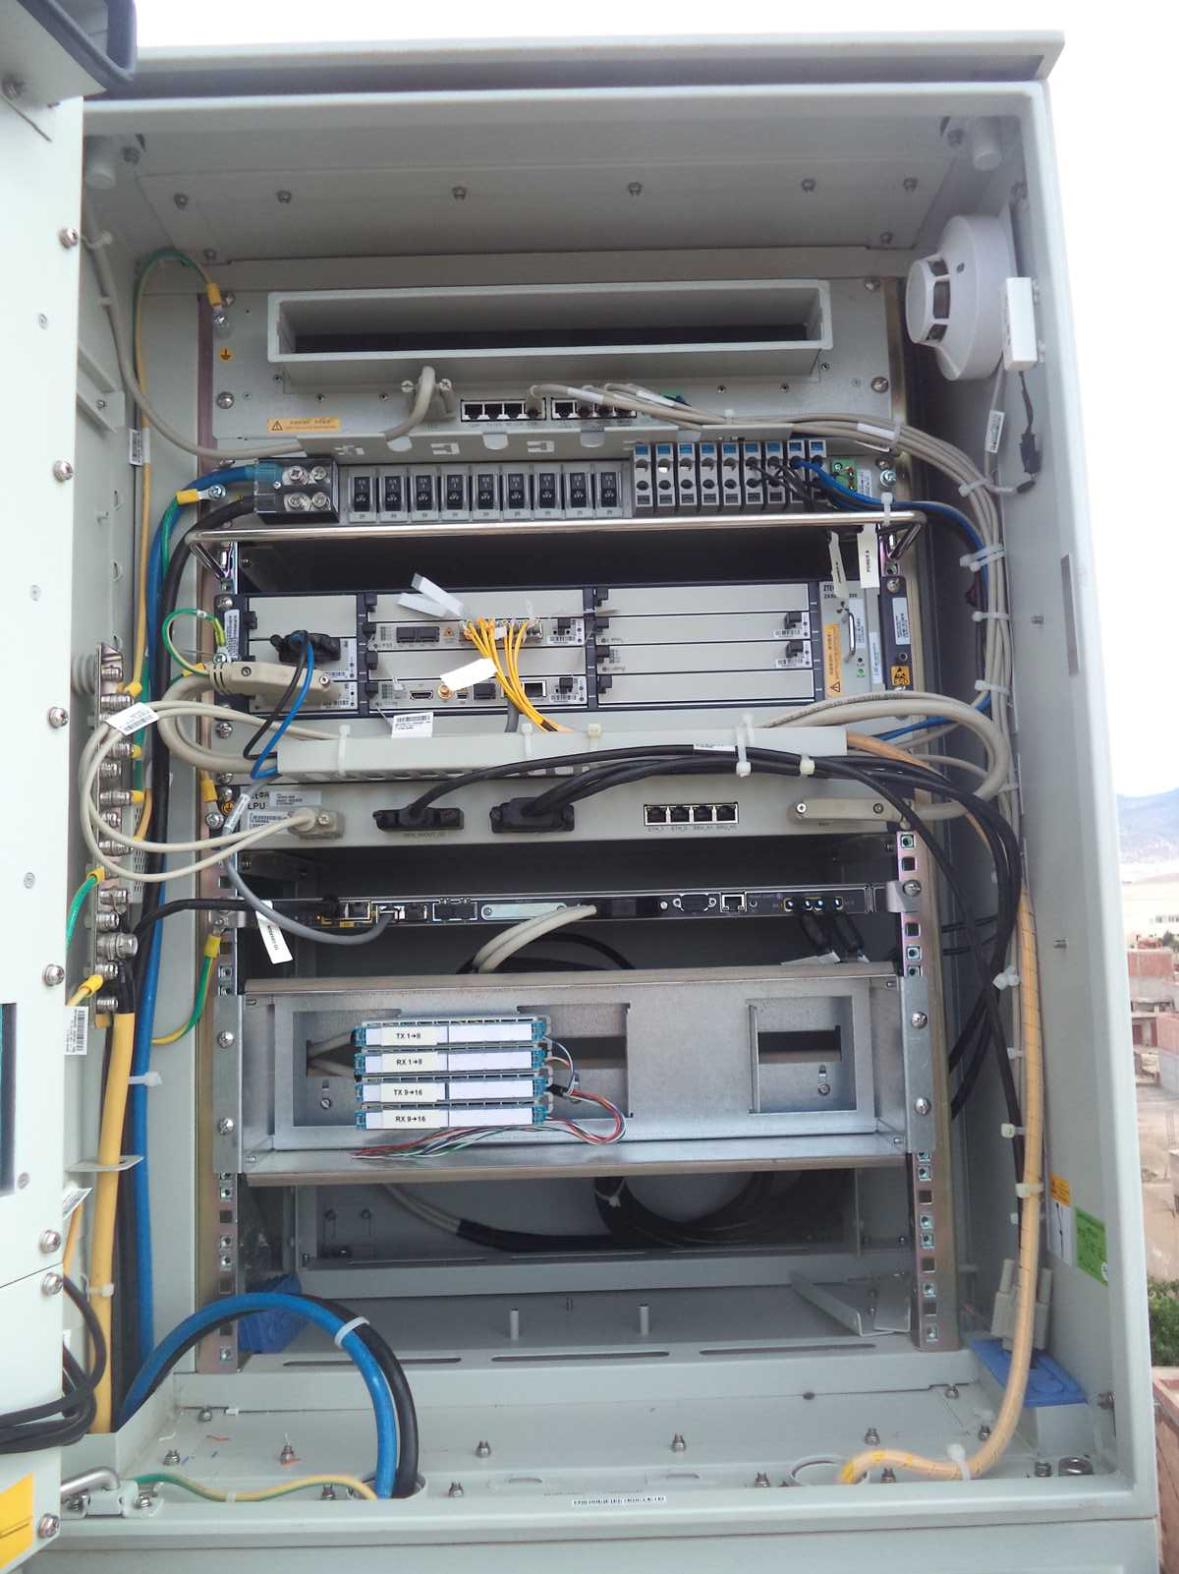
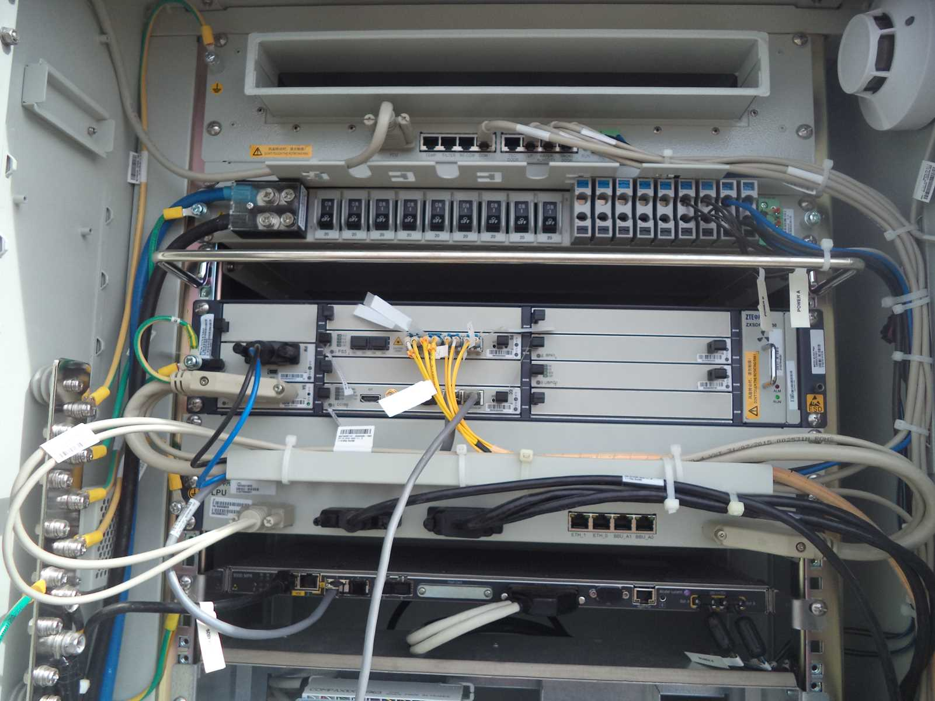
BBU (Connectivity and labeling)
Paste the Picture here

Slide 12
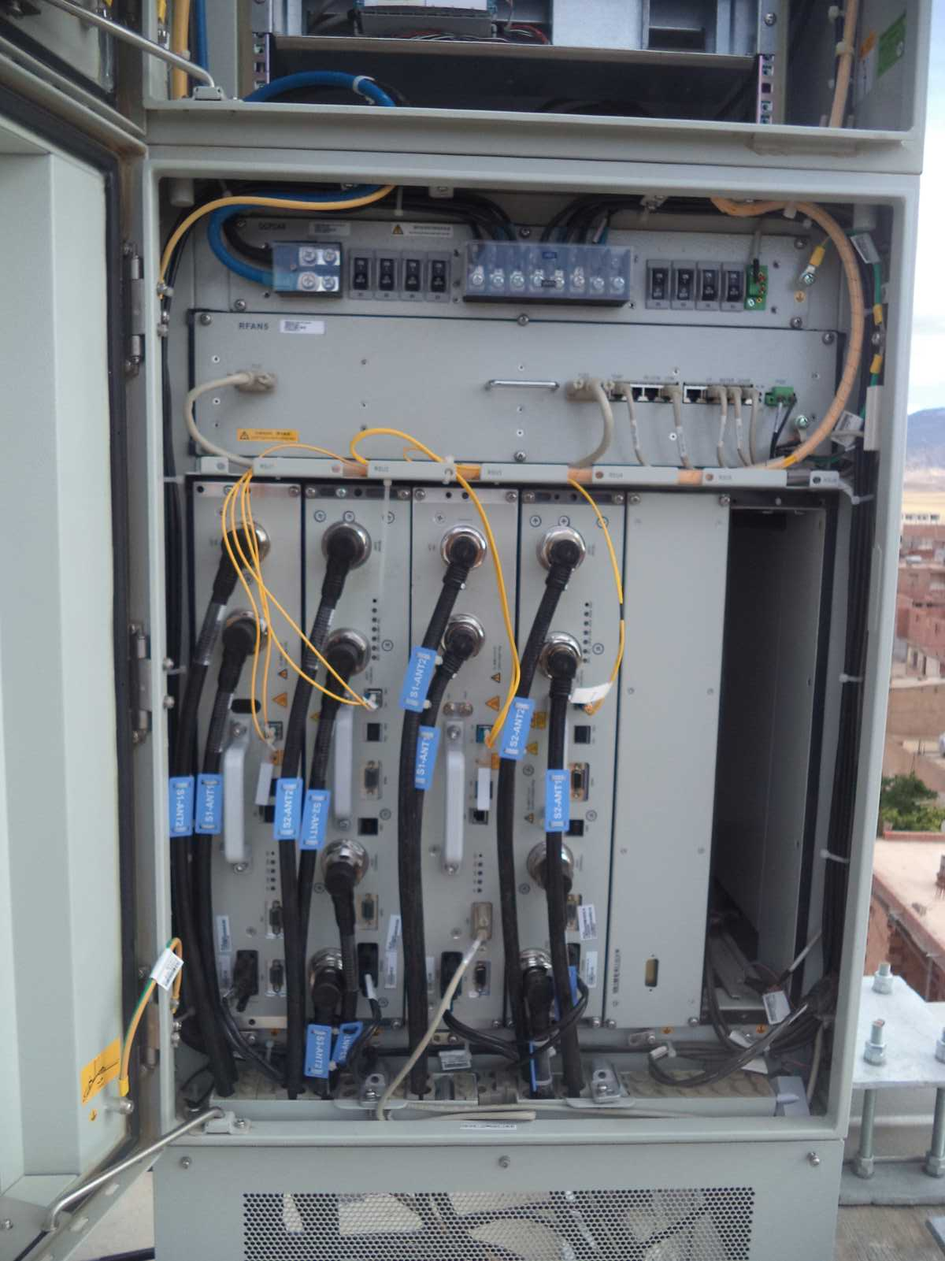
RSU/RRU
Paste the Picture here

Slide 13
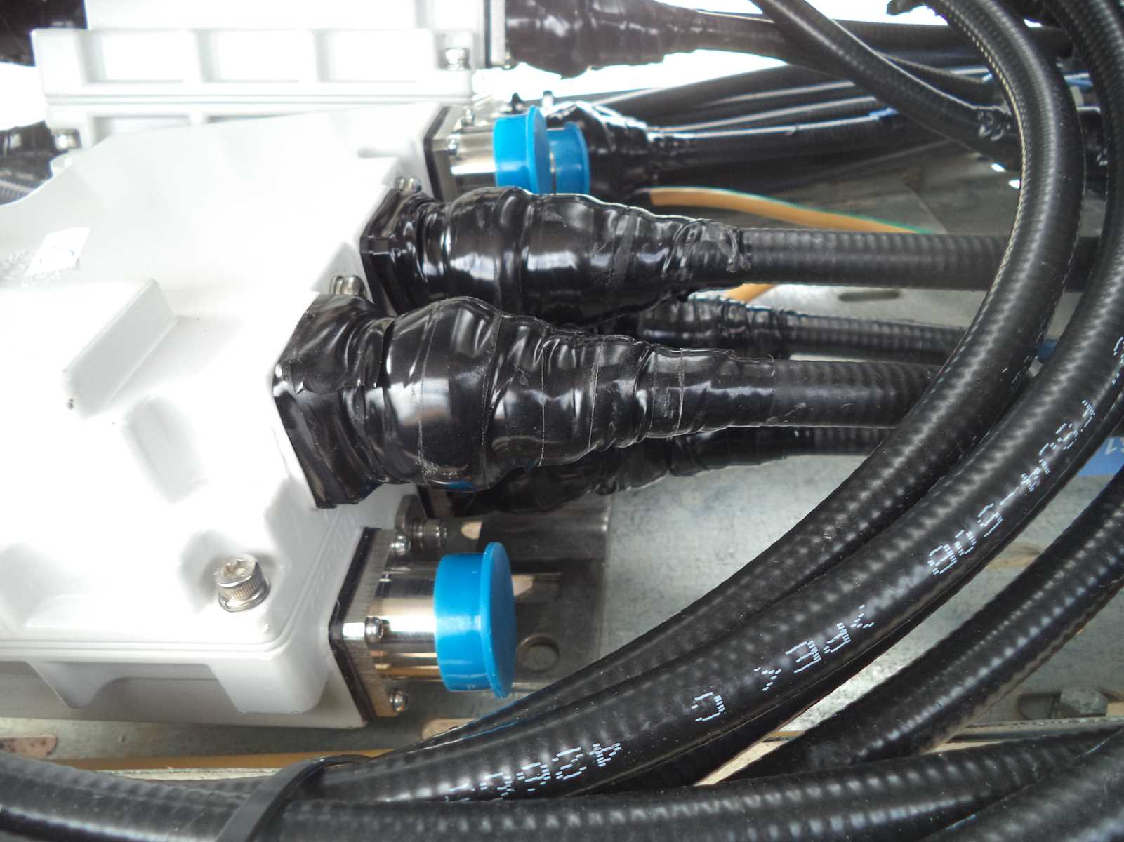
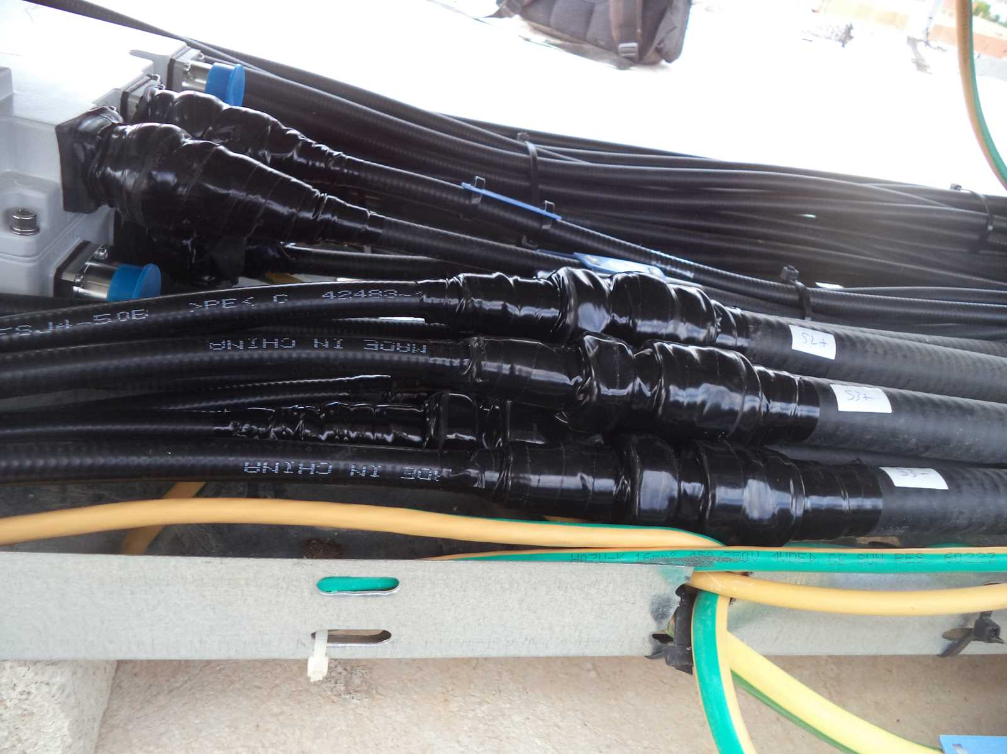
PROTECTION

Slide 14
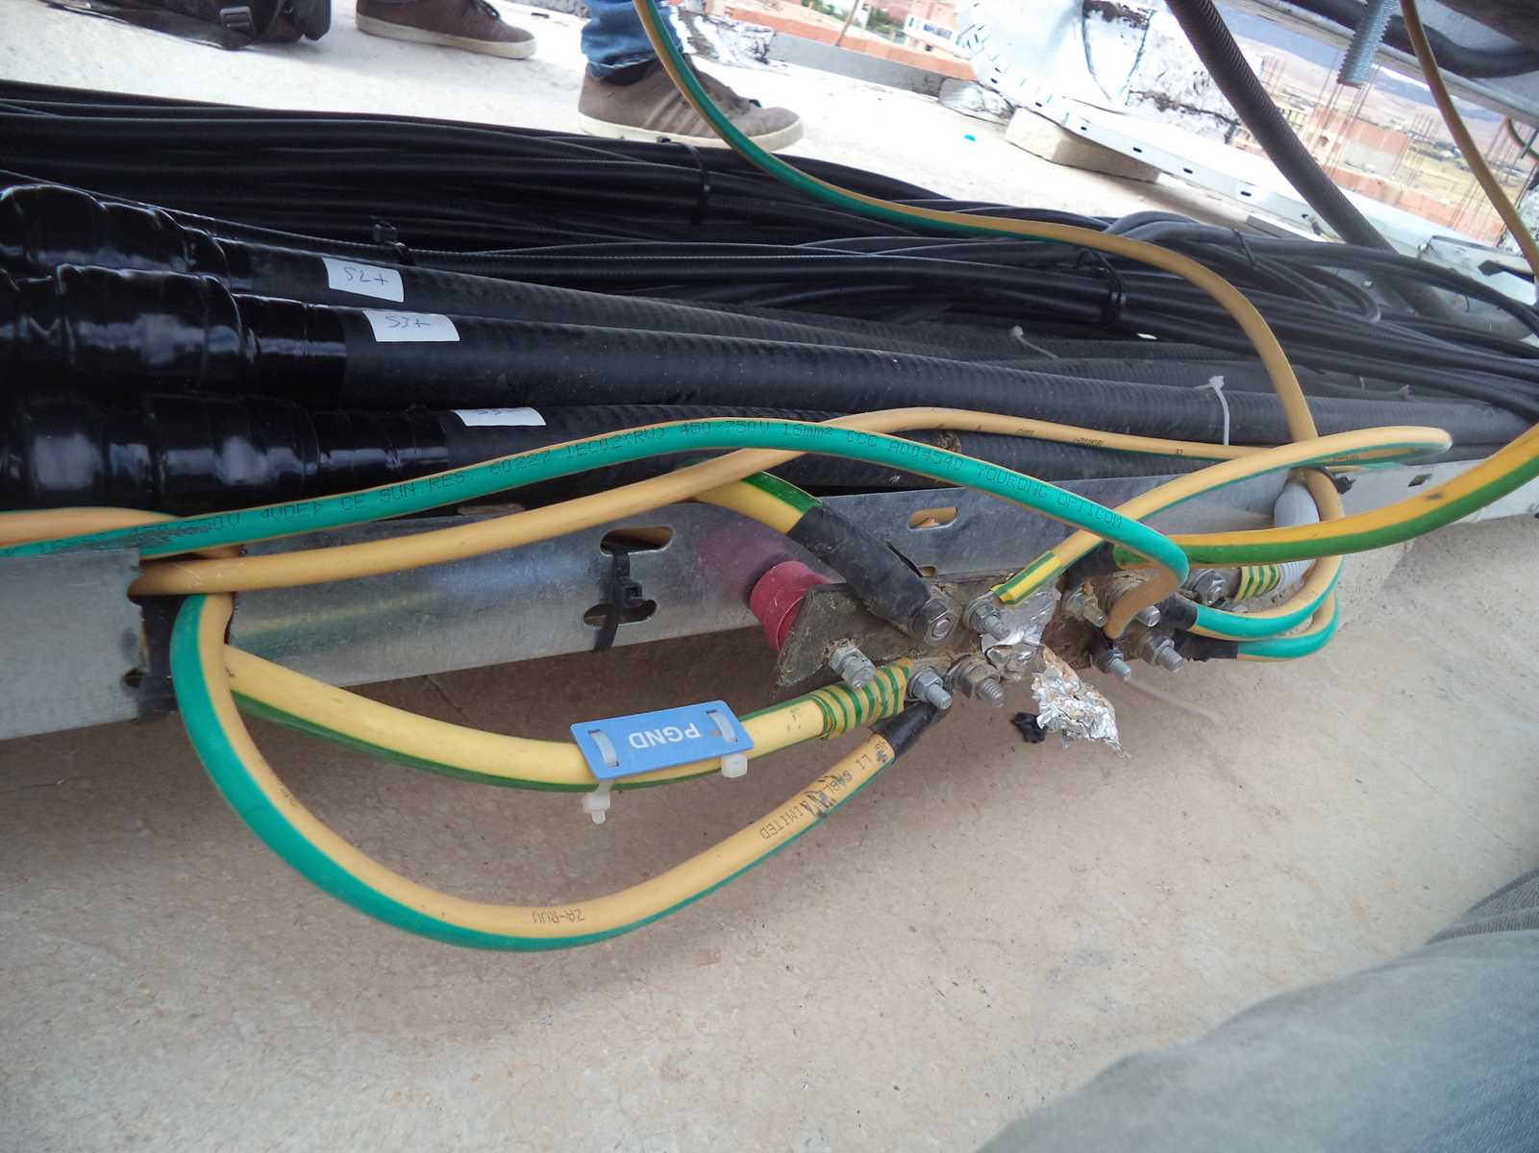
Grounding / Grounding Bar (Indoor and/or Outdoor)
Paste the Picture here

Slide 15
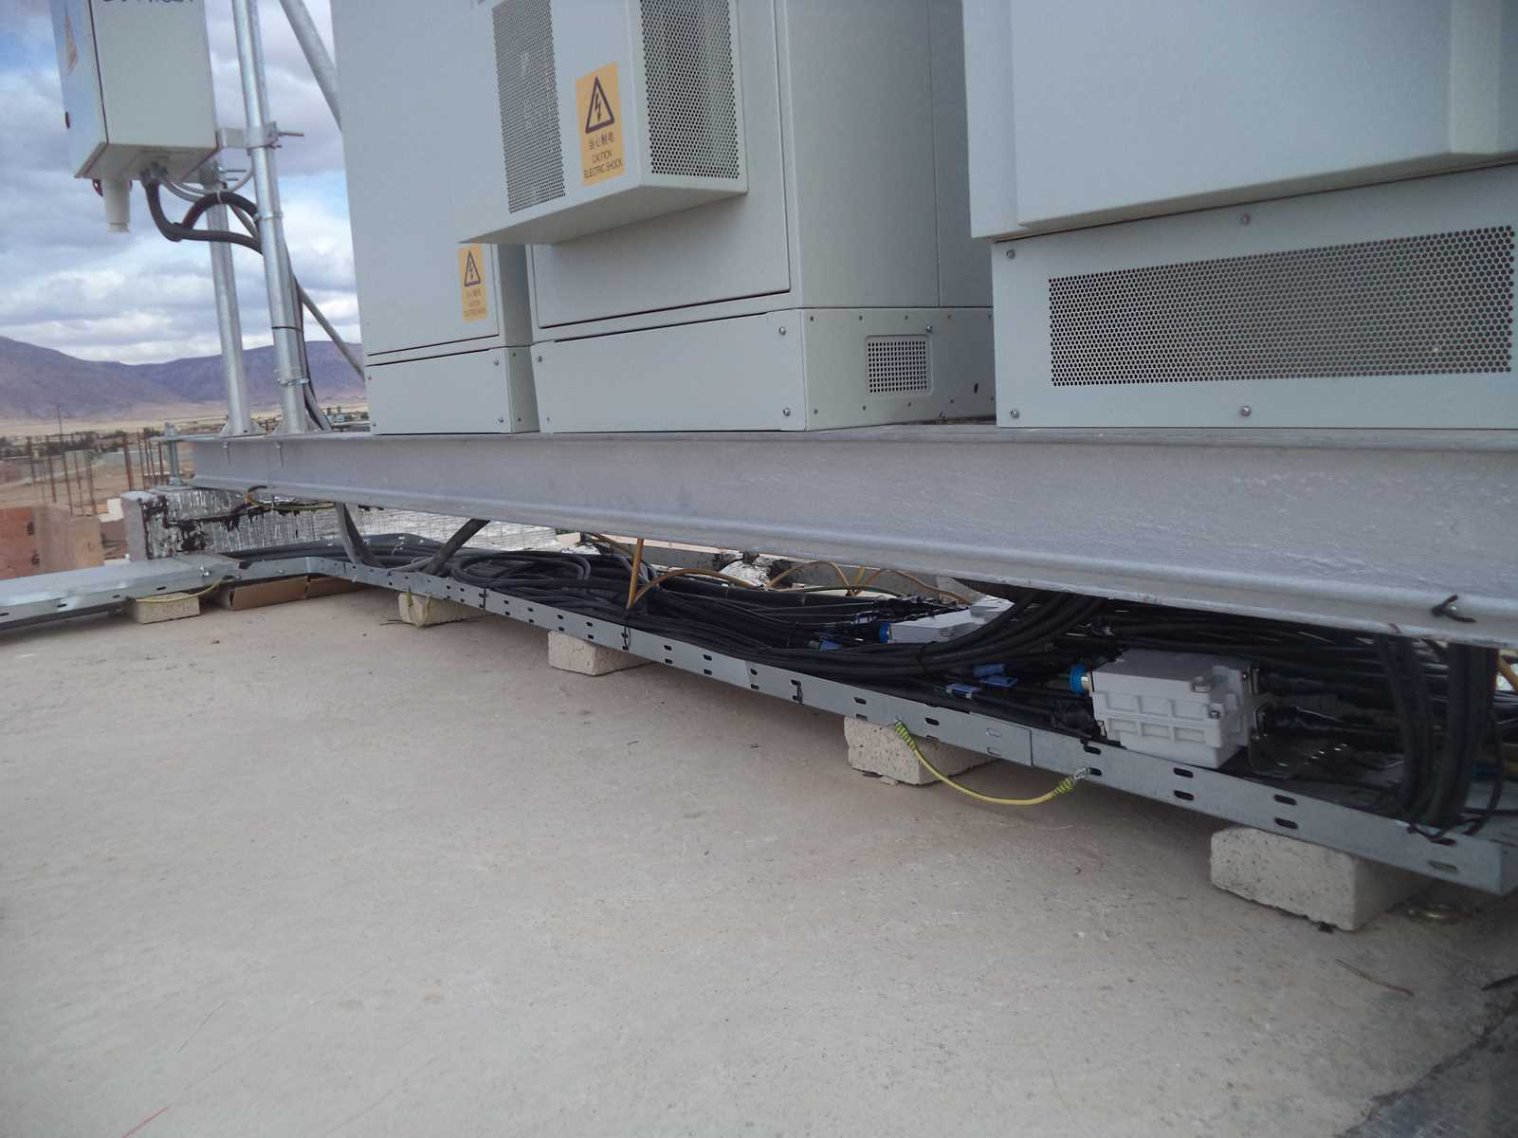
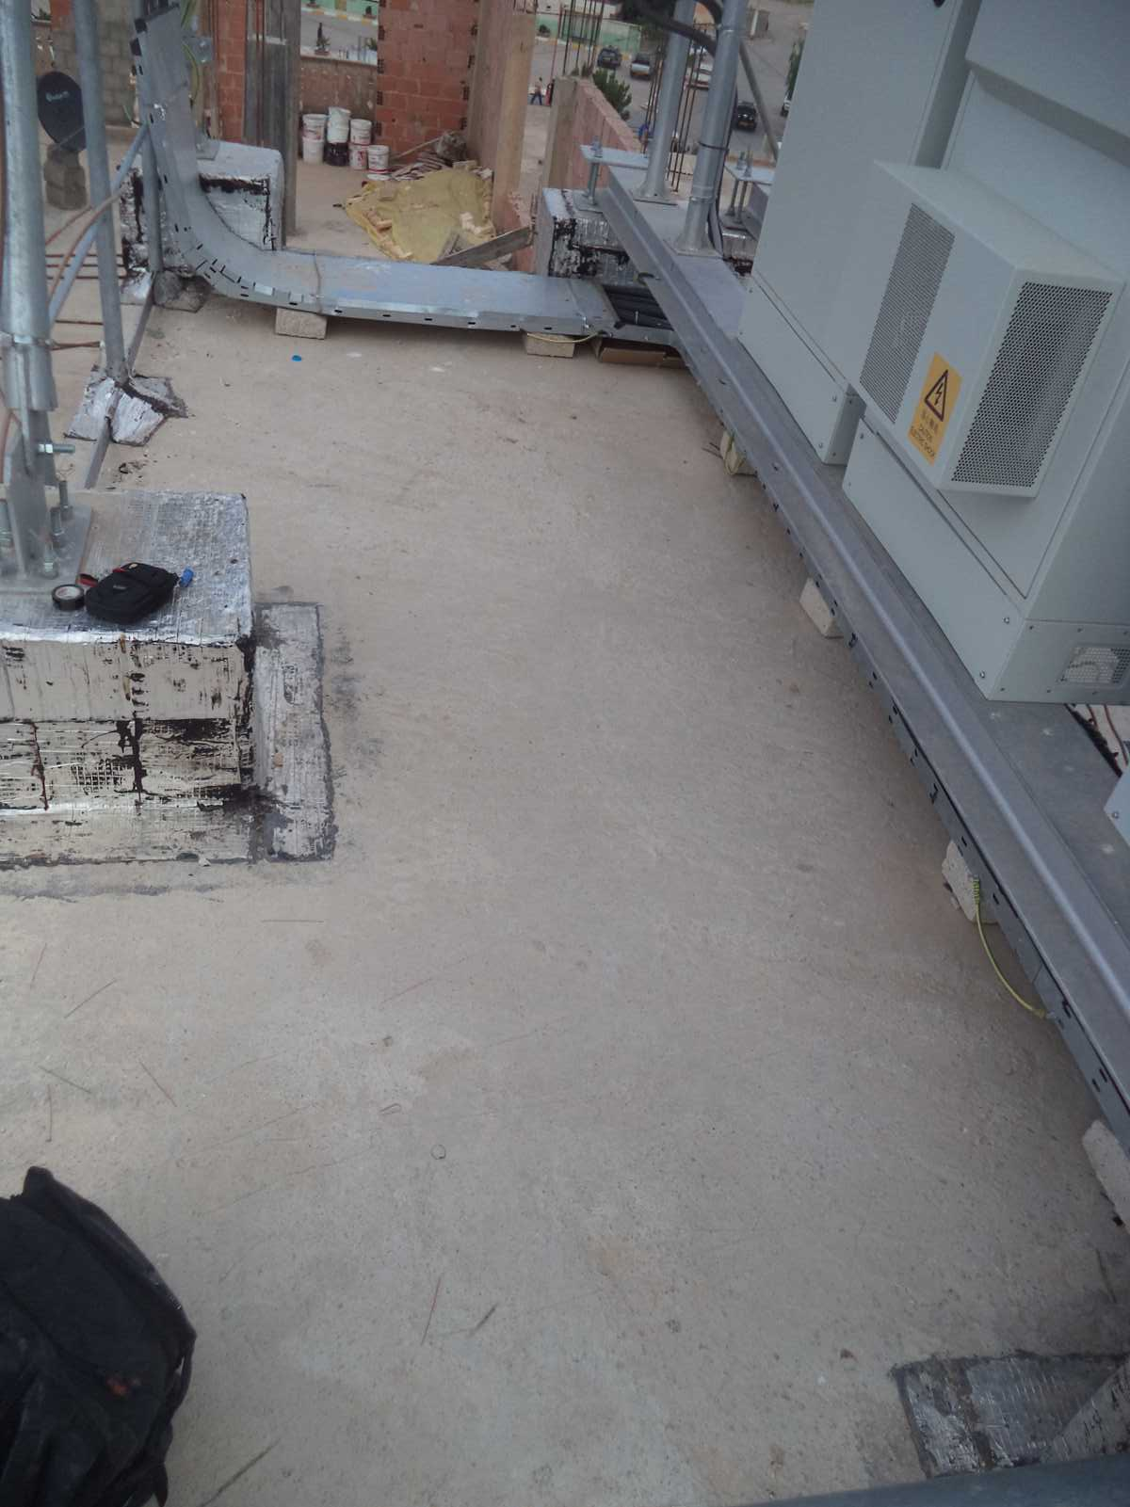
Cleanup
Paste the Picture here

Slide 16
H-Bar
Paste the Picture here

Slide 17
Others
Paste the Picture here

