Slide 1


POWER SUPPLY INSTALLATION
Subcontractor: MGNIC
Site ID: C36X010
Installation/Swap Date: 15/06/2016
Name: HAICHEUR HADJER
Department: Documentation (OTA Project)
Mail: haicheur.hadjer@zte.com.cn

Slide 2
Work Done ( Please to list bellow the work items done on the site)
Site View outdoor
Site View Indoor after
Equipments delivered
Cable labeling after
New position View
Transmission Equipment
After power supply
Power Supply Before
Batteries Grounding
Power and Breakers Grounding…

Slide 3
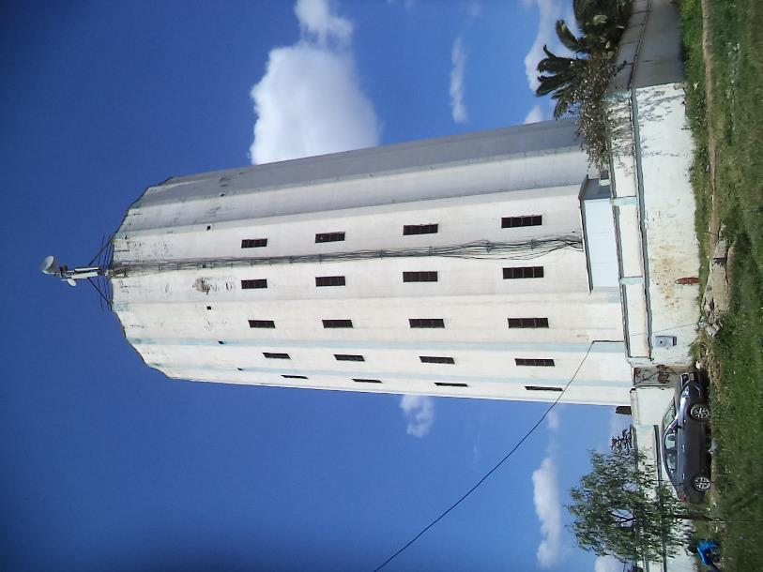
Site View outdoor
Paste the Picture here

Slide 4
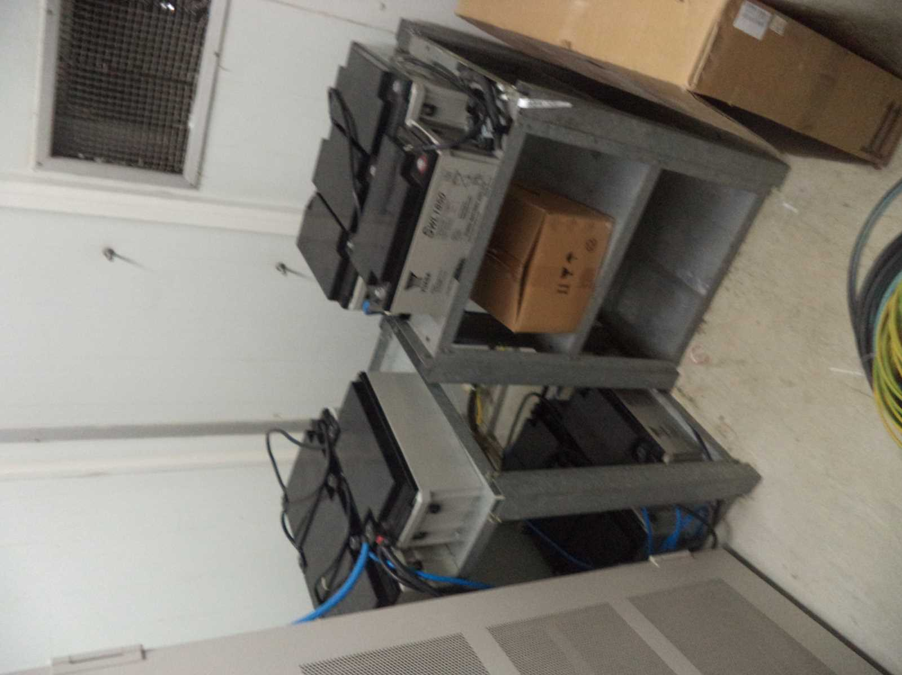
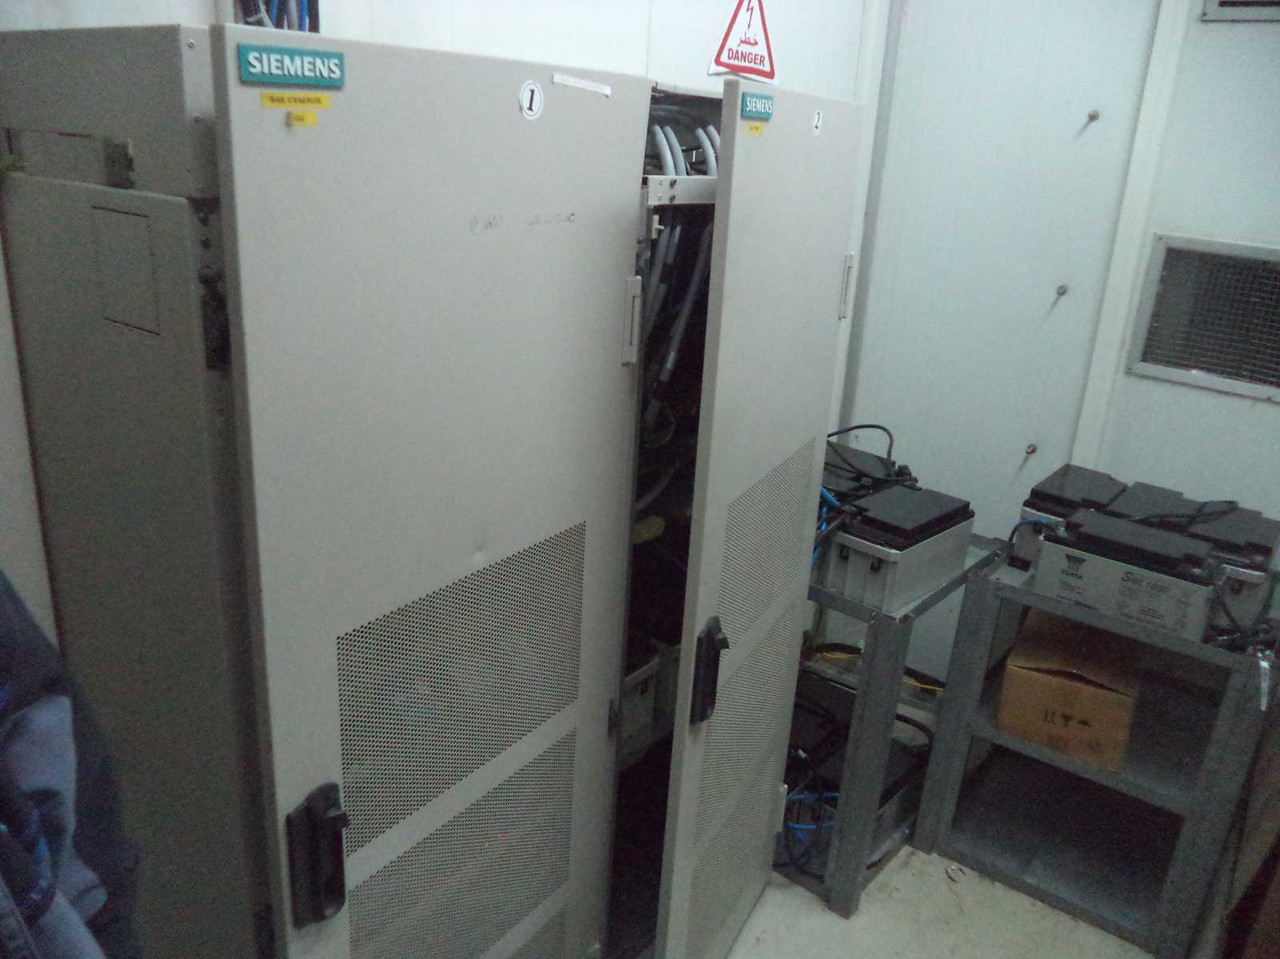
Site View Indoor after
Paste the Picture here

Slide 5
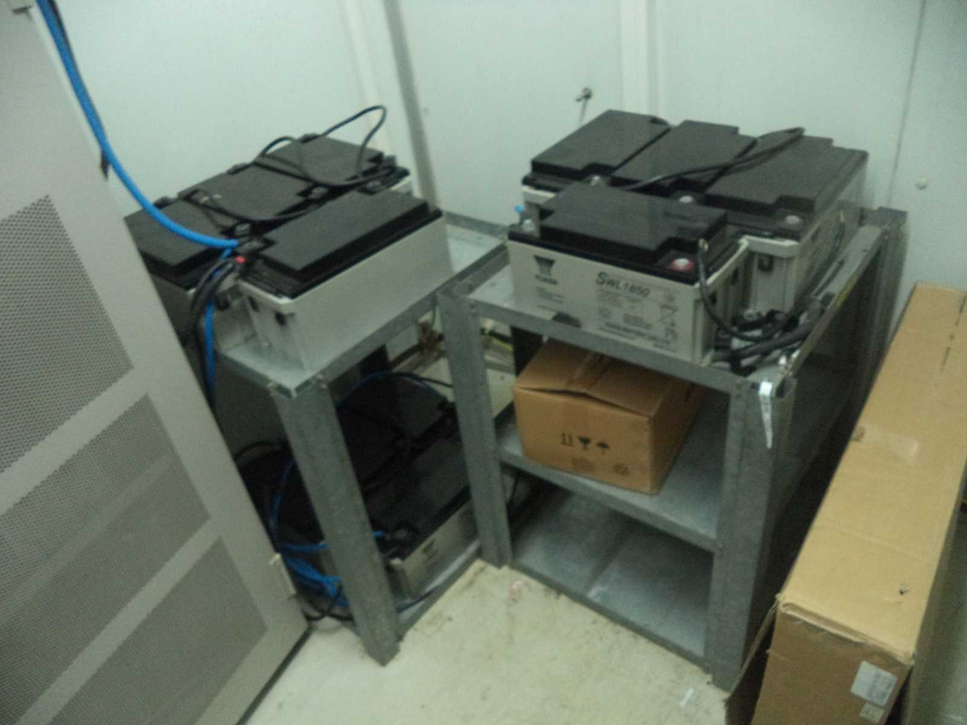
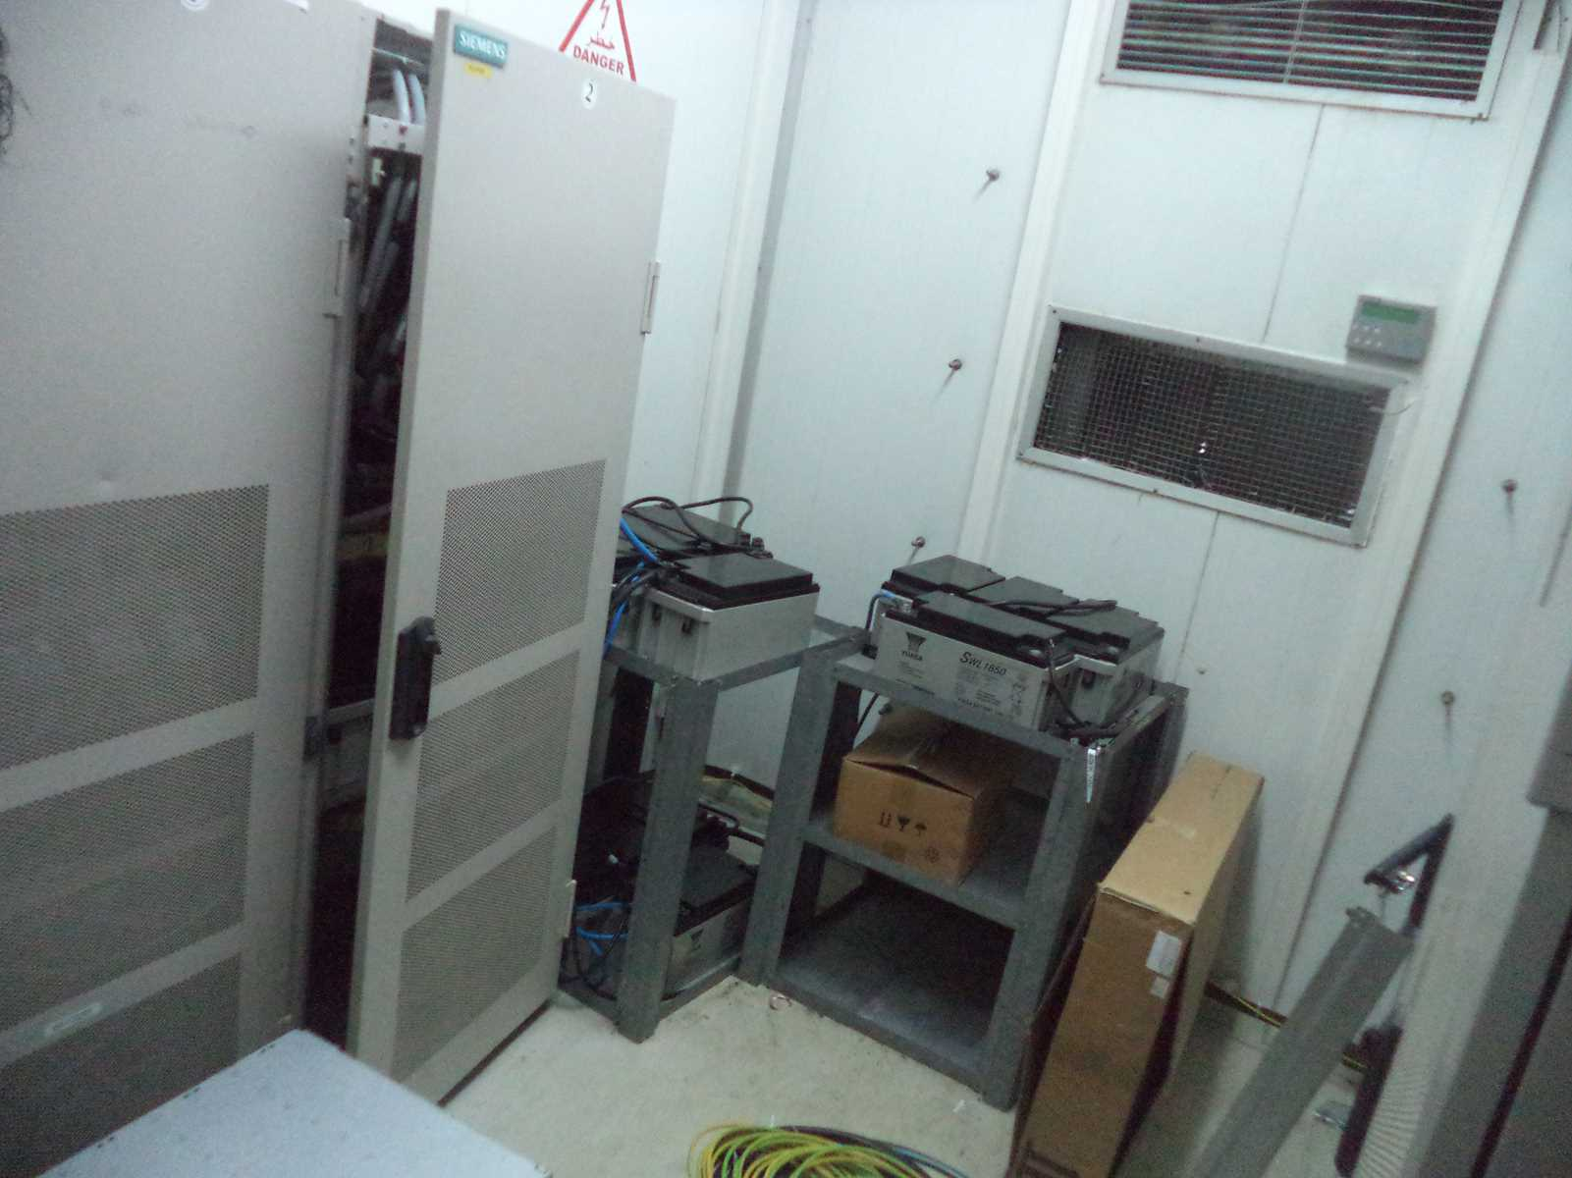
Site View Indoor after

Slide 6
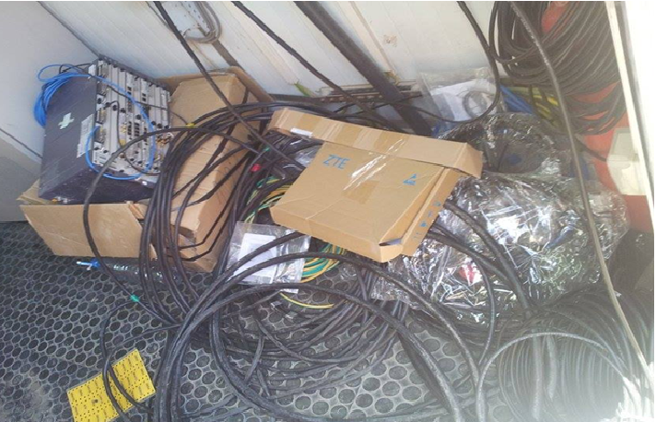
Equipments delivered
Paste the Picture here

Slide 7
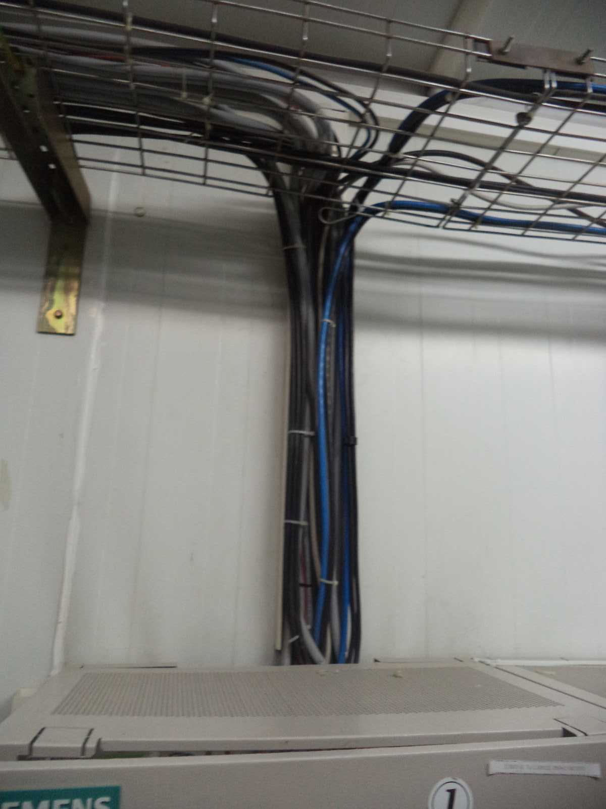
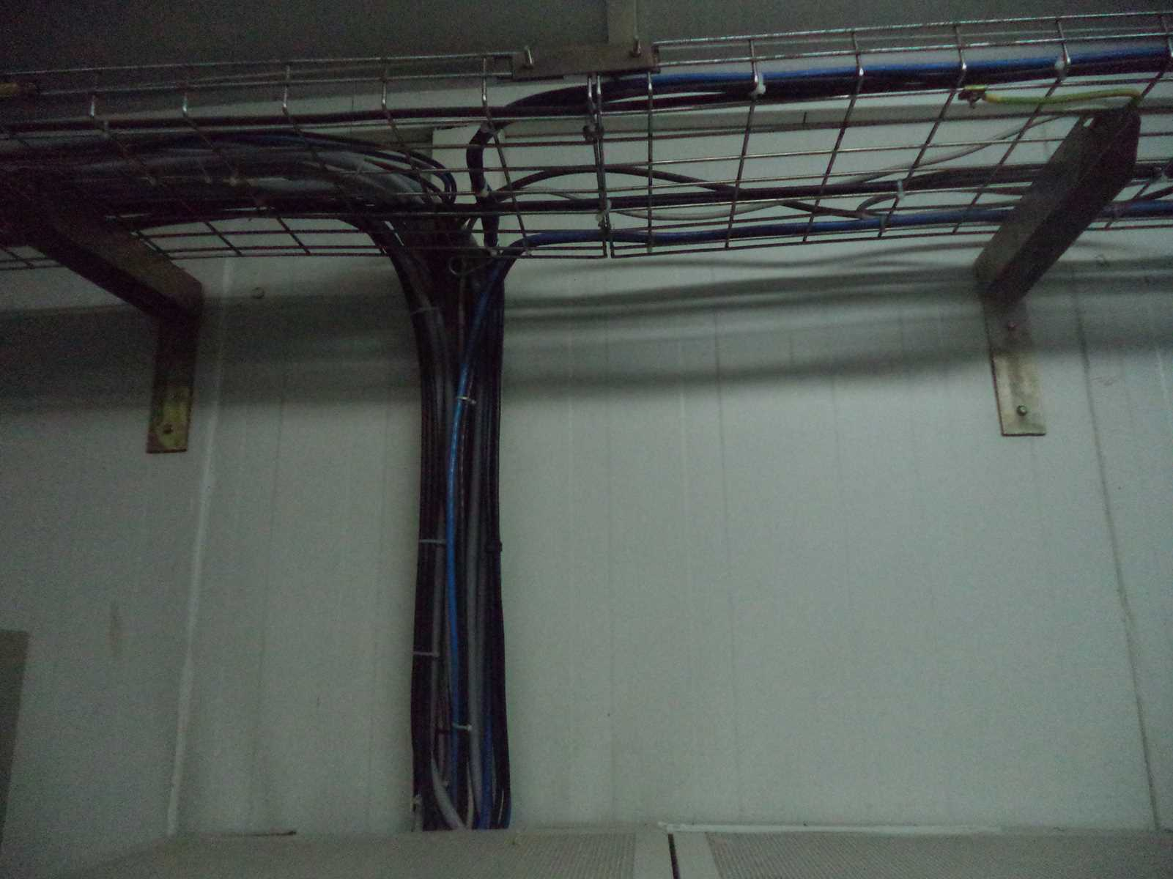
Cable labeling after

Slide 8
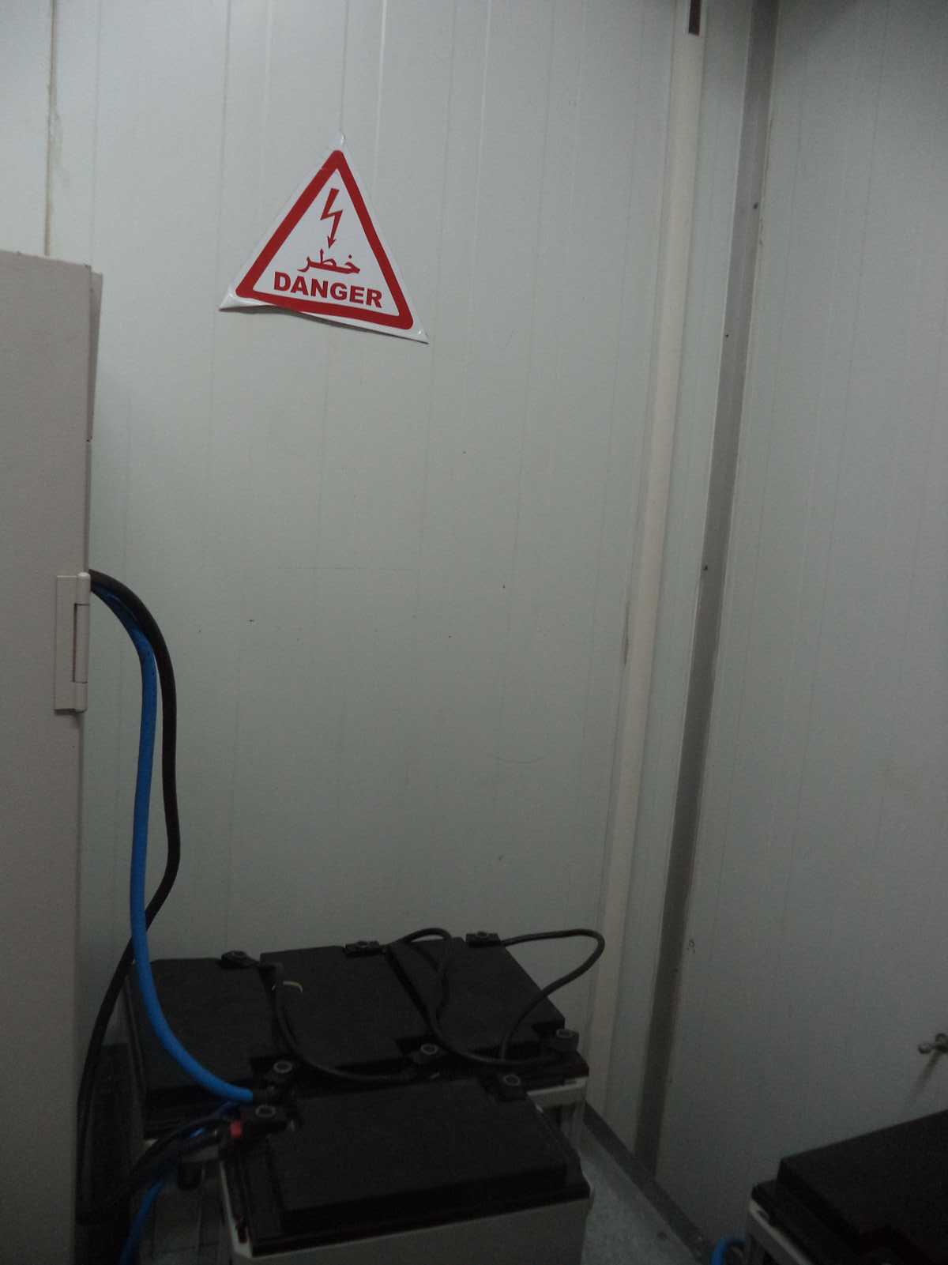
New position View

Slide 9
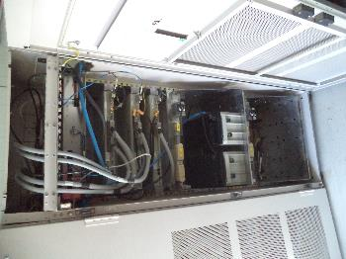
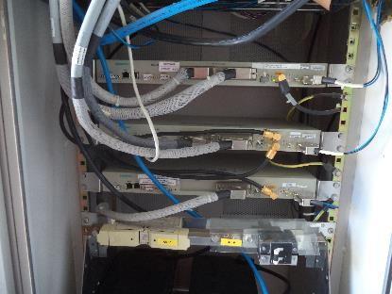
Transmission Equipment
Paste the Picture here

Slide 10
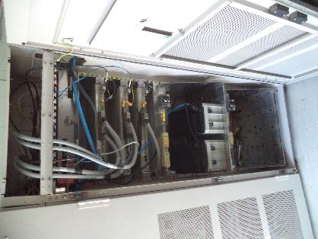
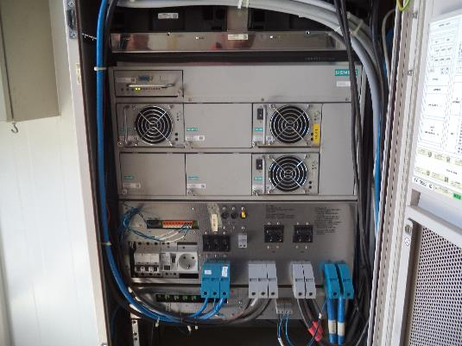
After power supply
Paste the Picture here

Slide 11
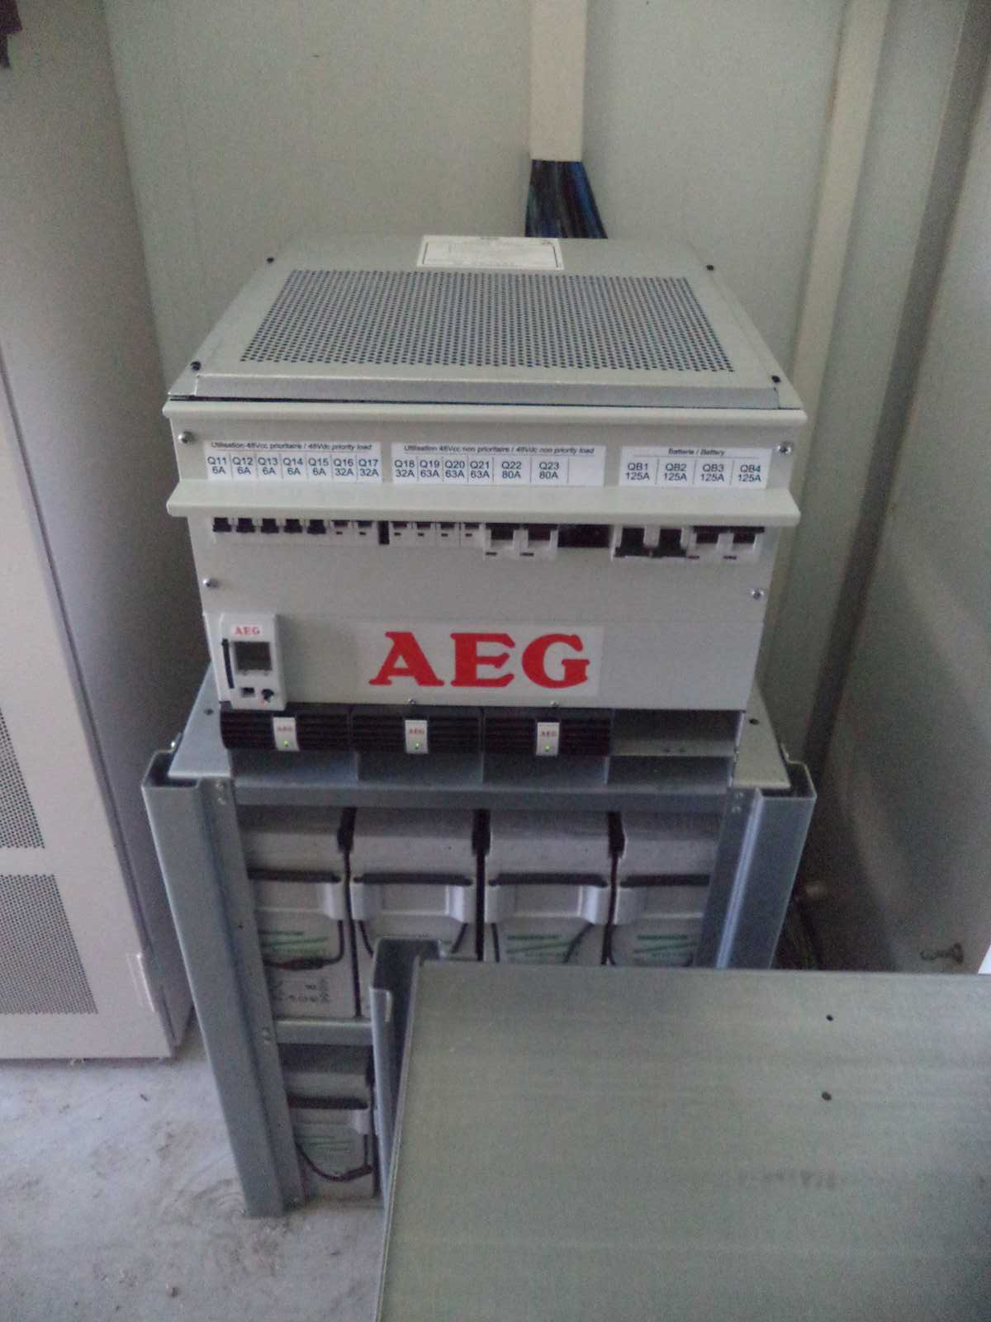
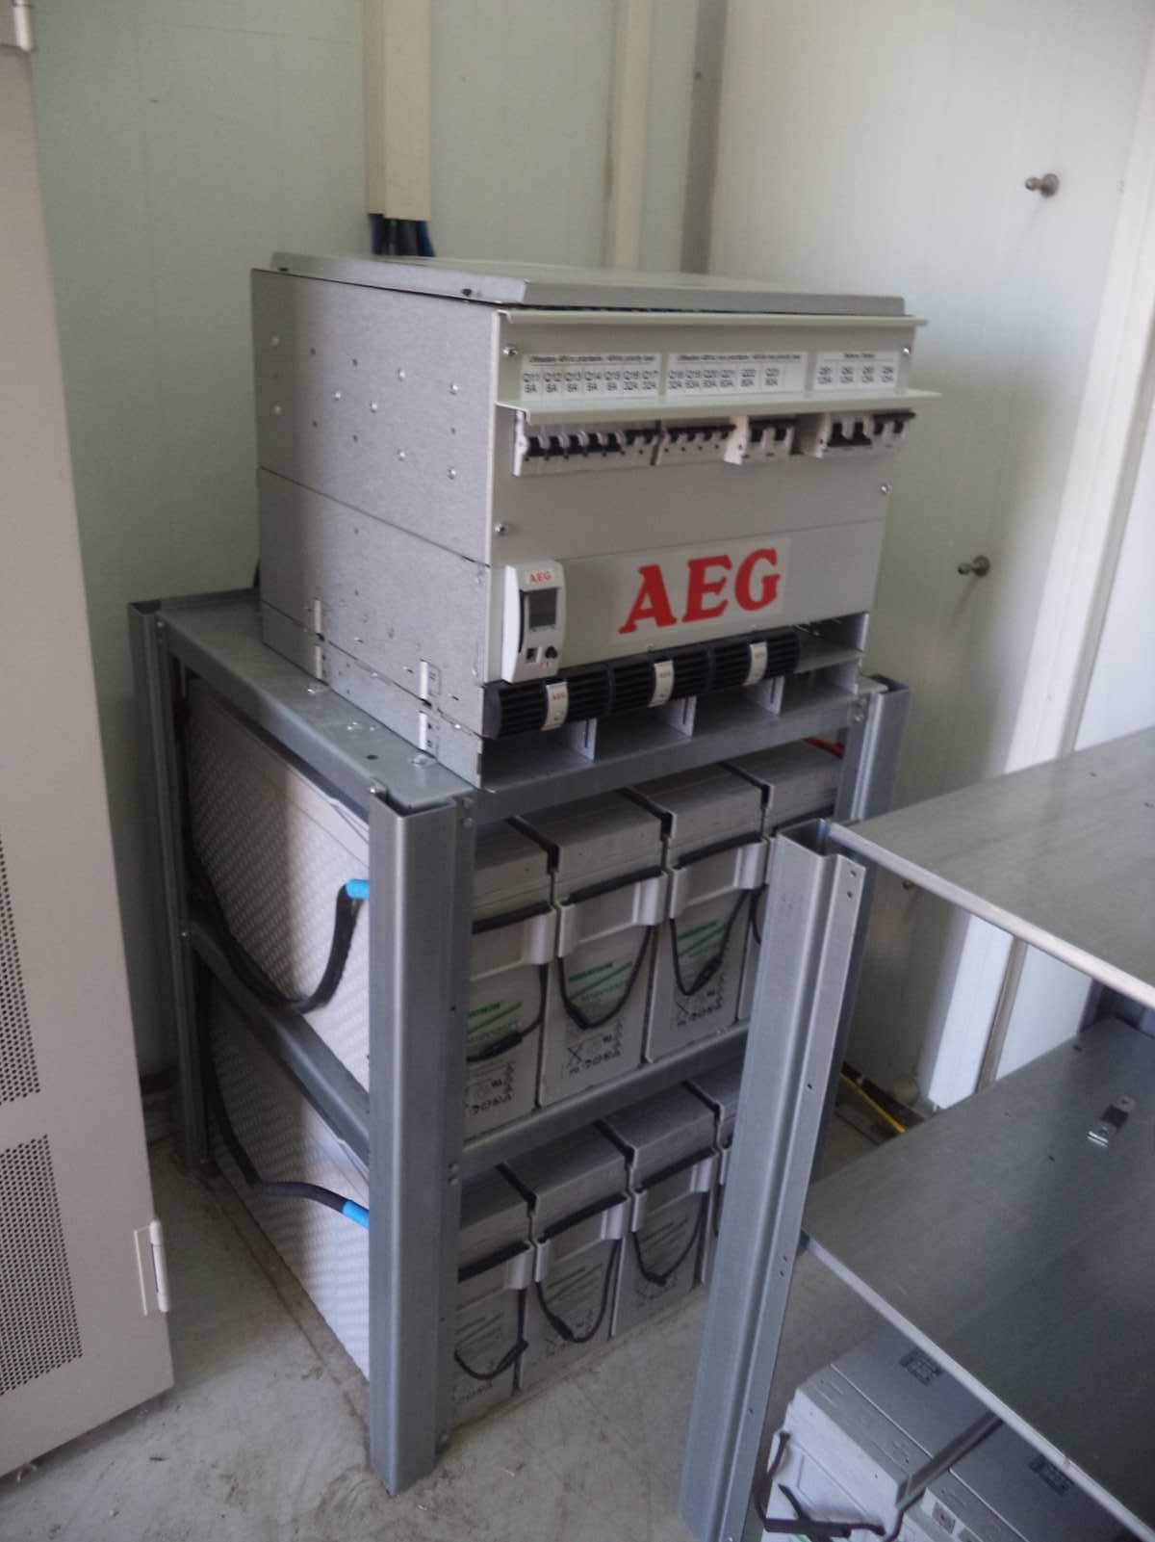
Power Supply Before
Paste the Picture here

Slide 12
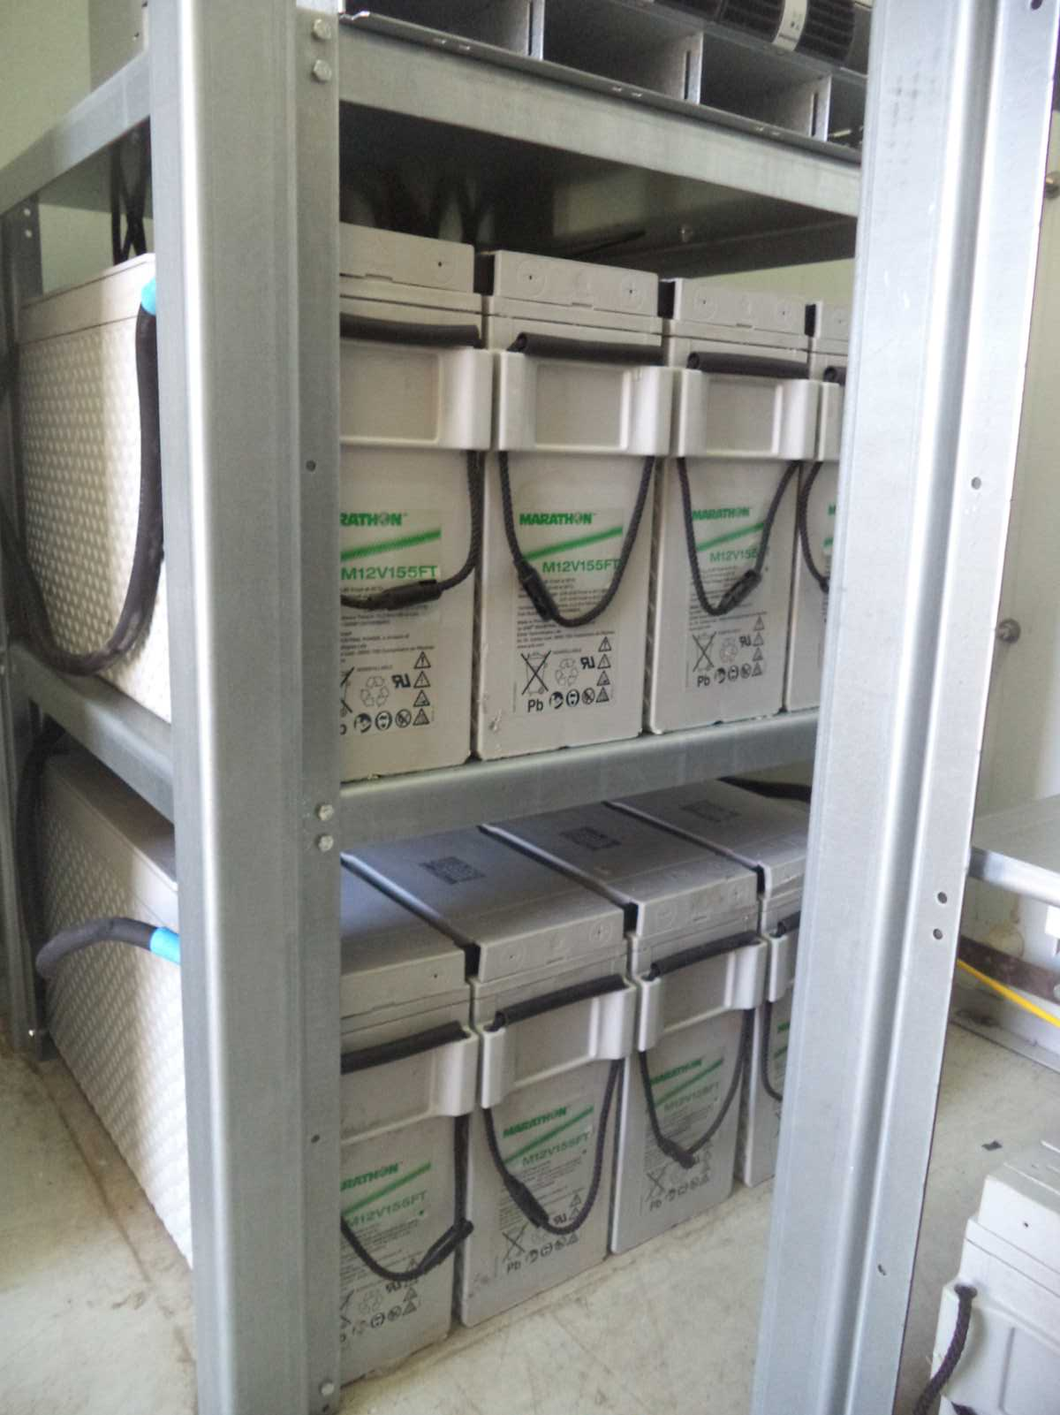
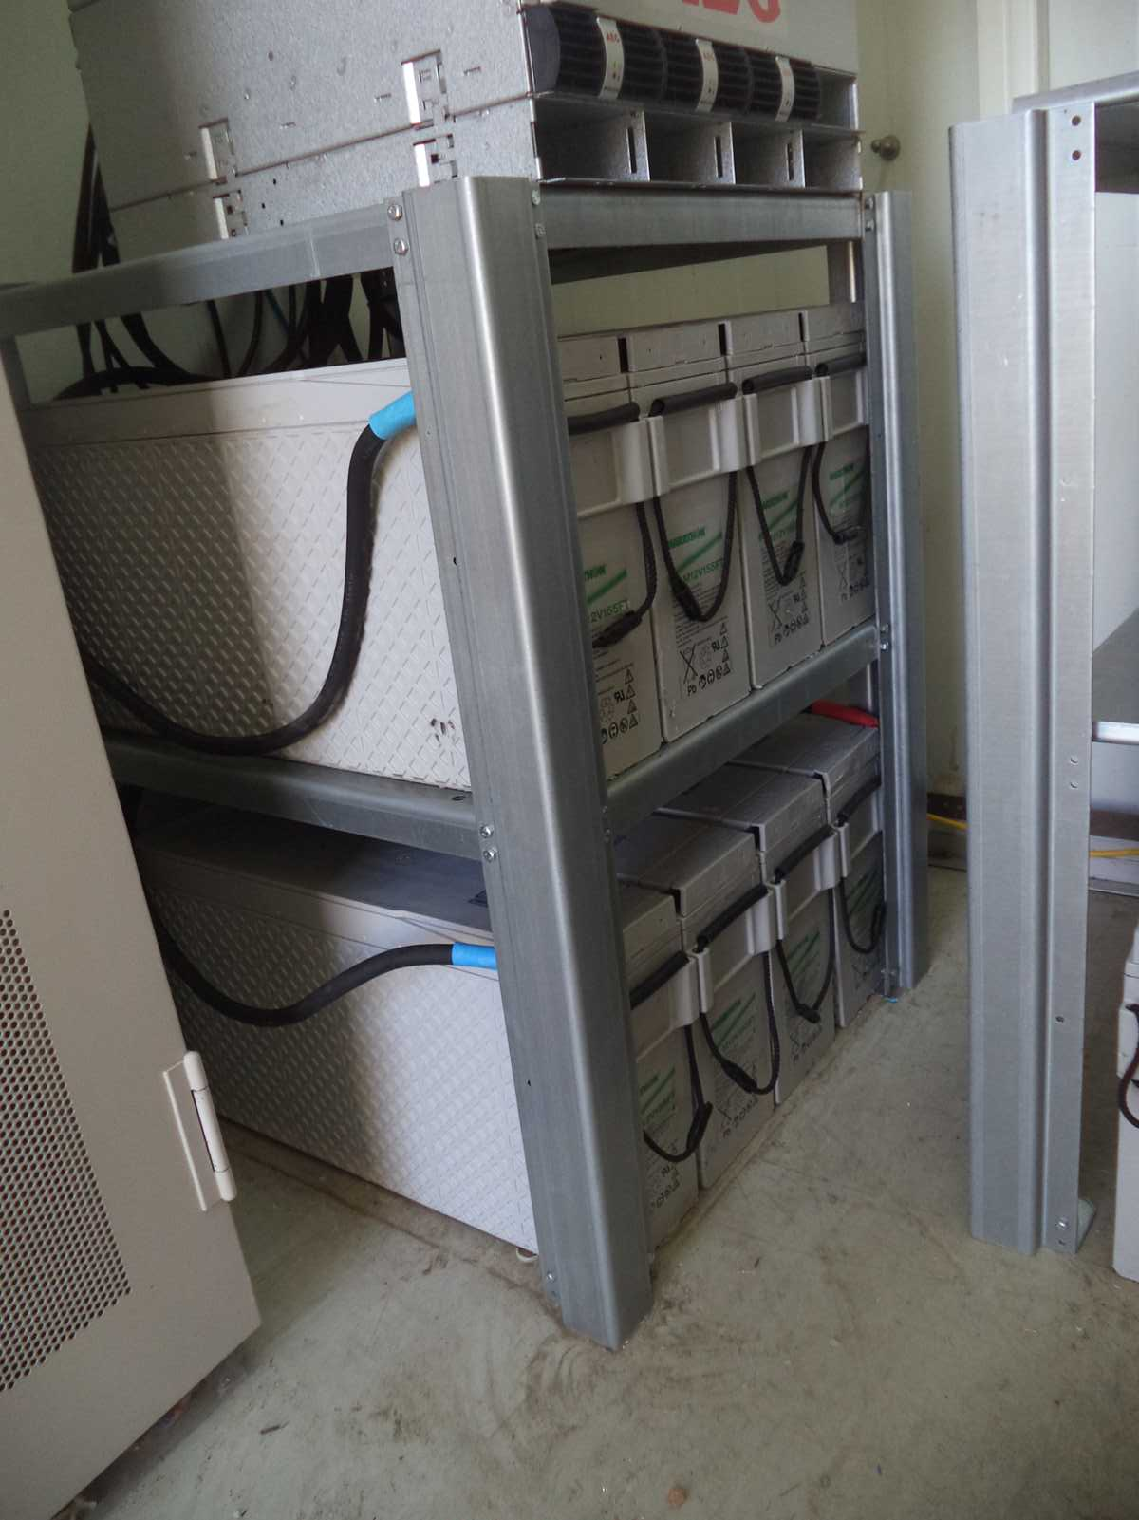
Batteries Grounding

Slide 13
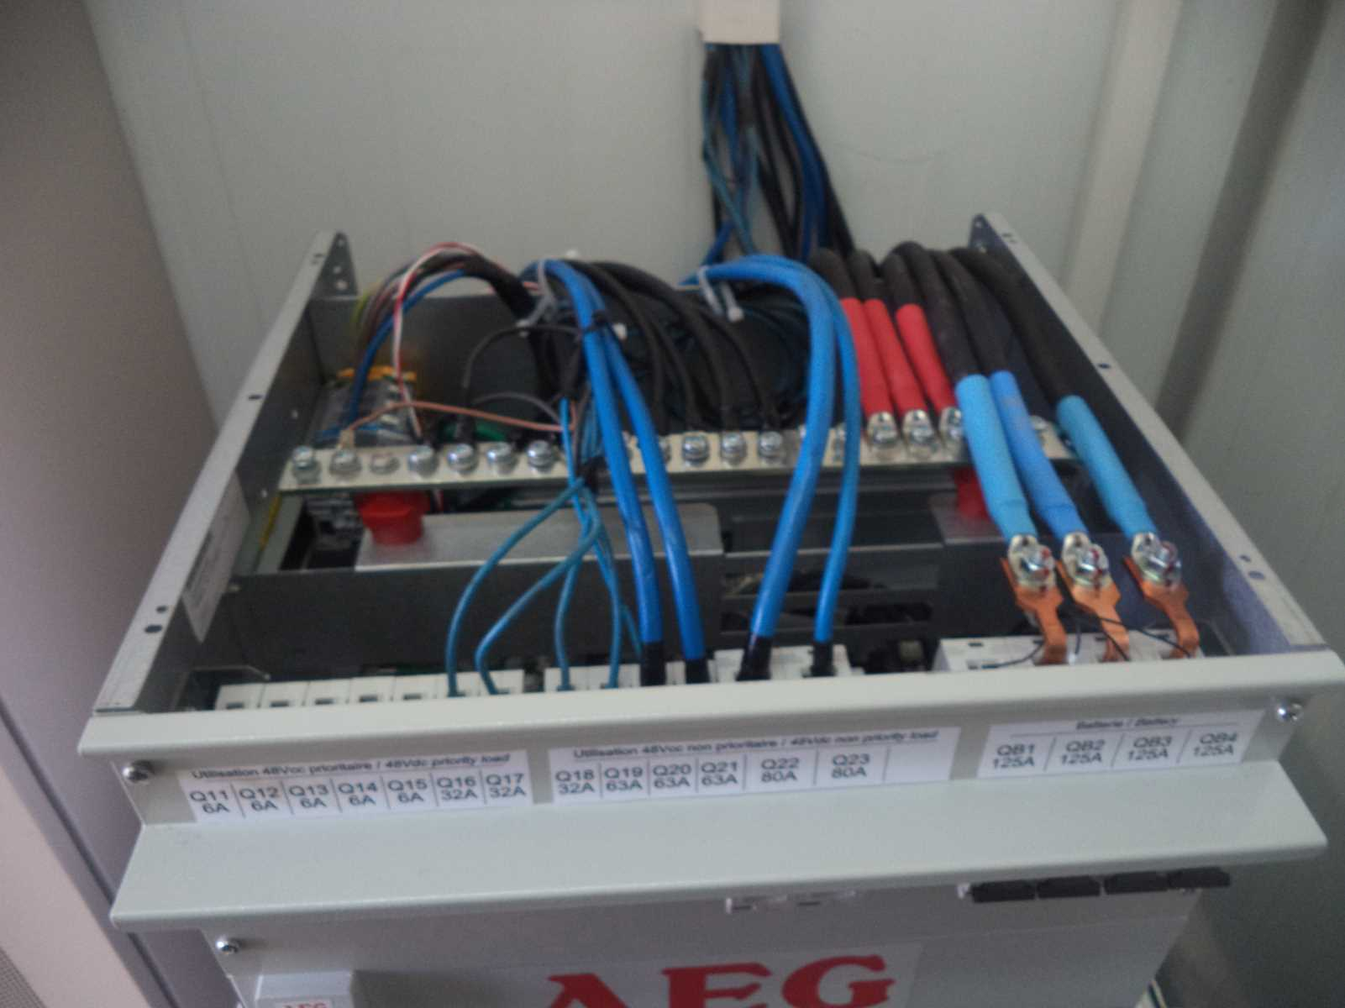
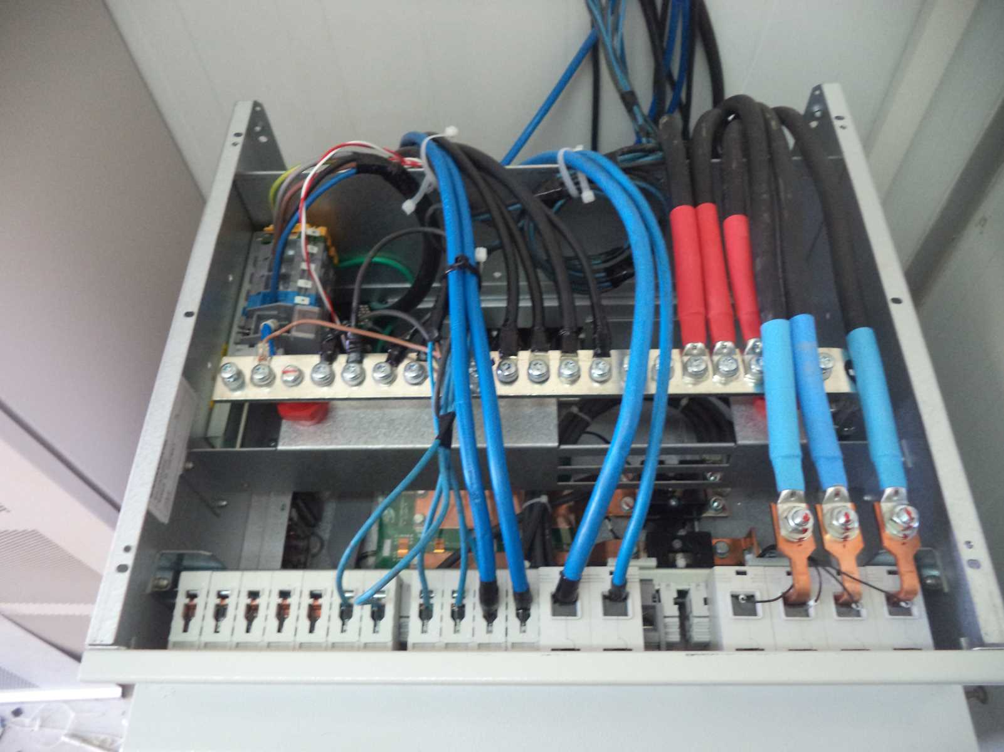
Power and Breakers Grounding
Paste the Picture here

Slide 14
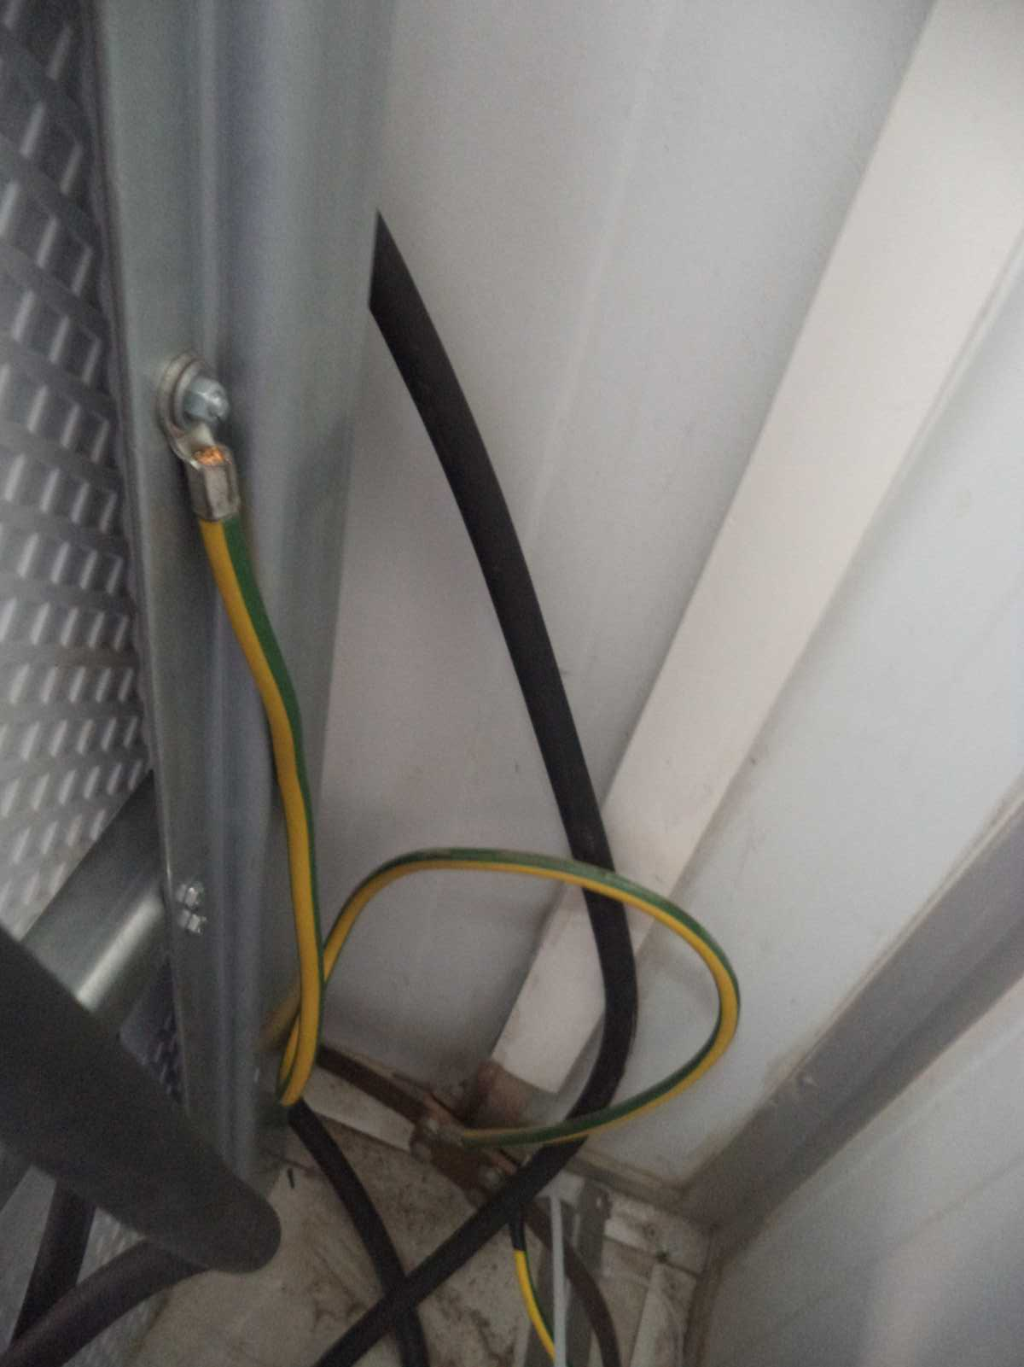
Bar Grounding

Slide 15
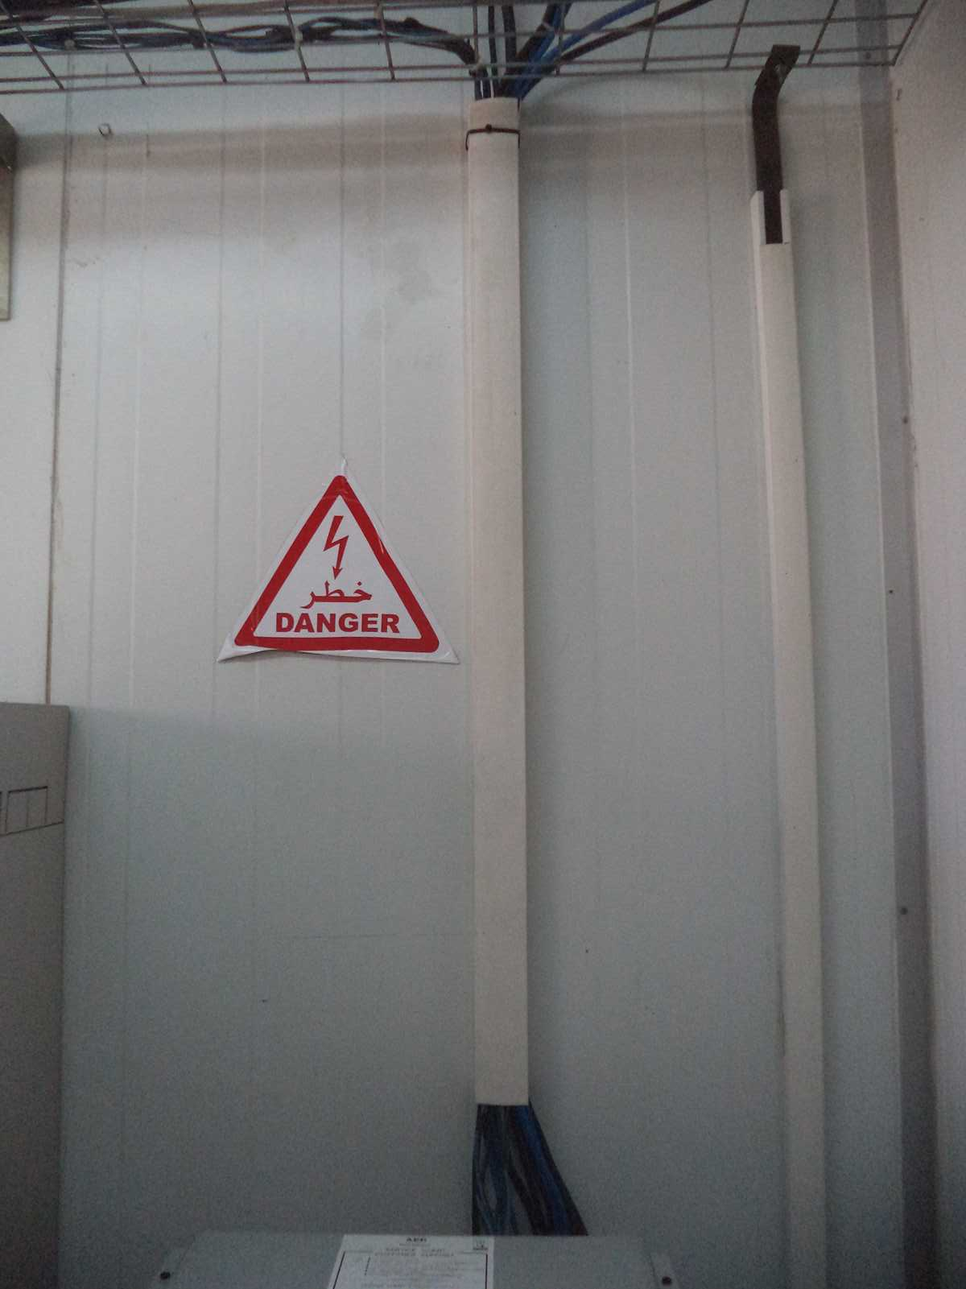
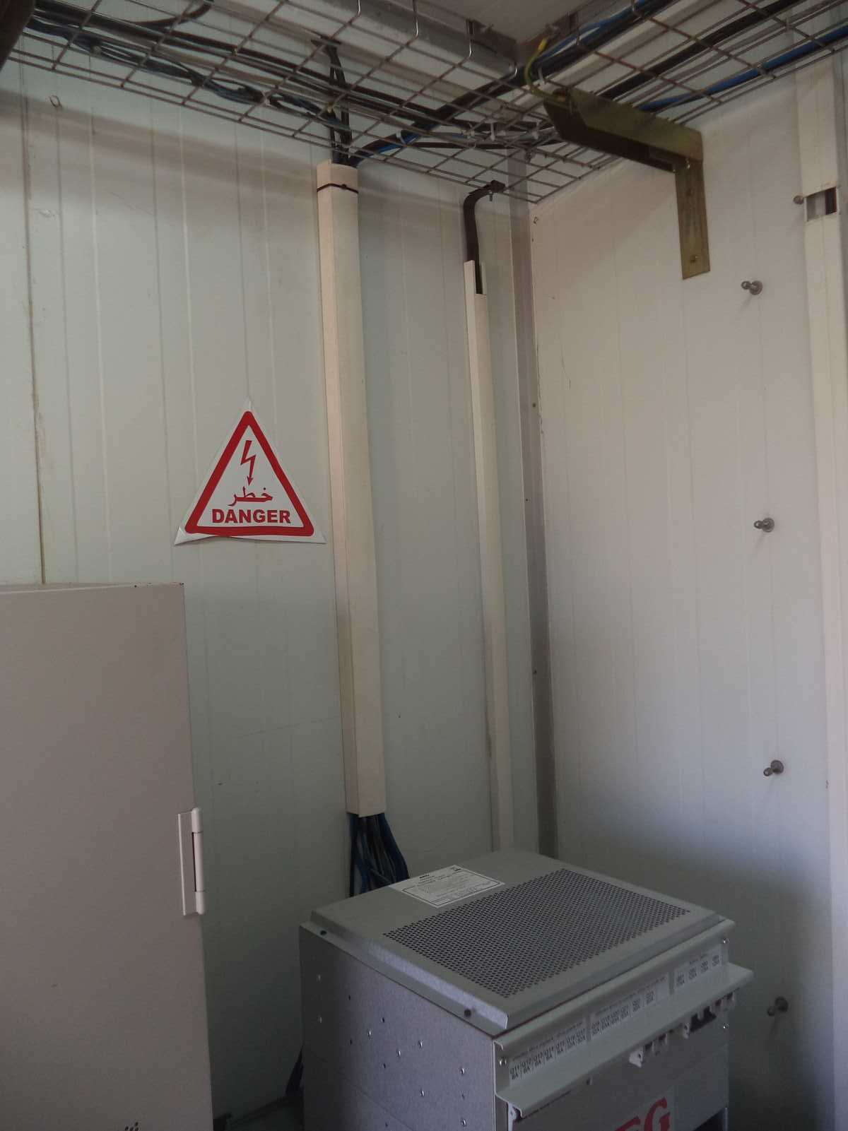
New Position Labeling
Paste the Picture here

Slide 16
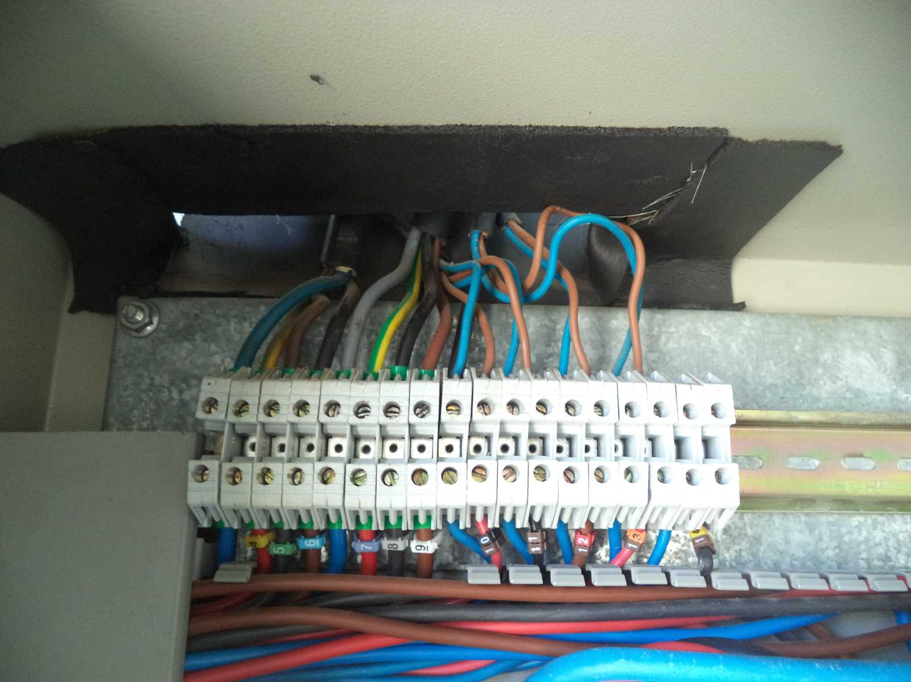
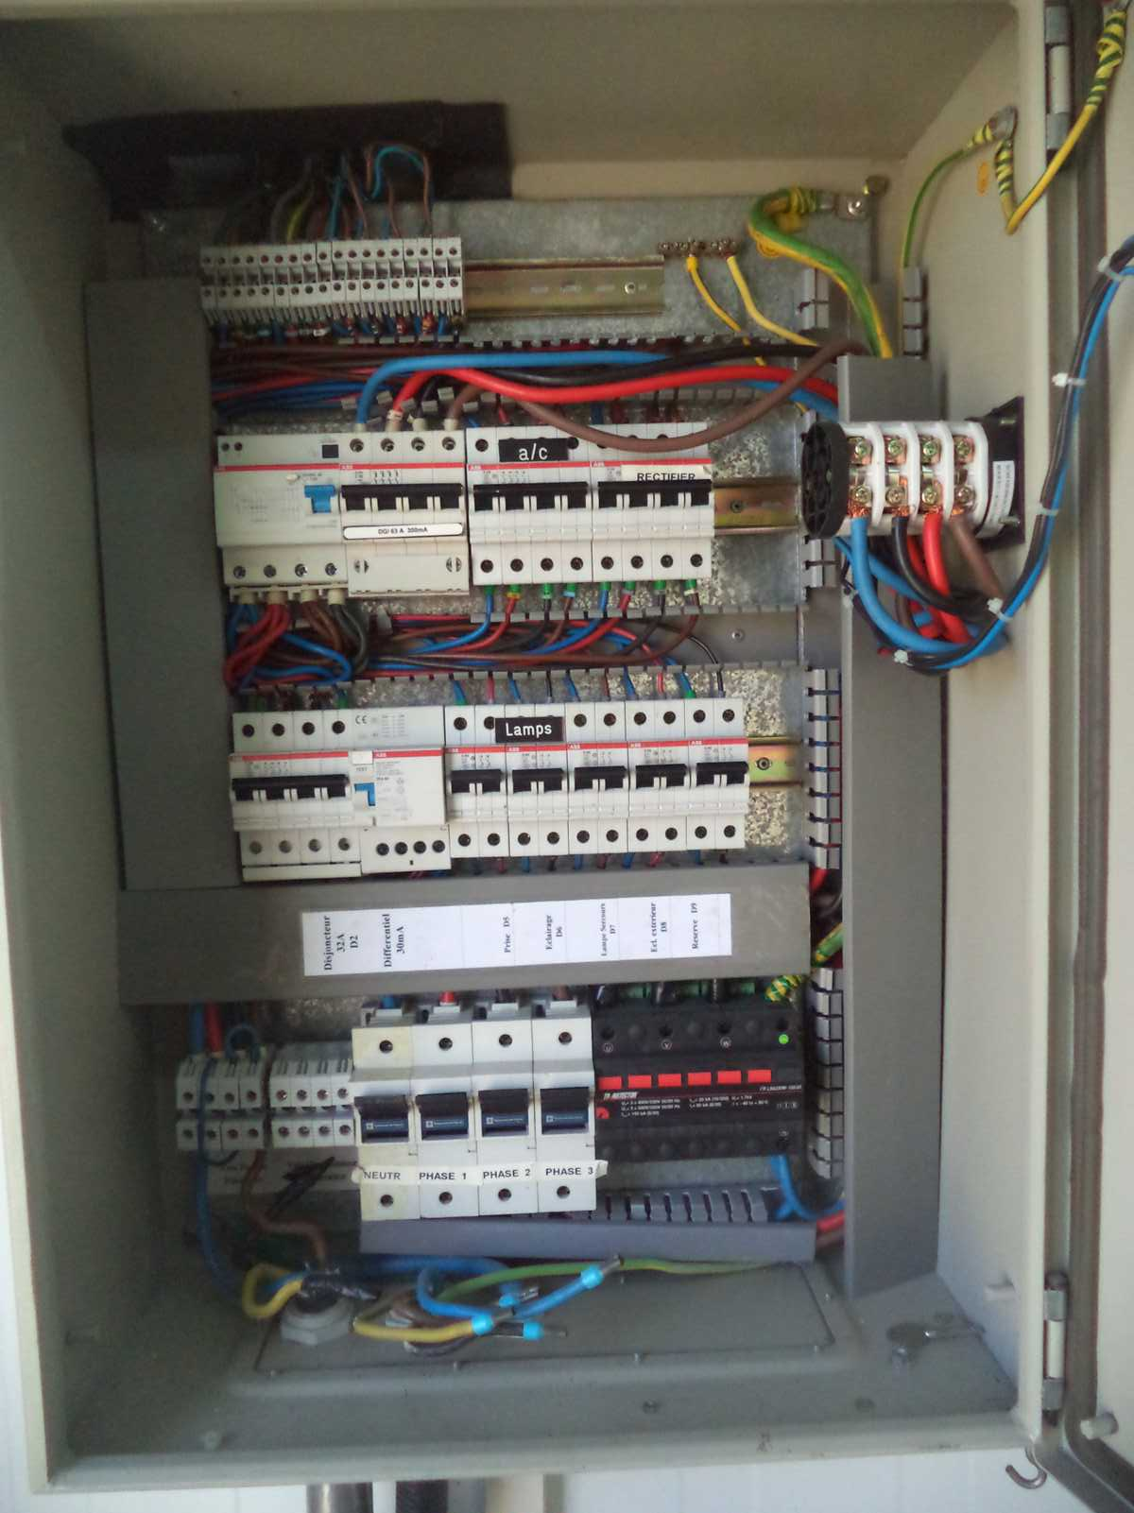
TGBT

Slide 17
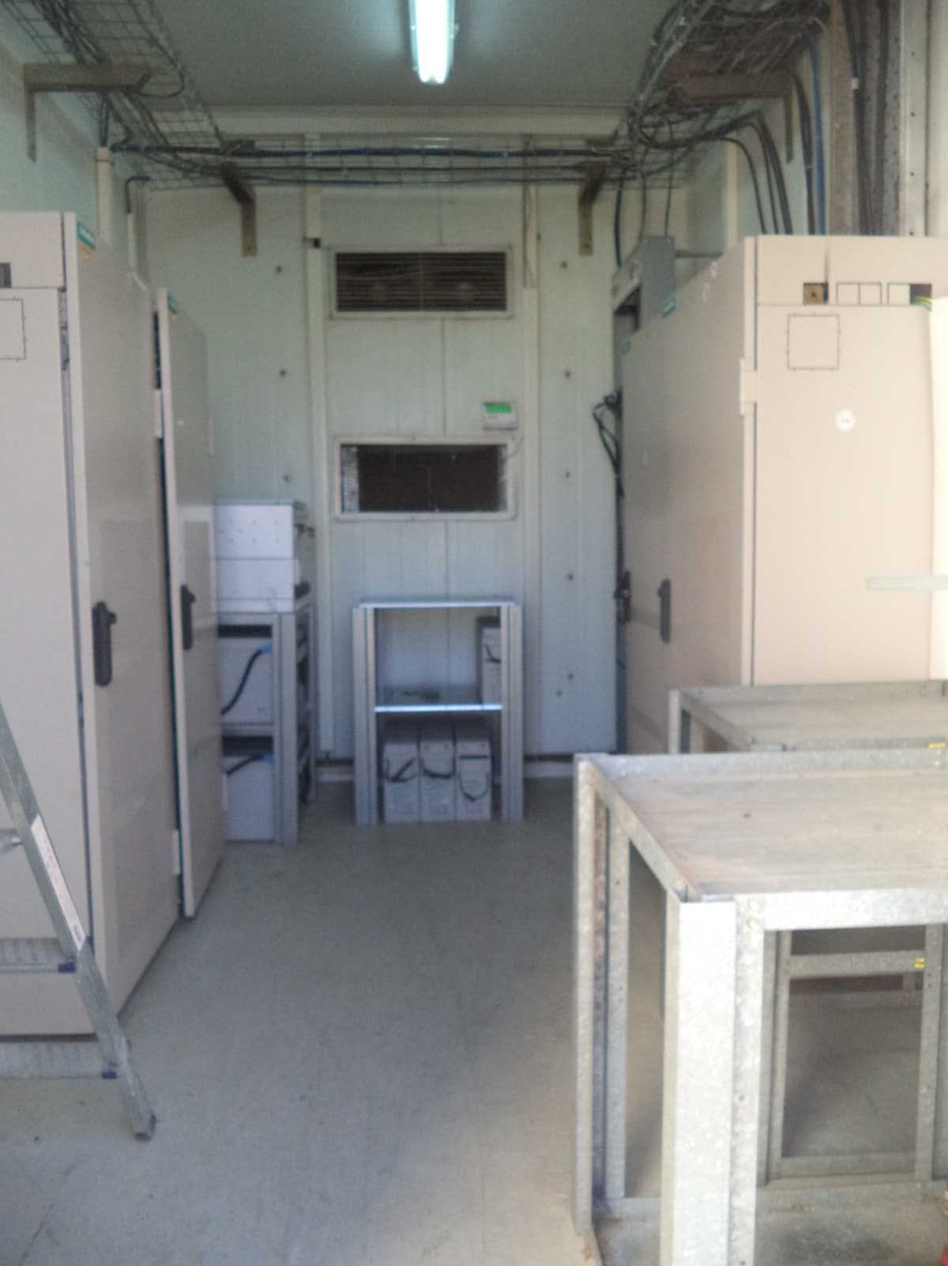
General view Before

Slide 18
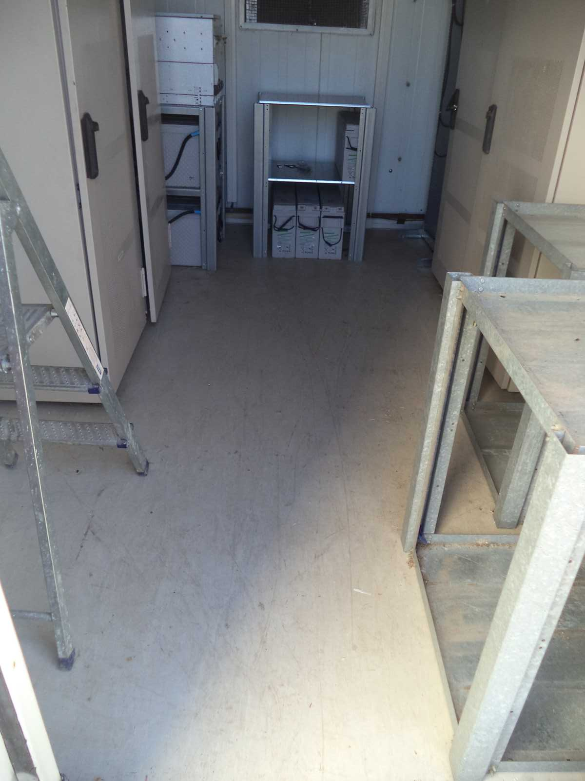
Cleanup
Paste the Picture here

Slide 19
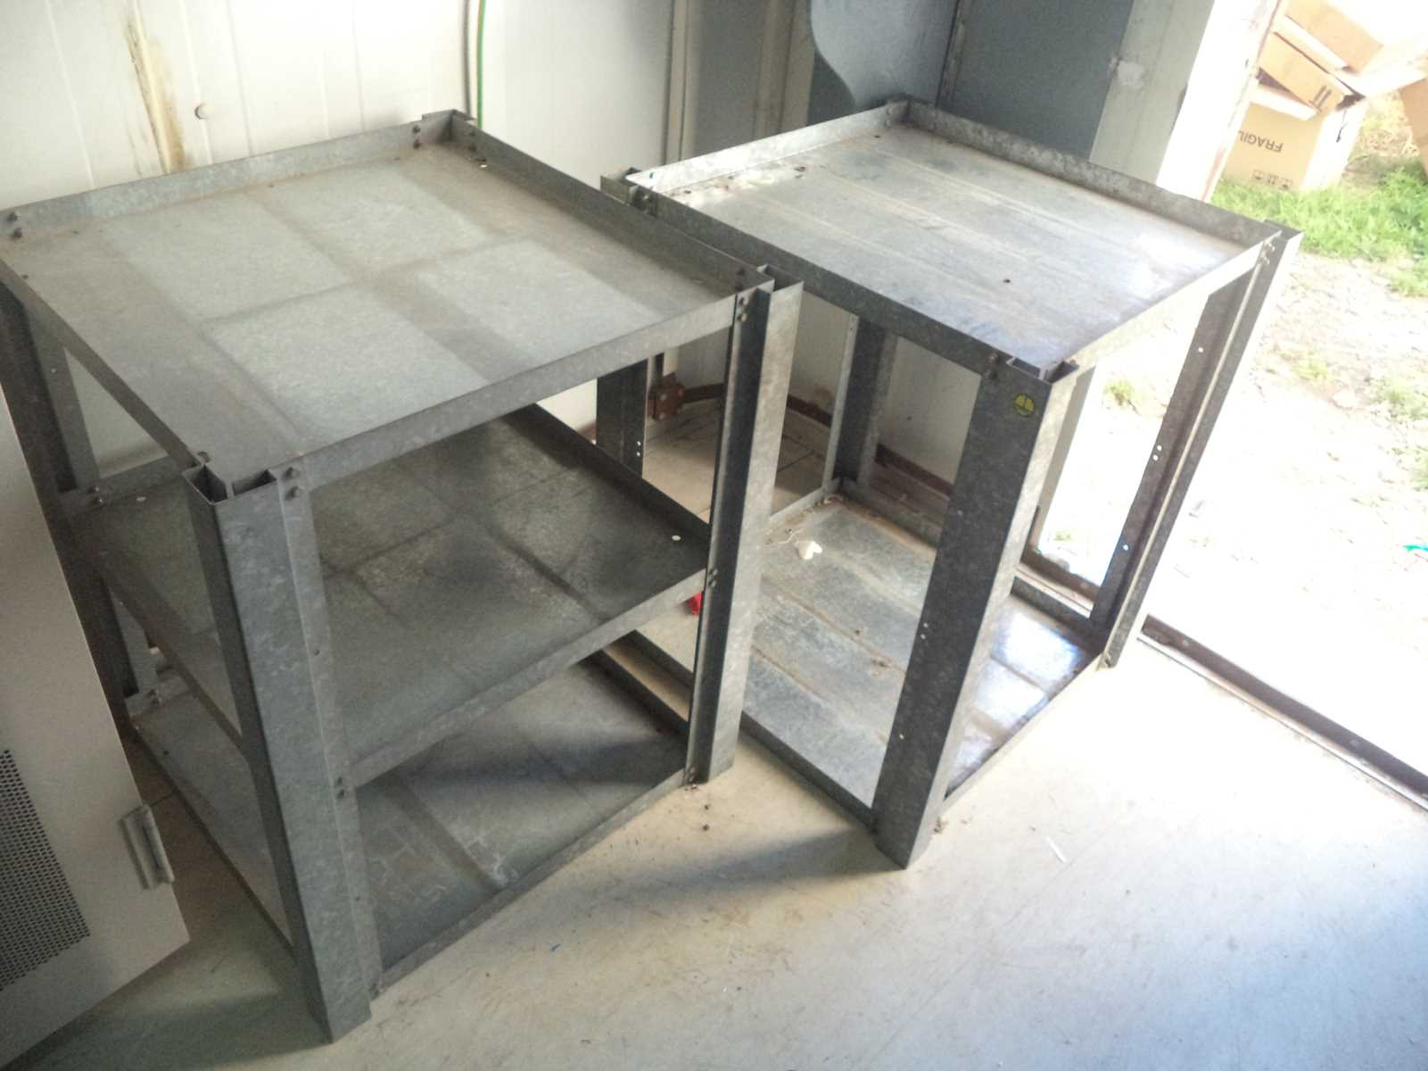
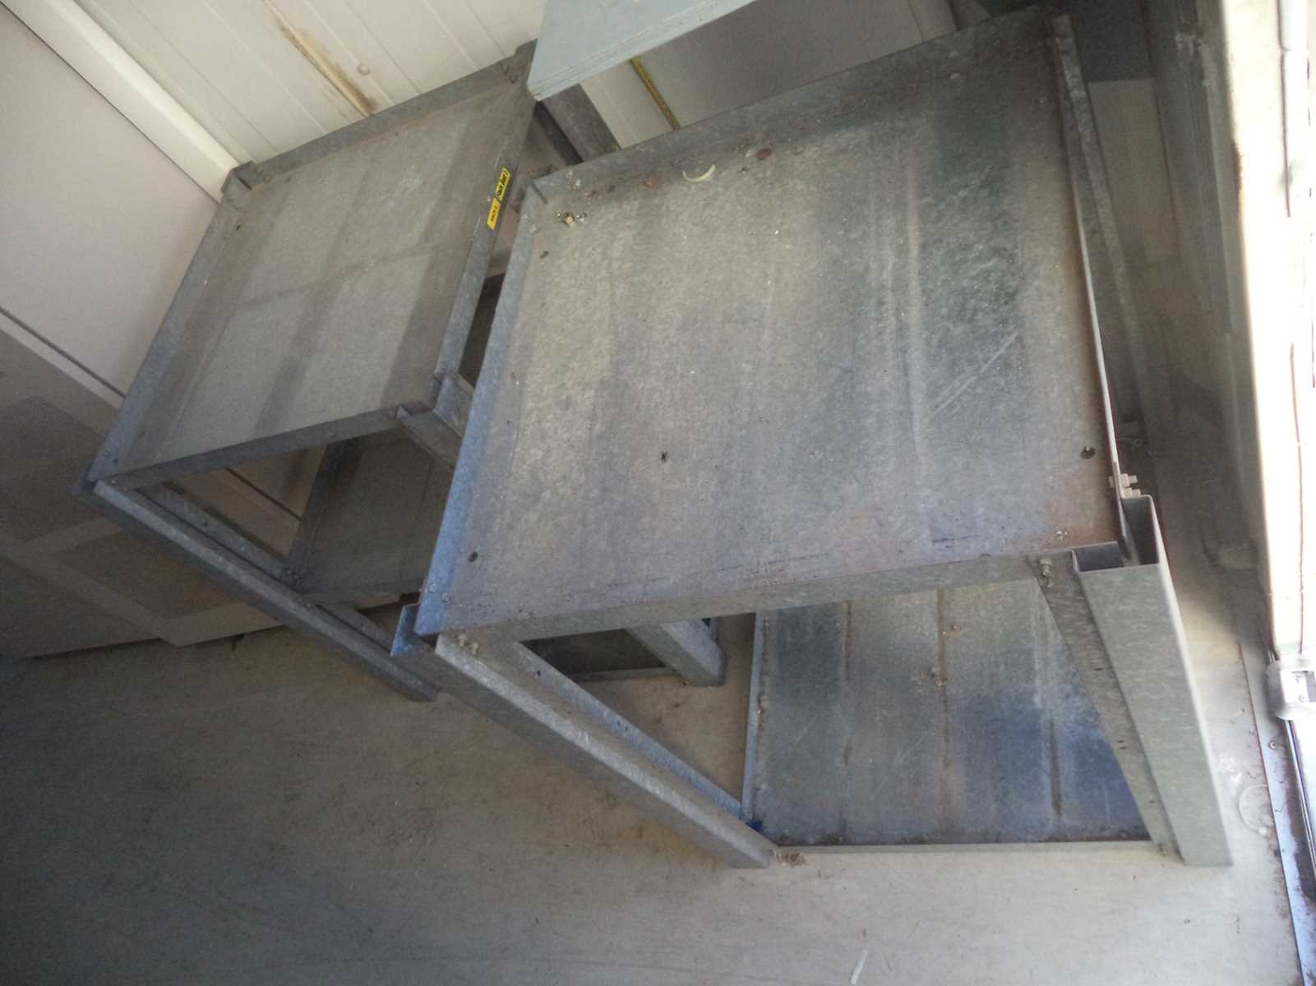
Rack Dismounted

